Slide 1


Dysgu o bell mewn mathemateg
Distance learning in mathematics
Dr Gareth Evans
Ysgol y Creuddyn
Agenda
Gwersi byw neu beidio?
Live lessons or not?
Technegau ar gyfer gwersi byw
Techniques for live lessons
Asesu dealltwriaeth
Assessing understanding
Technegau ar gyfer dysgu ar-lein
Techniques for teaching on-line
@mathemateg
/adolygumathemateg

Slide 2
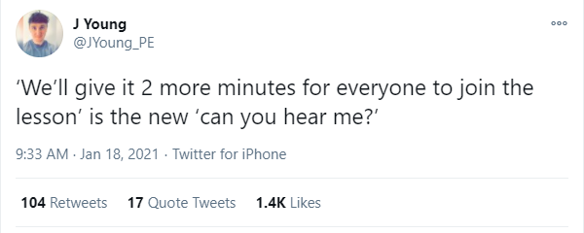
https://twitter.com/JYoung_PE/status/1351100505678868482?s=20

Slide 3
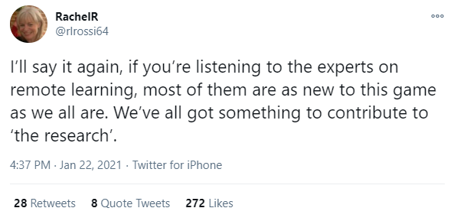
https://twitter.com/rlrossi64/status/1352656700004827138?s=20

Slide 4
Gwers byw neu beidio?
Live lessons or not?
@mathemateg
/adolygumathemateg

Slide 5
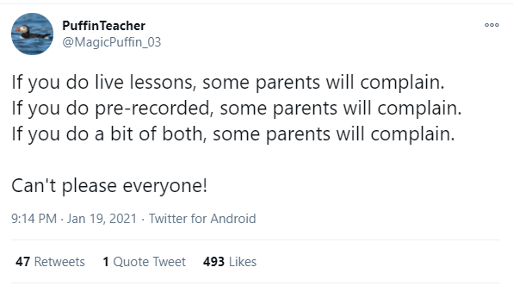
https://twitter.com/MagicPuffin_03/status/1351639088693202946?s=20

Slide 6

Gwersi byw neu beidio?
Live lessons or not?
https://twitter.com/marc_belli/status/1349682972652396545?s=20
Adroddiad llawn / Full report:
https://educationendowmentfoundation.org.uk/covid-19-resources/best-evidence-on-supporting-students-to-learn-remotely/

Slide 7
Technegau ar gyfer
gwersi byw
Techniques for live lessons
@mathemateg
/adolygumathemateg

Slide 8
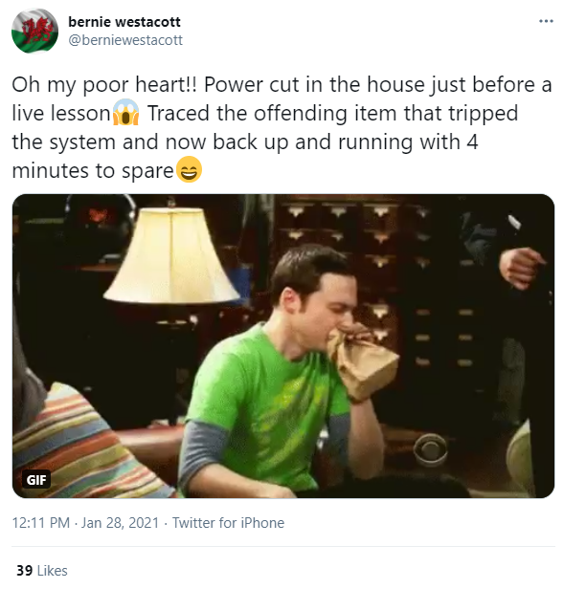
https://twitter.com/berniewestacott/status/1354764137079955457?s=20

Slide 9
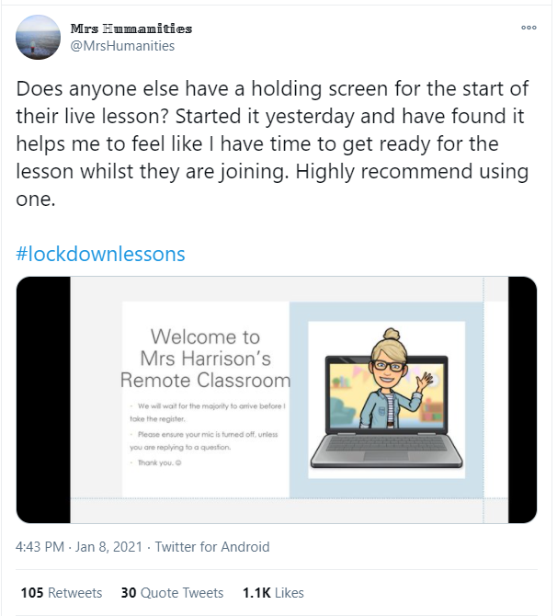
Cychwyn y wers:
Sgrîn Groeso
Start of the lesson:
Welcome Screen
https://twitter.com/MrsHumanities/status/1347584836983263232?s=20

Slide 10
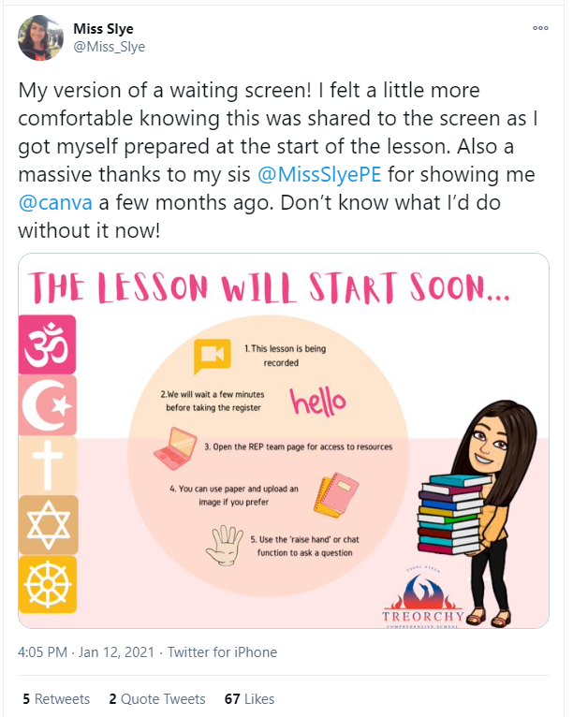
Cychwyn y wers:
Sgrîn Groeso
Start of the lesson:
Welcome Screen
https://twitter.com/Miss_Slye/status/1349024724685357063?s=20

Slide 11
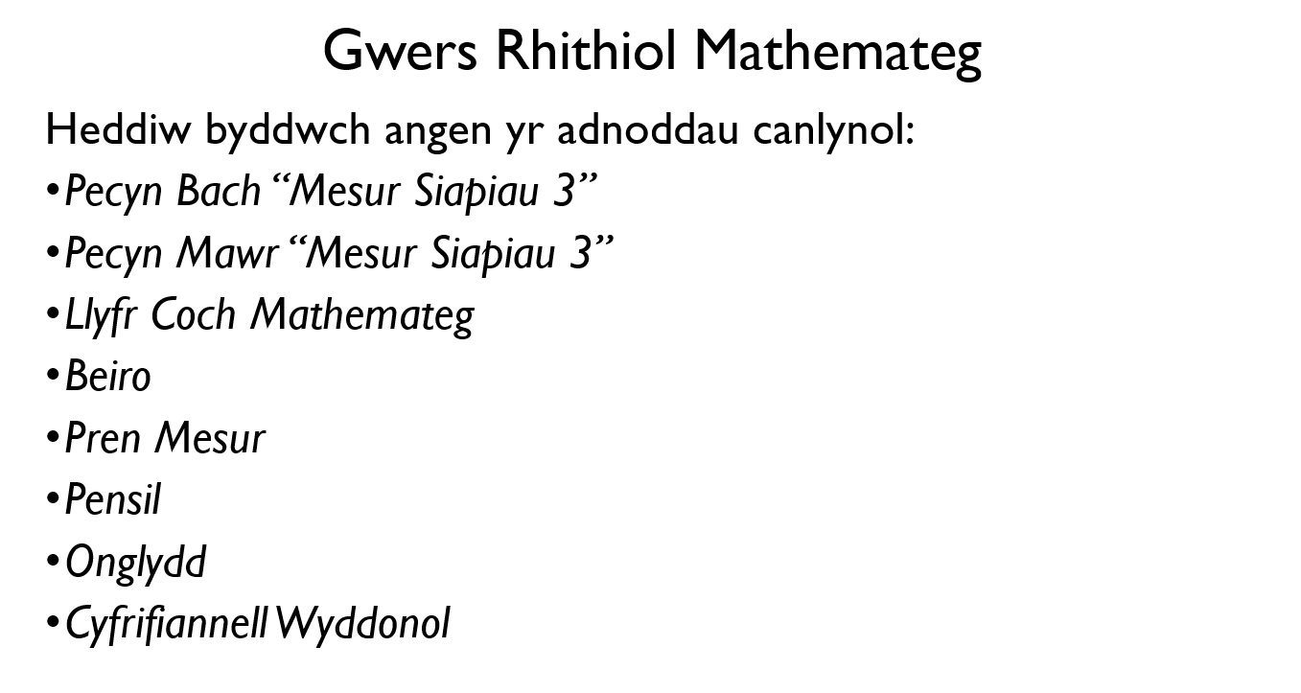
Cychwyn y wers:
Sgrîn Groeso
Start of the lesson:
Welcome Screen

Slide 12
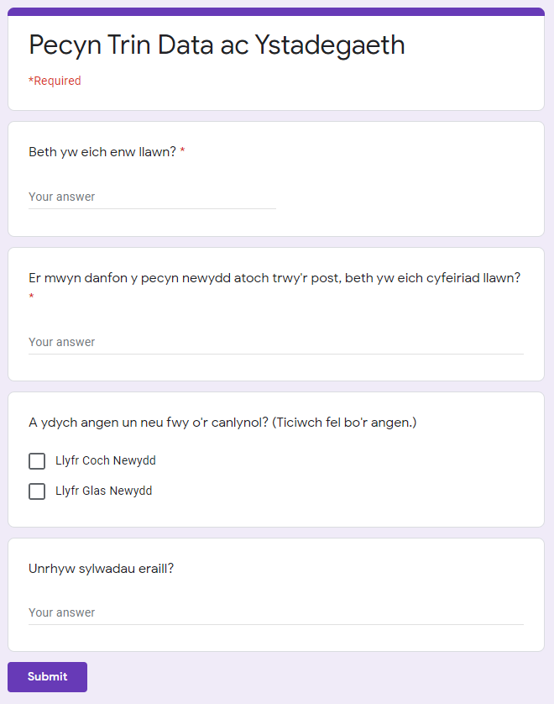
Adnoddau
Resources
Gwnewch unrhyw ddeunyddiau o’r wers ar gael yn hawdd.
Make any resources from the lesson easily available.
Gofynnwch os oes angen unrhyw ddeunyddau sydd ddim ar-lein.
Ask if any offline resources are needed.
Papur mathemategol / Mathematical paper:
https://www.mathemateg.com/mod/resource/view.php?id=4630
Archebwch galedwedd addas ar gyfer ffrydio’n fyw.
Order suitable hardware for live streaming.
Defnyddiwch yr ap camera.
Use the camera app.

Slide 13
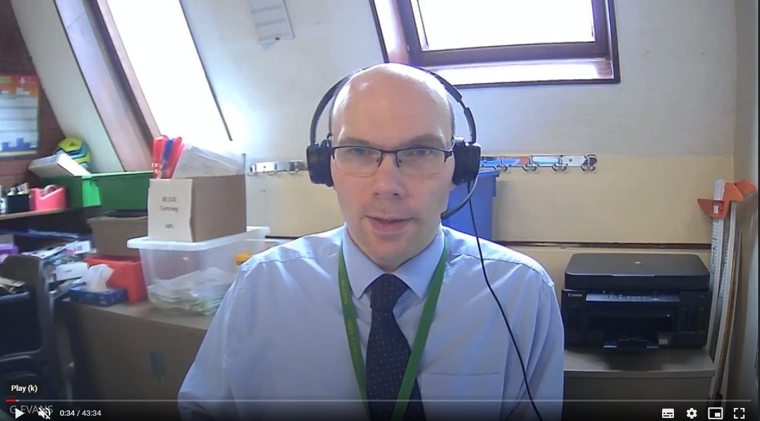
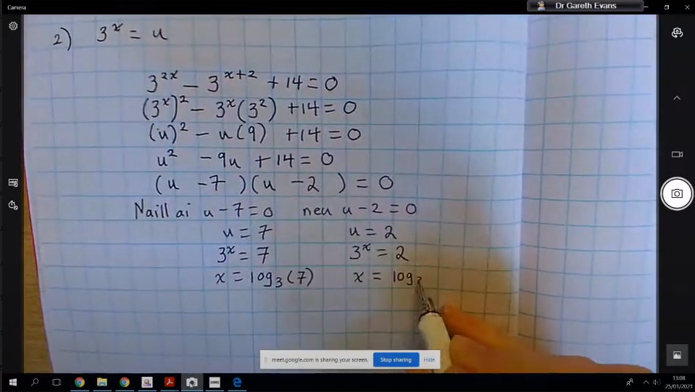
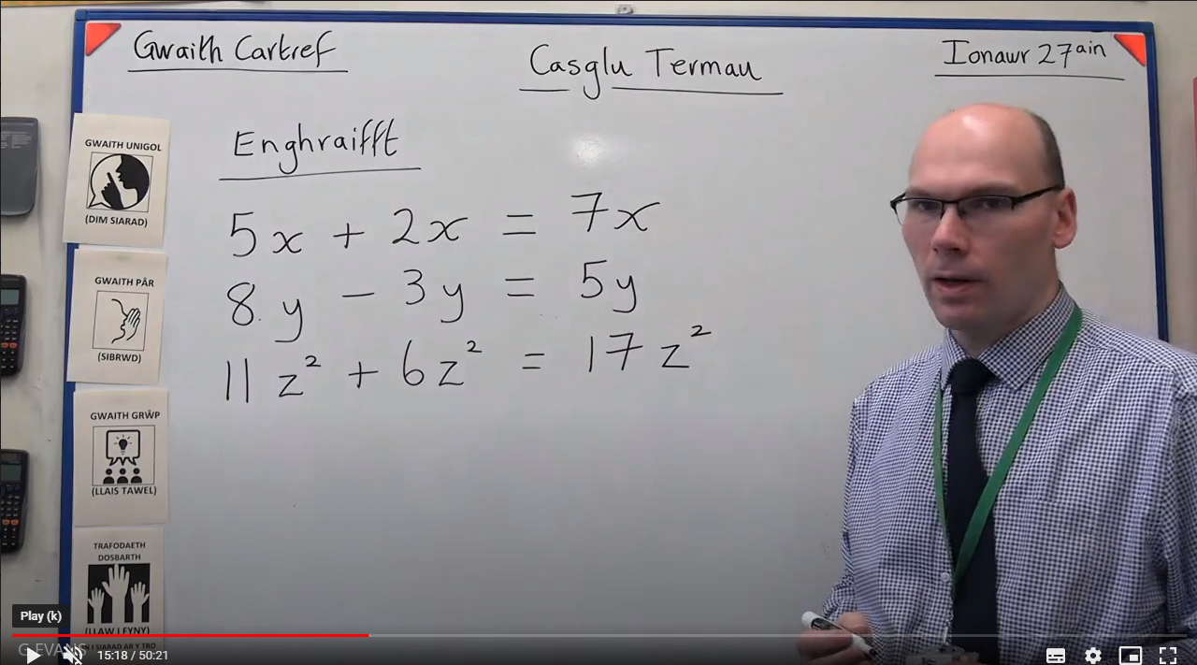

Slide 14
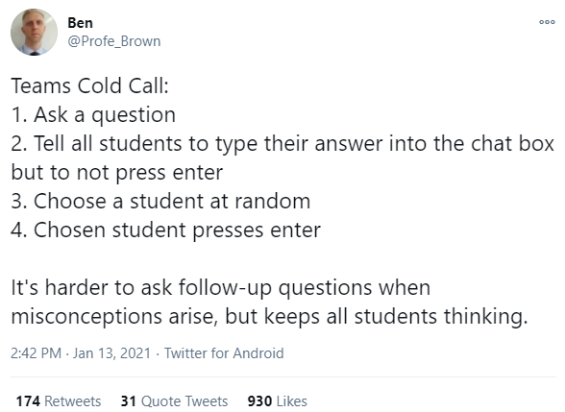
Sgwrsio
Chat
https://twitter.com/Profe_Brown/status/1349366143627231232?s=20

Slide 15
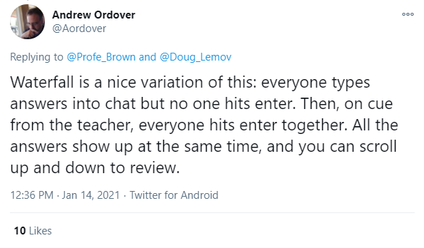
Sgwrsio
Chat
https://twitter.com/Aordover/status/1349696907501821953?s=20

Slide 16
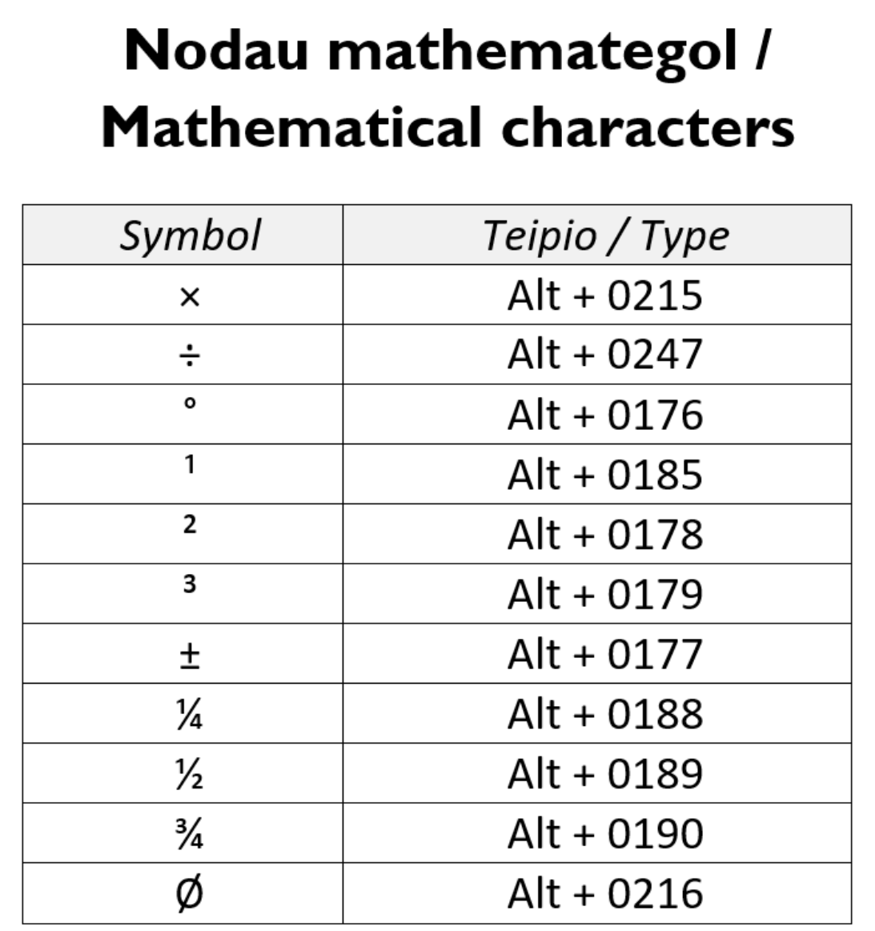
Sgwrsio
Chat
https://twitter.com/mathemateg/status/1356713887652061185?s=20

Slide 17
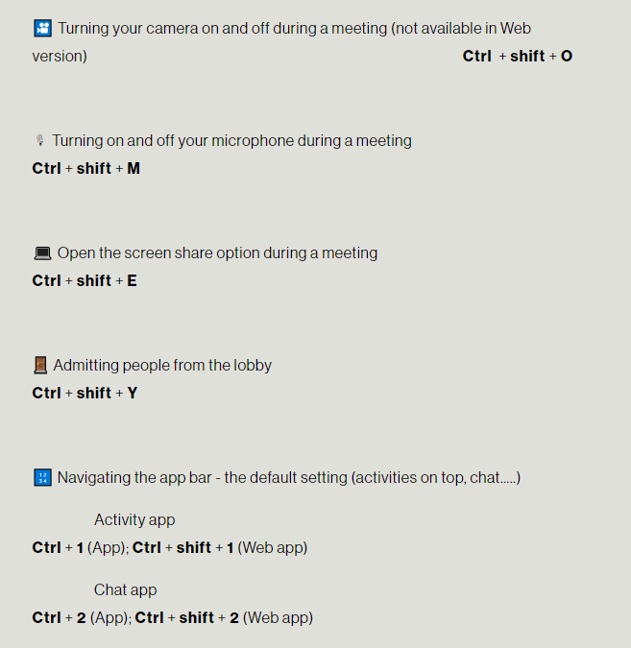
Microsoft Teams
Shortcuts Blog:
https://www.edtechinaction.co.uk/blog/unlocking-microsoft-teams-keyboard-shortcuts

Slide 18
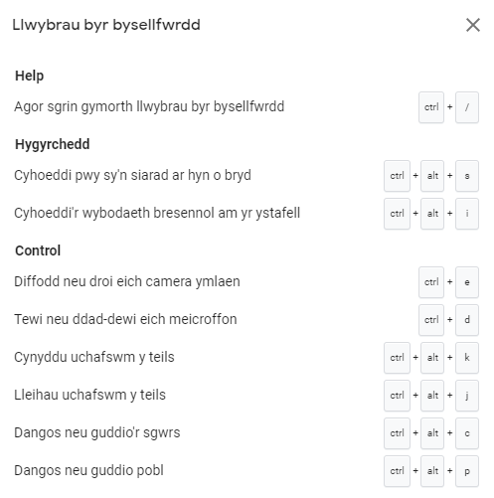
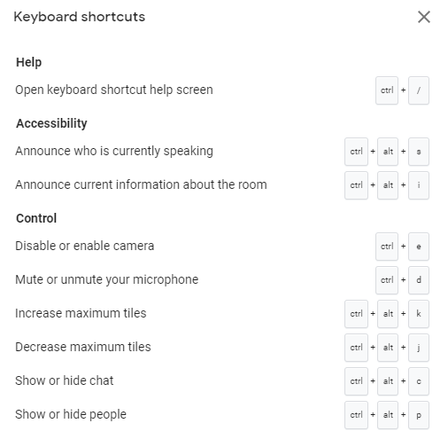
Google Meet

Slide 19
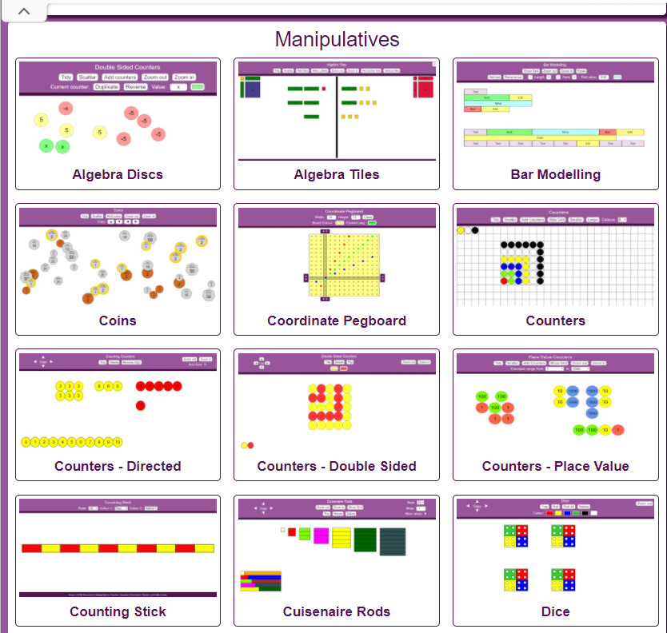
Offer Mathemategol
Mathematical Tools
MathsBot.com
Am ddim / free

Slide 20
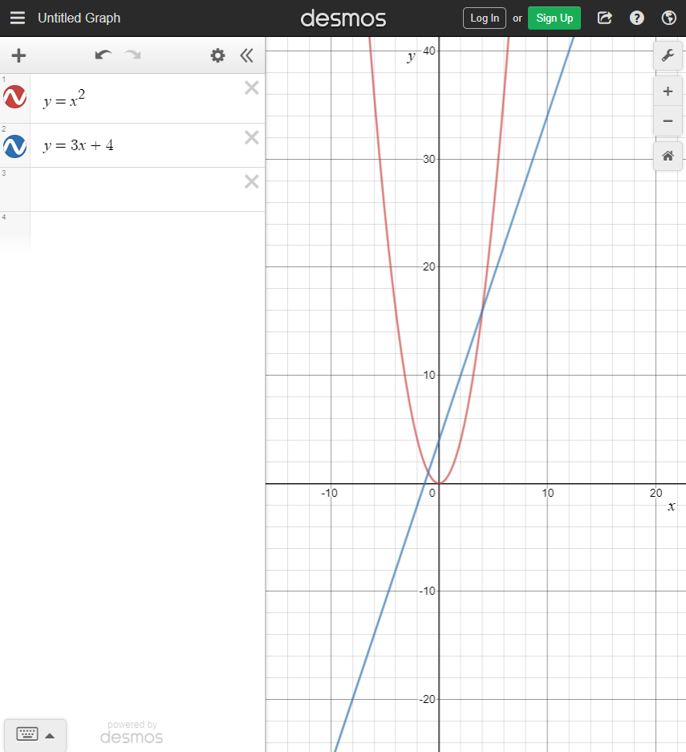
Offer Mathemategol
Mathematical Tools
Desmos Graph Plotter
Am ddim / free

Slide 21
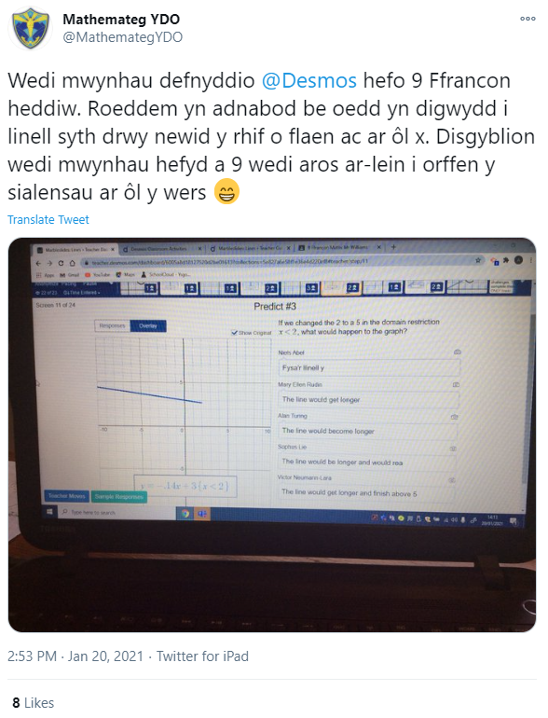
Offer Mathemategol
Mathematical Tools
Desmos Classroom
Am ddim / free

Slide 22

Offer Mathemategol
Mathematical Tools
Casio Calculator Emulator
Am ddim / free

Slide 23
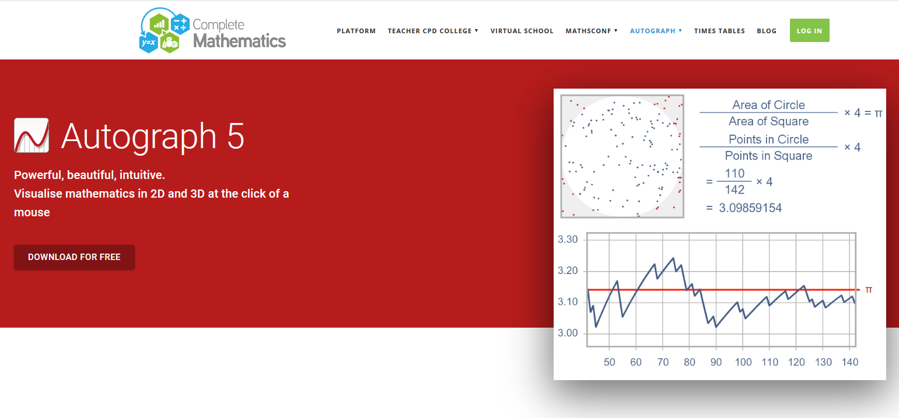
Offer Mathemategol
Mathematical Tools
Autograph Maths
Am ddim / free

Slide 24
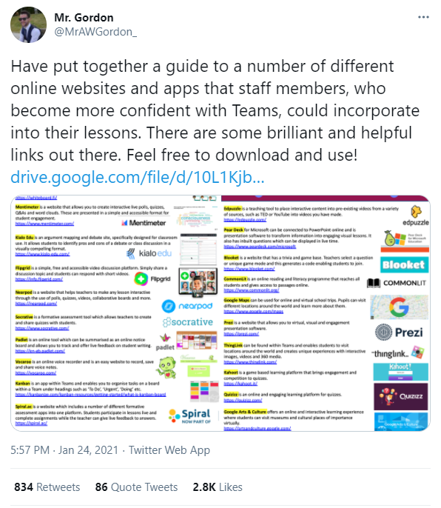
https://twitter.com/MrAWGordon_/status/1353401606021275651?s=20
https://drive.google.com/file/d/10L1Kjb2eCW55N-dIAfkh-U2uHOCFK_8Z/view

Slide 25
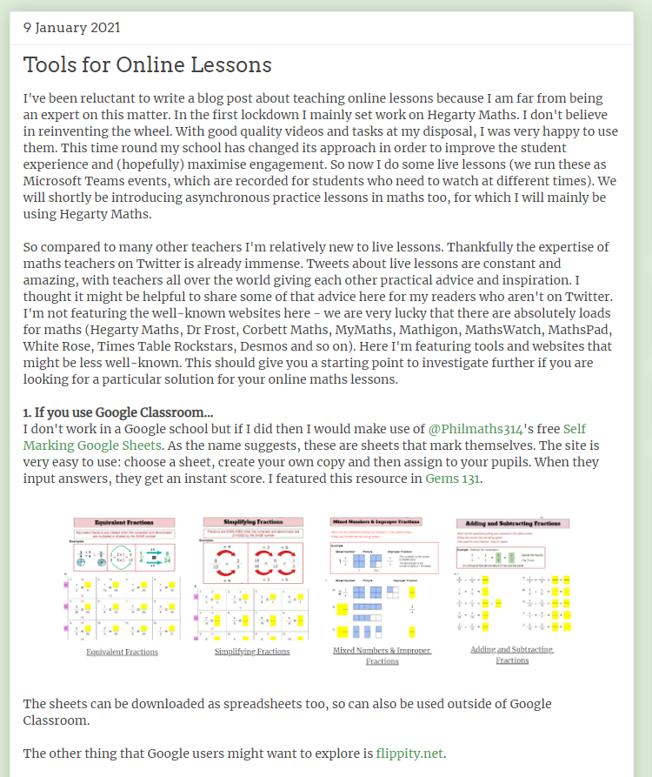
Blogiau
Blogs
Jo Morgan’s Blog on resourceaholic.com
Jo Morgan on Craig Barton’s podcast

Slide 26

Blogiau
Blogs
Mark Anderson’s Blog on Values, Vision and Learning in the Remote Classroom.

Slide 27
Asesu dealltwriaeth
Assessing understanding
@mathemateg
/adolygumathemateg

Slide 28
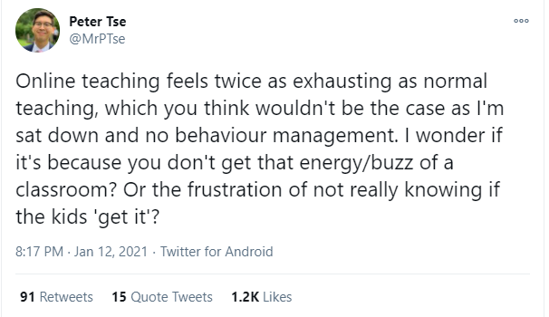
https://twitter.com/MrPTse/status/1349088029047201792?s=20

Slide 29
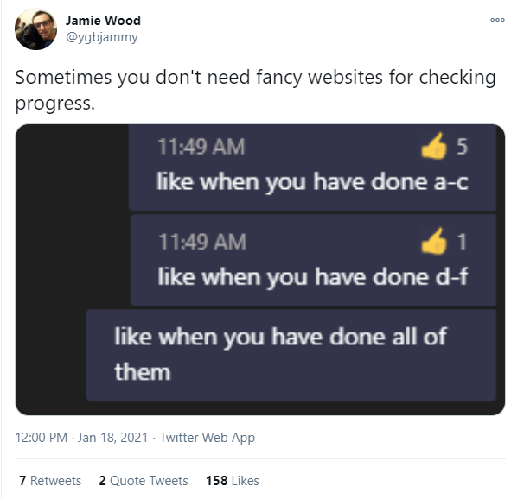
Microsoft Teams
https://twitter.com/ygbjammy/status/1351137428384444420?s=20

Slide 30
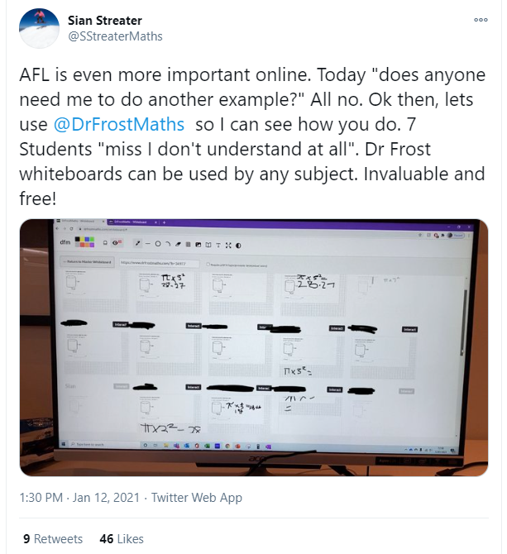
Asesu Dealltwriaeth
Assessing Understanding
Byrddau Gwyn Bach
Mini Whiteboards
https://www.drfrostmaths.com/
Am ddim / free

Slide 31
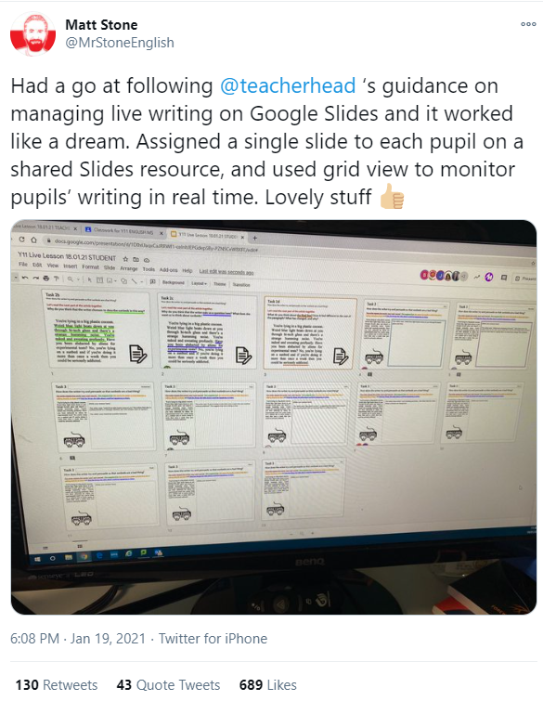
Asesu Dealltwriaeth
Assessing Understanding
Byrddau Gwyn Bach
Mini Whiteboards
https://twitter.com/MrStoneEnglish/status/1351592489724092418?s=20

Slide 32

Asesu Dealltwriaeth
Assessing Understanding
Byrddau Gwyn Bach
Mini Whiteboards
whiteboard.fi

Slide 33
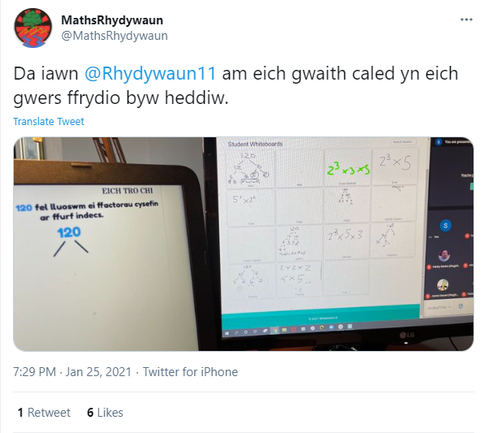
https://twitter.com/MathsRhydywaun/status/1353787193605713920?s=20

Slide 34
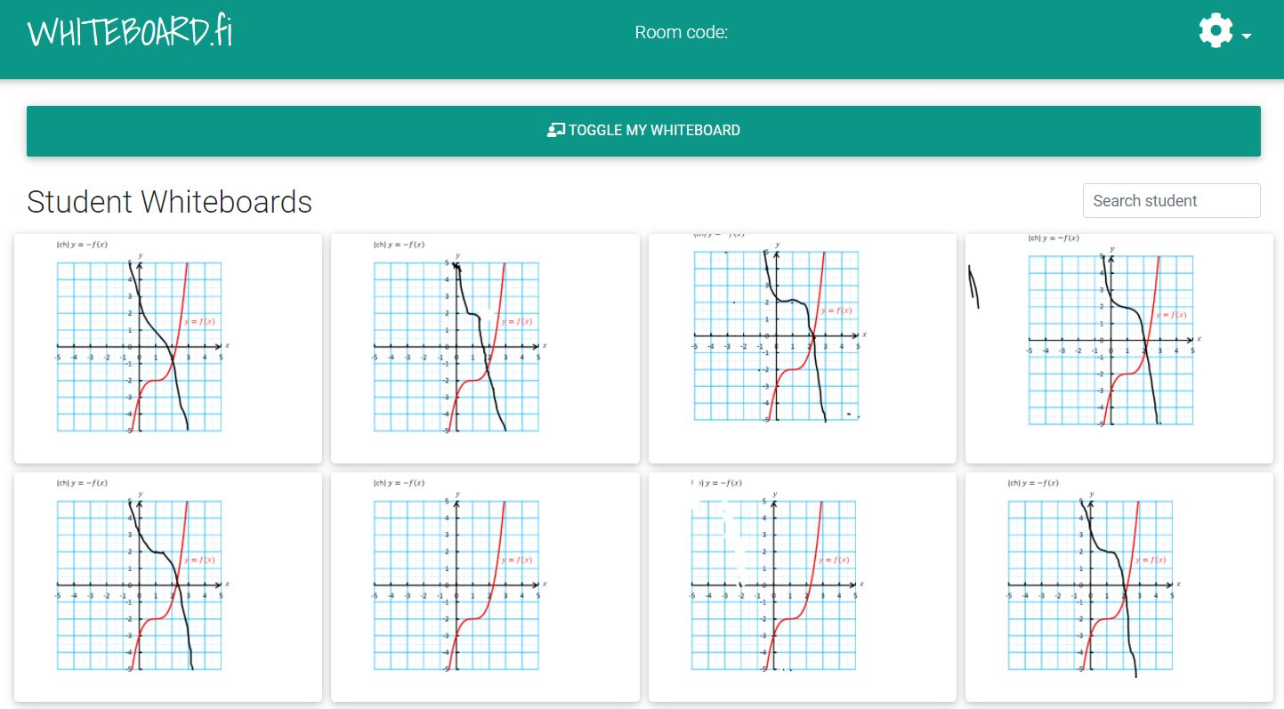
Byrddau Gwyn Bach
Mini Whiteboards
Asesu dealltwriaeth o dasg penodol.
To assess understanding of a particular task.
Gofyn am gymorth yn ystod y wers, heb ddefnyddio’r blwch sgwrsio.
Ask for help during a lesson without using the chat box.

Slide 35
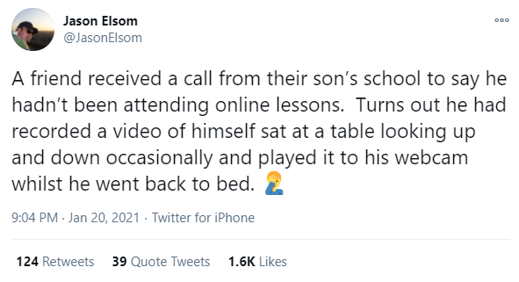
https://twitter.com/JasonElsom/status/1351999026040885249?s=20

Slide 36
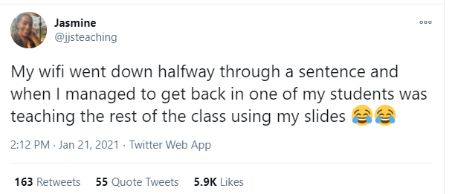
https://twitter.com/jjsteaching/status/1352257668719718411?s=20

Slide 37
Technegau ar gyfer
dysgu ar-lein
Techniques for teaching on-line
@mathemateg
/adolygumathemateg

Slide 38
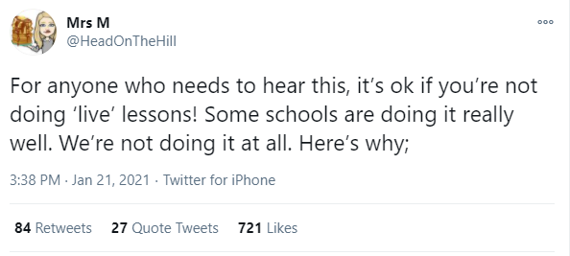
https://twitter.com/HeadOnTheHill/status/1352279418639626240?s=20

Slide 39
Rhesymau dros beidio cynnal gwersi byw
Reasons for not providing live lessons
Siblings can’t be online on one device at the same time (yes we’ve done our best to provide enough devices but they don’t all have their own). We are committed to equitable experiences for all during lockdown and a live offer wouldn’t align with that.
Some parents want live to allow pupils to check in with classmates. We have a ‘Posts’ page on Teams. It allows pupils to engage with each other in a safe way.
Assemblies allow pupils to continue to feel part of the community. A live lesson wouldn’t necessarily provide that.
Learning is our focus. Work submitted on Teams is checked and pupils get individual feedback. We’re not convinced a live lesson provides the opportunity for this level of feedback.
Even if a live lesson does provide this level of feedback, when would staff have the time? They are working hard to manage everything. Time out to teach live cuts down on time interacting with pupils individually.
Live lessons are exhausting. Workload is already far exceeding normal teaching. We must safeguard the wellbeing of our staff.
https://twitter.com/HeadOnTheHill/status/1352279418639626240?s=20

Slide 40
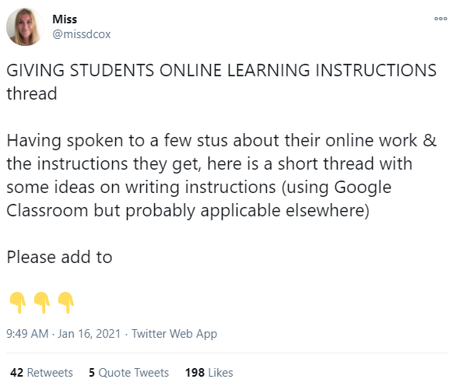
https://twitter.com/missdcox/status/1350379747730100224?s=20

Slide 41
Darparu Cyfarwyddiadau
Giving Instructions
Give the lesson/work a title - Label all documents/assignments/headings with the same title.
When setting a task, divide it into stages (use a numbered list) and be specific in the exact resource/task that they should complete and how you want it done.
Keep materials (resources), assignments, quizzes separate if possible, to keep things clear rather than putting them all into one assignment post. Using topic headings to organise them together with clear labelling.
Provide all internet links – not just ‘Watch the Oak Academy lesson on Moses’ but...
‘Follow this link and complete all of the ‘Moses and the Exodus’ Oak Academy lesson’ https://classroom.thenational.academy/lessons/moses-and-the-exodus-6mu6at?step=2&activity=video
Be clear on WHAT should/should not be submitted to the teacher and HOW this should be done…..
https://twitter.com/missdcox/status/1350379747730100224?s=20

Slide 42
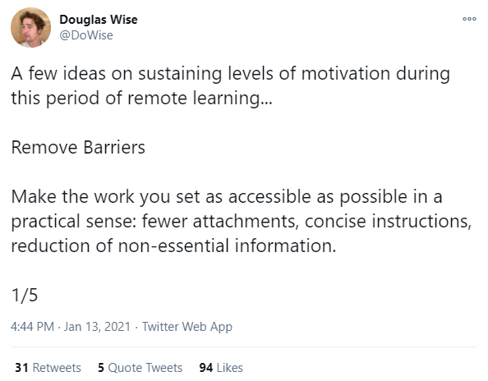
https://twitter.com/DoWise/status/1349396944632897544?s=20

Slide 43
Cynnal Cymhelliant
Sustaining Motivation
Remove Barriers
Make the work you set as accessible as possible in a practical sense: fewer attachments, concise instructions, reduction of non-essential information.
Convey Purpose
Emphasise to students that engaging with lessons will help them to know and do more in the future. As a way of showing this, make connections with work they’ve done in the past.
Overcommunicate Expectations
Clearly define the parameters of acceptable behaviour. Explicitly convey what you expect your wards to do and achieve, and repeat yourself often.
Promote Desirable Norms
Regularly highlight examples of good work to help positively influence students who might ordinarily be tempted to slack-off a bit. Remember that most students have a strong ‘herd mentality’.
Give Praise
Use established departmental and whole-school systems to convey meaningful praise. Reward both effort and attainment.
https://twitter.com/DoWise/status/1349396944632897544?s=20

Slide 44
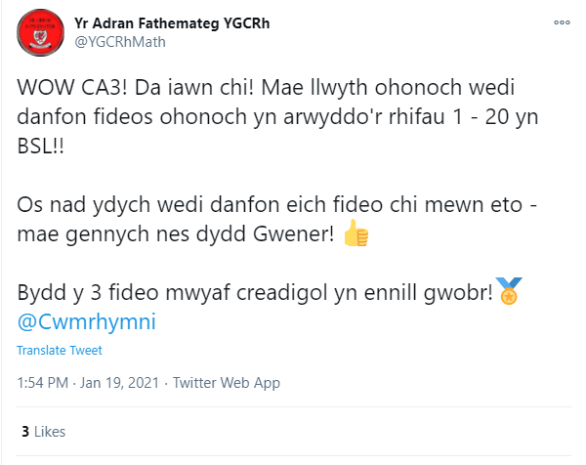
https://twitter.com/YGCRhMath/status/1351528410032590849?s=20

Slide 45
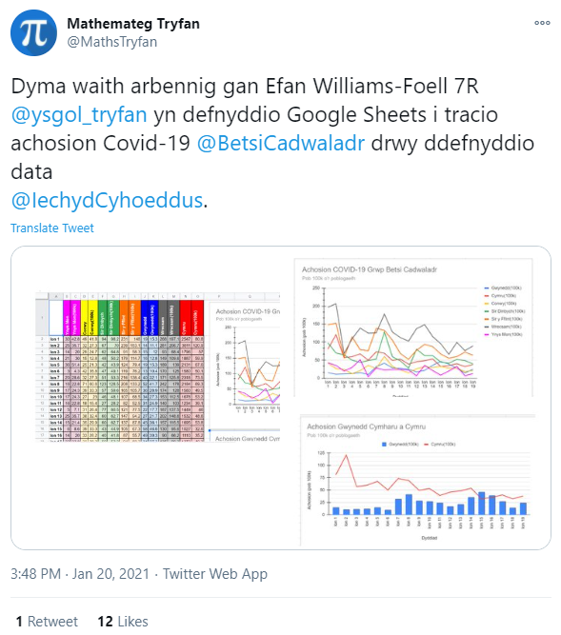
https://twitter.com/MathsTryfan/status/1351919455773798406?s=20

Slide 46
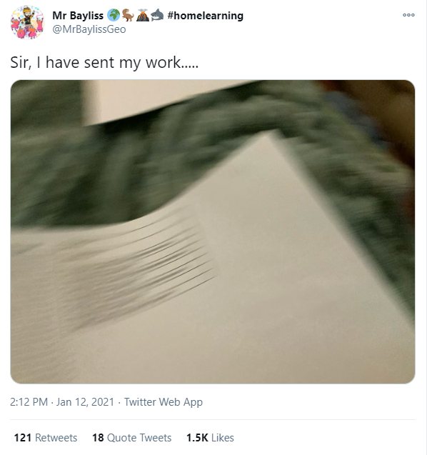
https://twitter.com/MrBaylissGeo/status/1348996181460975618?s=20

Slide 47
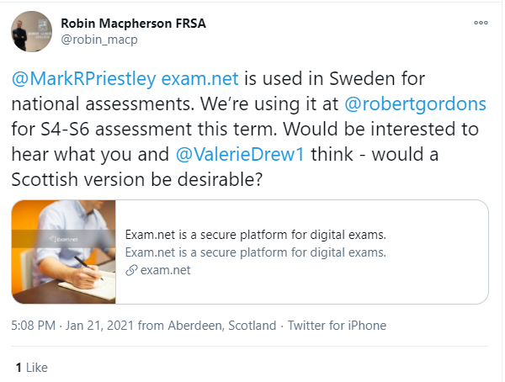
Profion
Tests
https://twitter.com/robin_macp/status/1352302007693012992?s=20
exam.net

Slide 48
Quizzes
Kahoot!
Carousel Learning
Quizzizz
Quizlet
Google Forms
Cwisiau
Quizzes

Slide 49
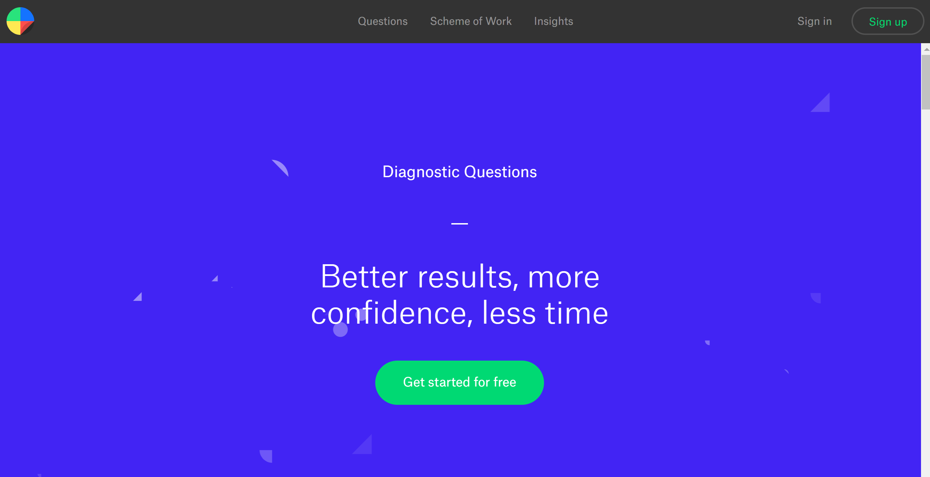
Diagnostic Questions
https://diagnosticquestions.com/

Slide 50
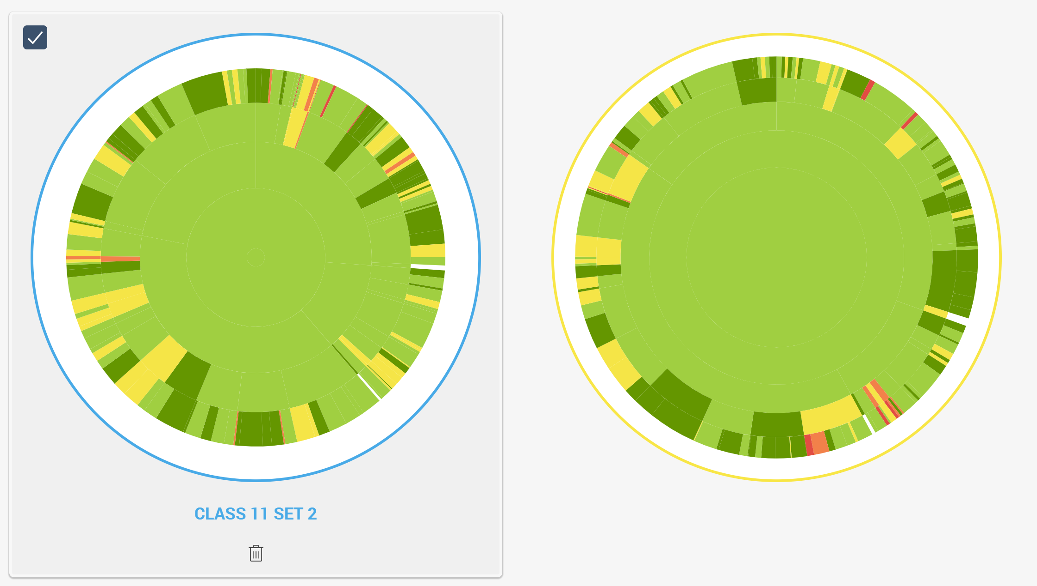

Diagnostic Questions
https://diagnosticquestions.com/

Slide 51
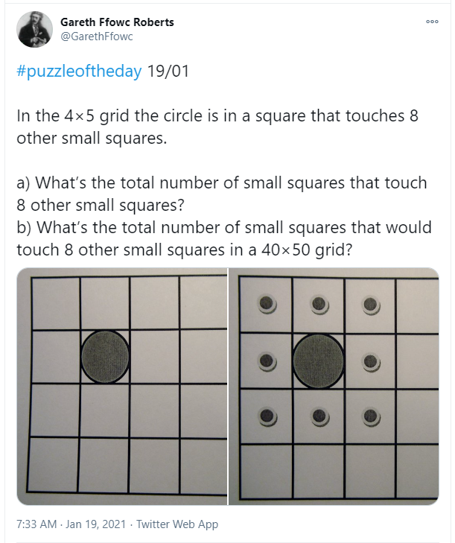
Adnoddau
Resources
Pos y dydd / Puzzle of the day
Twitter: @GarethFfowc

Slide 52
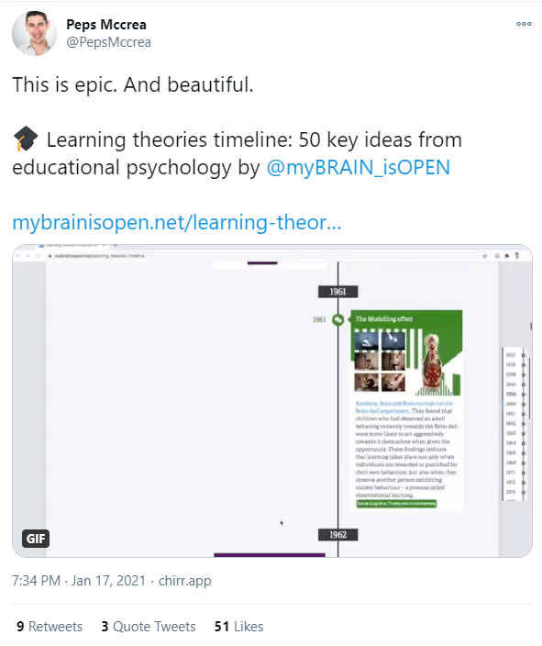
Seicoleg Addysg
Educational Psychology
https://twitter.com/PepsMccrea/status/1350889337878147072?s=20
Gwefan / website:
https://www.mybrainisopen.net/learning-theories-timeline

Slide 53
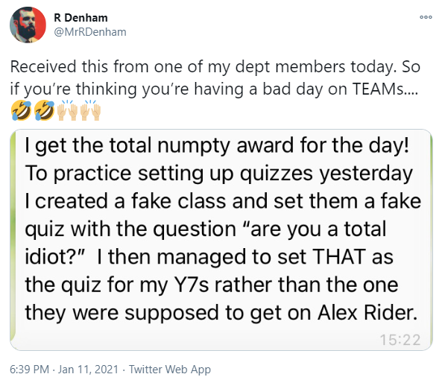
https://twitter.com/MrRDenham/status/1348701004485816321?s=20

Slide 54
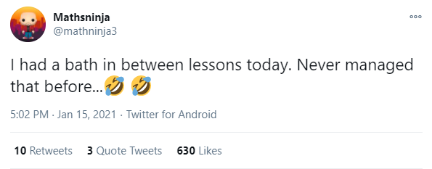
https://twitter.com/mathninja3/status/1350126226929758211?s=20

