Slide 1
Numeracy with
the Romans

Slide 2
Numeracy with the Romans
Roman Numerals
01 | 02 | 03 | 04 |  | 05 | 06 | 07 |  | 08 | 09 | 10
11 | 12 | 13 | 14 |  | 15 | 16 | 17 |  | 18 | 19 | 20
21 | 22 | 23 | 24 |  | 25 | 26 | 27 |  | 28 | 29 | 30
History Revision 01–10 |  |  |  | History Revision 11–20 |  |  |  | History Revision 21–30

Slide 3
1 | 2 | 3 | 4 | 5 | 6 | 7 | 8 | 9 | 10
11 | 12 | 13 | 14 | 15 | 16 | 17 | 18 | 19 | 20
21 | 22 | 23 | 24 | 25 | 26 | 27 | 28 | 29 | 30
31 | 32 | 33 | 34 | 35 | 36 | 37 | 38 | 39 | 40
41 | 42 | 43 | 44 | 45 | 46 | 47 | 48 | 49 | 50
51 | 52 | 53 | 54 | 55 | 56 | 57 | 58 | 59 | 60
61 | 62 | 63 | 64 | 65 | 66 | 67 | 68 | 69 | 70
71 | 72 | 73 | 74 | 75 | 76 | 77 | 78 | 79 | 80
81 | 82 | 83 | 84 | 85 | 86 | 87 | 88 | 89 | 90
91 | 92 | 93 | 94 | 95 | 96 | 97 | 98 | 99 | 100
Numeracy with the Romans
Roman Numerals

Slide 4
1 I | 2 II | 3 III | 4 IV | 5 V | 6 VI | 7 VII | 8 VII | 9 IX | 10 X
11 XI | 12 XII | 13 XIII | 14 XIV | 15 XV | 16 XVI | 17 XVII | 18 XVIII | 19 XIX | 20 XX
21 XXI | 22 XXII | 23 XXIII | 24 XXIV | 25 XXV | 26 XXVI | 27 XXVII | 28 XXVIII | 29 XXIX | 30 XXX
31 XXXI | 32 XXXII | 33 XXXIII | 34 XXXIV | 35 XXXV | 36 XXXVI | 37 XXXVII | 38 XXXVIII | 39 XXXIX | 40 XL
41 XLI | 42 XLII | 43 XLIII | 44 XLIV | 45 XLV | 46 XLVI | 47 XLVII | 48 XLVIII | 49 XLIX | 50 L
51 LI | 52 LII | 53 LIII | 54 LIV | 55 LV | 56 LVI | 57 LVII | 58 LVIII | 59 LIX | 60 LX
61 LXI | 62 LXII | 63 LXIII | 64 LXIV | 65 LXV | 66 LXVI | 67 LXVII | 68 LXVIII | 69 LXIX | 70 LXX
71 LXXI | 72 LXXII | 73 LXXIII | 74 LXXIV | 75 LXXV | 76 LXXVI | 77 LXXVII | 78 LXXVIII | 79 LXXIX | 80 LXXX
81 LXXXI | 82 LXXXII | 83 LXXXIII | 84 LXXXIV | 85 LXXXV | 86 LXXVI | 87 LXXXVII | 88 LXXXVIII | 89 LXXXIX | 90 XC
91 XCI | 92 XCII | 93 XCIII | 94 XCIV | 95 XCV | 96 XCVI | 97 XCVII | 98 XCVIII | 99 XCIX | 100 C
Numeracy with the Romans
Roman Numerals – Answers

Slide 5
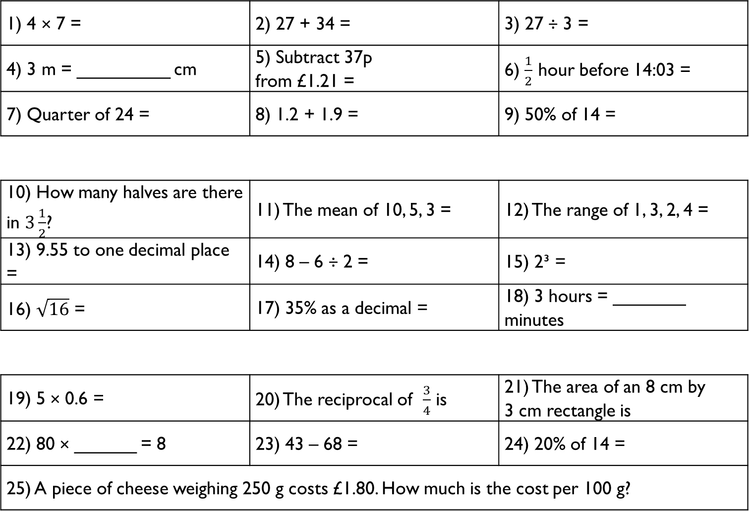
1) 4 × 7 = | 2) 27 + 34 = | 3) 27 ÷ 3 =
4) 3 m = _________ cm | 5) Subtract 37p from £1.21 = | 6) $\frac{1}{2}$ hour before 14:03 =
7) Quarter of 24 = | 8) 1.2 + 1.9 = | 9) 50% of 14 =
10) How many halves are there in $3\frac{1}{2}$? | 11) The mean of 10, 5, 3 = | 12) The range of 1, 3, 2, 4 =
13) 9.55 to one decimal place = | 14) 8 – 6 ÷ 2 = | 15) 2³ =
16) $\sqrt{16}$ = | 17) 35% as a decimal = | 18) 3 hours = _______ minutes
19) 5 × 0.6 = | 20) The reciprocal of $\frac{3}{4}$ is | 21) The area of an 8 cm by 3 cm rectangle is
22) 80 × ______ = 8 | 23) 43 – 68 = | 24) 20% of 14 =
25) A piece of cheese weighing 250 g costs £1.80. How much is the cost per 100 g?
Gladiator
Numeracy with the Romans
Session 01
Citizen
Emperor

Slide 6
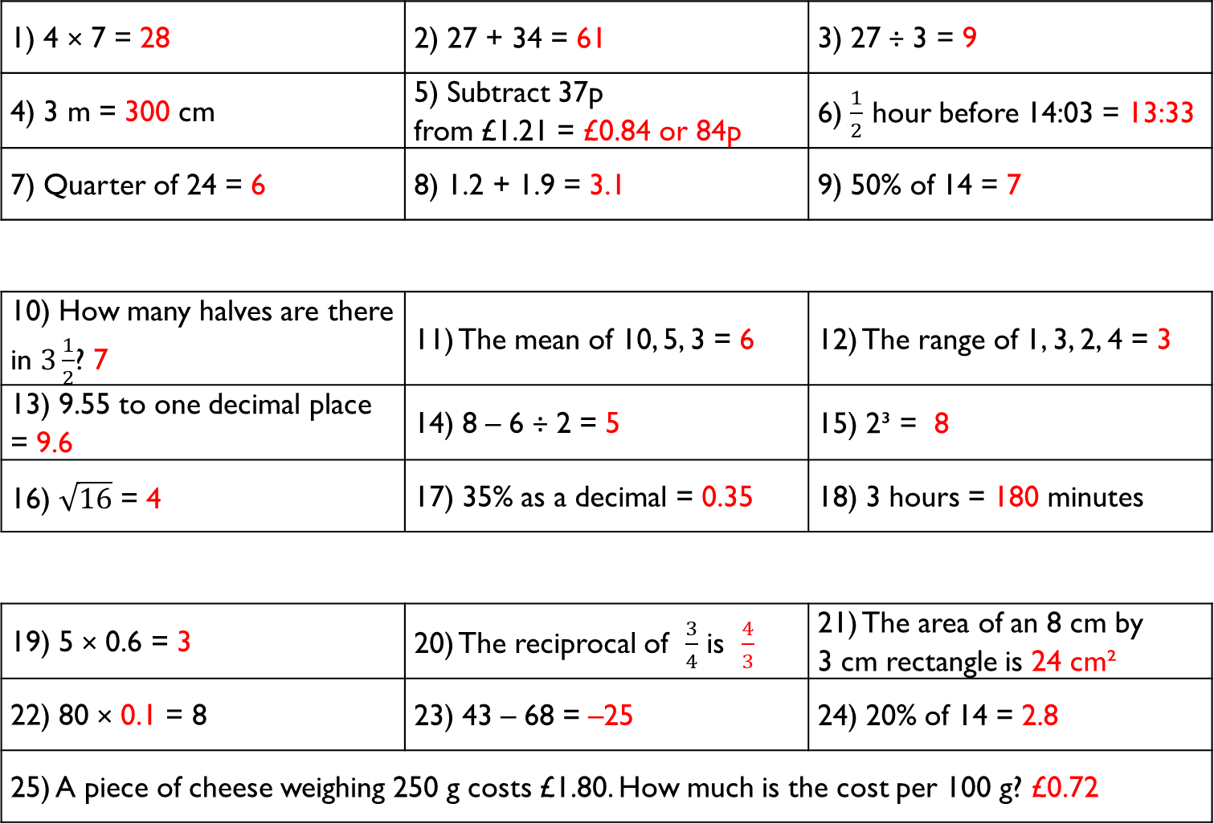
1) 4 × 7 = 28 | 2) 27 + 34 = 61 | 3) 27 ÷ 3 = 9
4) 3 m = 300 cm | 5) Subtract 37p from £1.21 = £0.84 or 84p | 6) $\frac{1}{2}$ hour before 14:03 = 13:33
7) Quarter of 24 = 6 | 8) 1.2 + 1.9 = 3.1 | 9) 50% of 14 = 7
10) How many halves are there in $3\frac{1}{2}$? 7 | 11) The mean of 10, 5, 3 = 6 | 12) The range of 1, 3, 2, 4 = 3
13) 9.55 to one decimal place = 9.6 | 14) 8 – 6 ÷ 2 = 5 | 15) 2³ = 8
16) $\sqrt{16}$ = 4 | 17) 35% as a decimal = 0.35 | 18) 3 hours = 180 minutes
19) 5 × 0.6 = 3 | 20) The reciprocal of $\frac{3}{4}$ is $\frac{4}{3}$ | 21) The area of an 8 cm by 3 cm rectangle is 24 cm²
22) 80 × 0.1 = 8 | 23) 43 – 68 = –25 | 24) 20% of 14 = 2.8
25) A piece of cheese weighing 250 g costs £1.80. How much is the cost per 100 g? £0.72
Gladiator
Numeracy with the Romans
Answers for Session 01
Citizen
Emperor

Slide 7
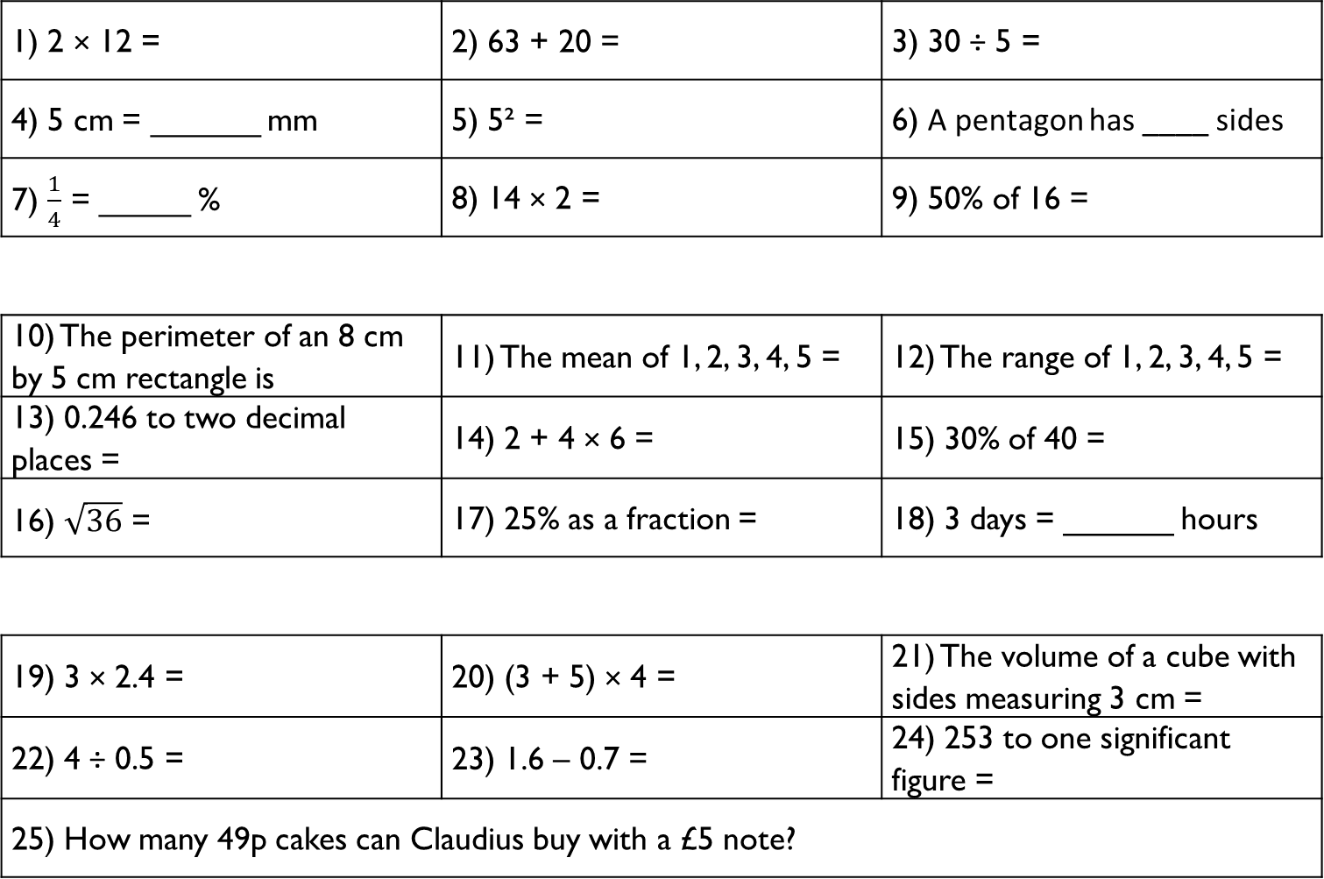
1) 2 × 12 = | 2) 63 + 20 = | 3) 30 ÷ 5 =
4) 5 cm = ______ mm | 5) 5² = | 6) A pentagon has ____ sides
7) $\frac{1}{4}$ = _____ % | 8) 14 × 2 = | 9) 50% of 16 =
10) The perimeter of an 8 cm by 5 cm rectangle is | 11) The mean of 1, 2, 3, 4, 5 = | 12) The range of 1, 2, 3, 4, 5 =
13) 0.246 to two decimal places = | 14) 2 + 4 × 6 = | 15) 30% of 40 =
16) $\sqrt{36}$ = | 17) 25% as a fraction = | 18) 3 days = ______ hours
19) 3 × 2.4 = | 20) (3 + 5) × 4 = | 21) The volume of a cube with sides measuring 3 cm =
22) 4 ÷ 0.5 = | 23) 1.6 – 0.7 = | 24) 253 to one significant figure =
25) How many 49p cakes can Claudius buy with a £5 note?
Gladiator
Numeracy with the Romans
Session 02
Citizen
Emperor

Slide 8
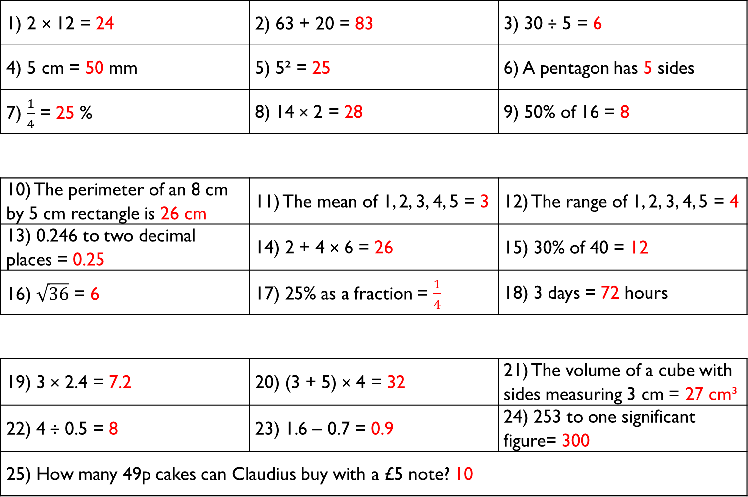
1) 2 × 12 = 24 | 2) 63 + 20 = 83 | 3) 30 ÷ 5 = 6
4) 5 cm = 50 mm | 5) 5² = 25 | 6) A pentagon has 5 sides
7) $\frac{1}{4}$ = 25 % | 8) 14 × 2 = 28 | 9) 50% of 16 = 8
10) The perimeter of an 8 cm by 5 cm rectangle is 26 cm | 11) The mean of 1, 2, 3, 4, 5 = 3 | 12) The range of 1, 2, 3, 4, 5 = 4
13) 0.246 to two decimal places = 0.25 | 14) 2 + 4 × 6 = 26 | 15) 30% of 40 = 12
16) $\sqrt{36}$ = 6 | 17) 25% as a fraction = $\frac{1}{4}$ | 18) 3 days = 72 hours
19) 3 × 2.4 = 7.2 | 20) (3 + 5) × 4 = 32 | 21) The volume of a cube with sides measuring 3 cm = 27 cm³
22) 4 ÷ 0.5 = 8 | 23) 1.6 – 0.7 = 0.9 | 24) 253 to one significant figure= 300
25) How many 49p cakes can Claudius buy with a £5 note? 10
Gladiator
Numeracy with the Romans
Answers for Session 02
Citizen
Emperor

Slide 9
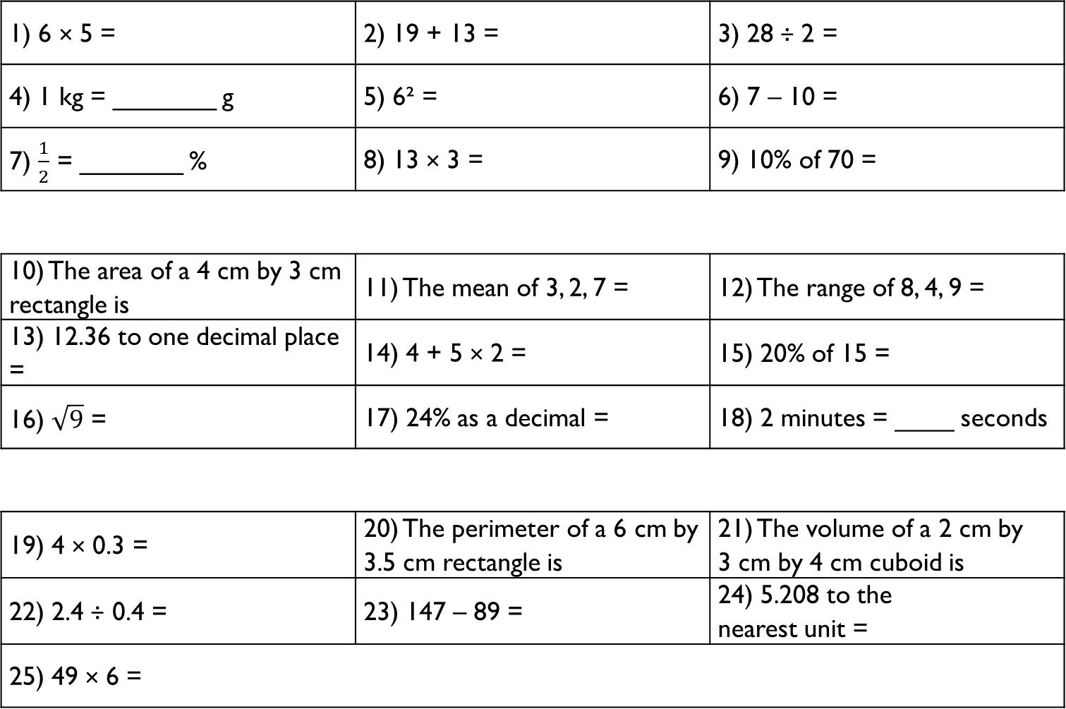
1) 6 × 5 = | 2) 19 + 13 = | 3) 28 ÷ 2 =
4) 1 kg = _______ g | 5) 6² = | 6) 7 – 10 =
7) $\frac{1}{2}$ = _______ % | 8) 13 × 3 = | 9) 10% of 70 =
10) The area of a 4 cm by 3 cm rectangle is | 11) The mean of 3, 2, 7 = | 12) The range of 8, 4, 9 =
13) 12.36 to one decimal place = | 14) 4 + 5 × 2 = | 15) 20% of 15 =
16) $\sqrt{9}$ = | 17) 24% as a decimal = | 18) 2 minutes = ____ seconds
19) 4 × 0.3 = | 20) The perimeter of a 6 cm by 3.5 cm rectangle is | 21) The volume of a 2 cm by 3 cm by 4 cm cuboid is
22) 2.4 ÷ 0.4 = | 23) 147 – 89 = | 24) 5.208 to the nearest unit =
25) 49 × 6 =
Gladiator
Numeracy with the Romans
Session 03
Citizen
Emperor

Slide 10
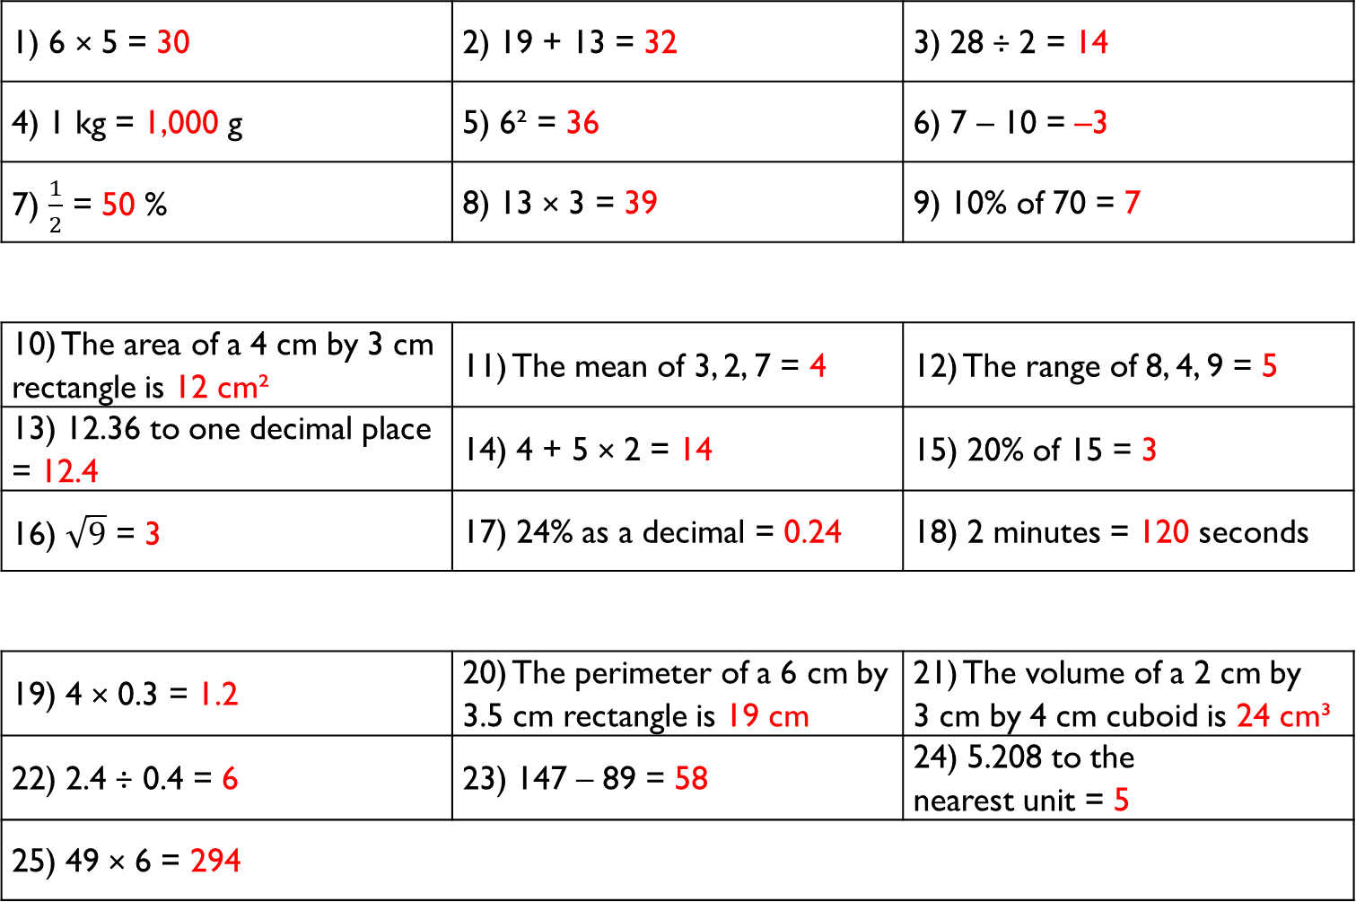
1) 6 × 5 = 30 | 2) 19 + 13 = 32 | 3) 28 ÷ 2 = 14
4) 1 kg = 1,000 g | 5) 6² = 36 | 6) 7 – 10 = –3
7) $\frac{1}{2}$ = 50 % | 8) 13 × 3 = 39 | 9) 10% of 70 = 7
10) The area of a 4 cm by 3 cm rectangle is 12 cm² | 11) The mean of 3, 2, 7 = 4 | 12) The range of 8, 4, 9 = 5
13) 12.36 to one decimal place = 12.4 | 14) 4 + 5 × 2 = 14 | 15) 20% of 15 = 3
16) $\sqrt{9}$ = 3 | 17) 24% as a decimal = 0.24 | 18) 2 minutes = 120 seconds
19) 4 × 0.3 = 1.2 | 20) The perimeter of a 6 cm by 3.5 cm rectangle is 19 cm | 21) The volume of a 2 cm by 3 cm by 4 cm cuboid is 24 cm³
22) 2.4 ÷ 0.4 = 6 | 23) 147 – 89 = 58 | 24) 5.208 to the nearest unit = 5
25) 49 × 6 = 294
Gladiator
Numeracy with the Romans
Answers for Session 03
Citizen
Emperor

Slide 11
1) 582 to the nearest 10 = | 2) 28 to the nearest 10 = | 3) 389 to the nearest 10 =
4) 283 to the nearest 100 = | 5) 2,829 to the nearest 100 = | 6) 13,532 to the nearest 100 =
7) 4,327 to the nearest 1,000 = | 8) 14,872 to the nearest 1,000 = | 9) 624,239 to the nearest 1,000 =
10) 3.27 to the nearest unit = | 11) 8.06 to the nearest unit = | 12) 213.81 to the nearest unit =
13) 7.21 to one decimal place = | 14) 82.35 to one decimal place = | 15) 4.98 to one decimal place =
16) 12.372 to two decimal places = | 17) 287.027 to two decimal places = | 18) 1,245.72502 to two decimal places =
19) 83 to one significant figure = | 20) 7,622 to one significant figure = | 21) 0.0023 to one significant figure =
22) 278 to two significant figures = | 23) 92,345 to two significant figures = | 24) 0.002352 to two significant figures =
25) Calculate 2 + 7 × 3, giving your answer to one significant figure.
Gladiator
Numeracy with the Romans
Session 04
Citizen
Emperor

Slide 12
1) 582 to the nearest 10 = 580 | 2) 28 to the nearest 10 = 30 | 3) 389 to the nearest 10 = 390
4) 283 to the nearest 100 = 300 | 5) 2,829 to the nearest 100 = 2,800 | 6) 13,532 to the nearest 100 = 13,500
7) 4,327 to the nearest 1,000 = 4,000 | 8) 14,872 to the nearest 1,000 = 15,000 | 9) 624,239 to the nearest 1,000 = 624,000
10) 3.27 to the nearest unit = 3 | 11) 8.06 to the nearest unit = 8 | 12) 213.81 to the nearest unit = 214
13) 7.21 to one decimal place = 7.2 | 14) 82.35 to one decimal place = 82.4 | 15) 4.98 to one decimal place = 5.0
16) 12.372 to two decimal places = 23.37 | 17) 287.027 to two decimal places = 287.03 | 18) 1,245.72502 to two decimal places = 1,245.73
19) 83 to one significant figure = 80 | 20) 7,622 to one significant figure = 8,000 | 21) 0.0023 to one significant figure = 0.002
22) 278 to two significant figures = 280 | 23) 92,345 to two significant figures = 92,000 | 24) 0.002352 to two significant figures = 0.0024
25) Calculate 2 + 7 × 3, giving your answer to one significant figure. 20
Gladiator
Numeracy with the Romans
Answers for Session 04
Citizen
Emperor

Slide 13
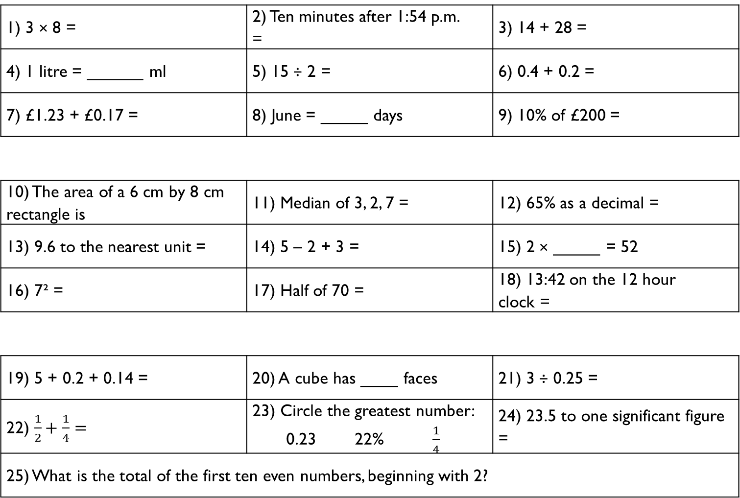
1) 3 × 8 = | 2) Ten minutes after 1:54 p.m. = | 3) 14 + 28 =
4) 1 litre = ______ ml | 5) 15 ÷ 2 = | 6) 0.4 + 0.2 =
7) £1.23 + £0.17 = | 8) June = _____ days | 9) 10% of £200 =
10) The area of a 6 cm by 8 cm rectangle is | 11) Median of 3, 2, 7 = | 12) 65% as a decimal =
13) 9.6 to the nearest unit = | 14) 5 – 2 + 3 = | 15) 2 × _____ = 52
16) 7² = | 17) Half of 70 = | 18) 13:42 on the 12 hour clock =
19) 5 + 0.2 + 0.14 = | 20) A cube has ____ faces | 21) 3 ÷ 0.25 =
22) $\frac{1}{2}+\frac{1}{4}=$ | 23) Circle the greatest number: 0.23 22% $\frac{1}{4}$ | 24) 23.5 to one significant figure =
25) What is the total of the first ten even numbers, beginning with 2?
Gladiator
Numeracy with the Romans
Session 05
Citizen
Emperor

Slide 14
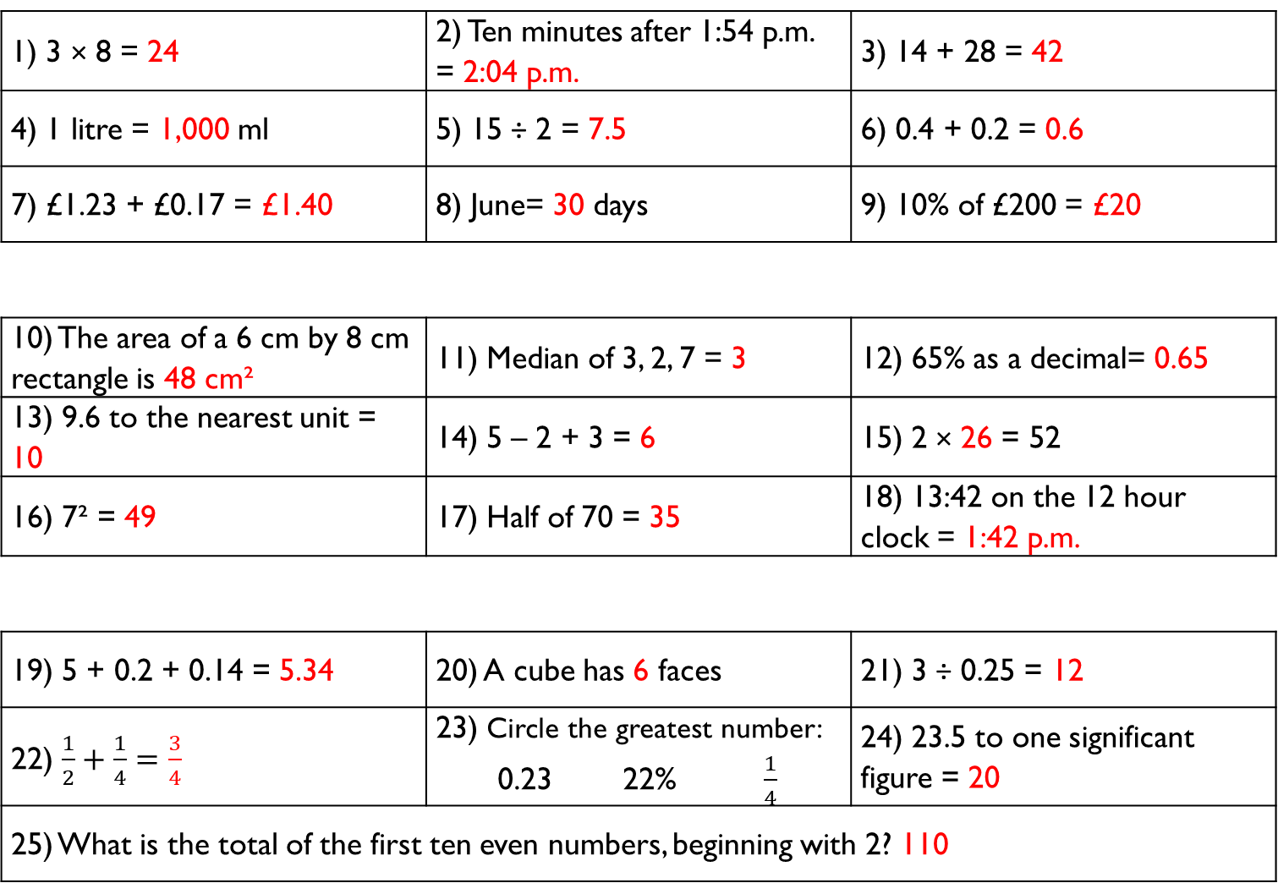
1) 3 × 8 = 24 | 2) Ten minutes after 1:54 p.m. = 2:04 p.m. | 3) 14 + 28 = 42
4) 1 litre = 1,000 ml | 5) 15 ÷ 2 = 7.5 | 6) 0.4 + 0.2 = 0.6
7) £1.23 + £0.17 = £1.40 | 8) June= 30 days | 9) 10% of £200 = £20
10) The area of a 6 cm by 8 cm rectangle is 48 cm² | 11) Median of 3, 2, 7 = 3 | 12) 65% as a decimal= 0.65
13) 9.6 to the nearest unit = 10 | 14) 5 – 2 + 3 = 6 | 15) 2 × 26 = 52
16) 7² = 49 | 17) Half of 70 = 35 | 18) 13:42 on the 12 hour clock = 1:42 p.m.
19) 5 + 0.2 + 0.14 = 5.34 | 20) A cube has 6 faces | 21) 3 ÷ 0.25 = 12
22) $\frac{1}{2}+\frac{1}{4}=$ $\frac{3}{4}$ | 23) Circle the greatest number: 0.23 22% $\frac{1}{4}$ | 24) 23.5 to one significant figure = 20
25) What is the total of the first ten even numbers, beginning with 2? 110
Gladiator
Numeracy with the Romans
Answers for Session 05
Citizen
Emperor

Slide 15
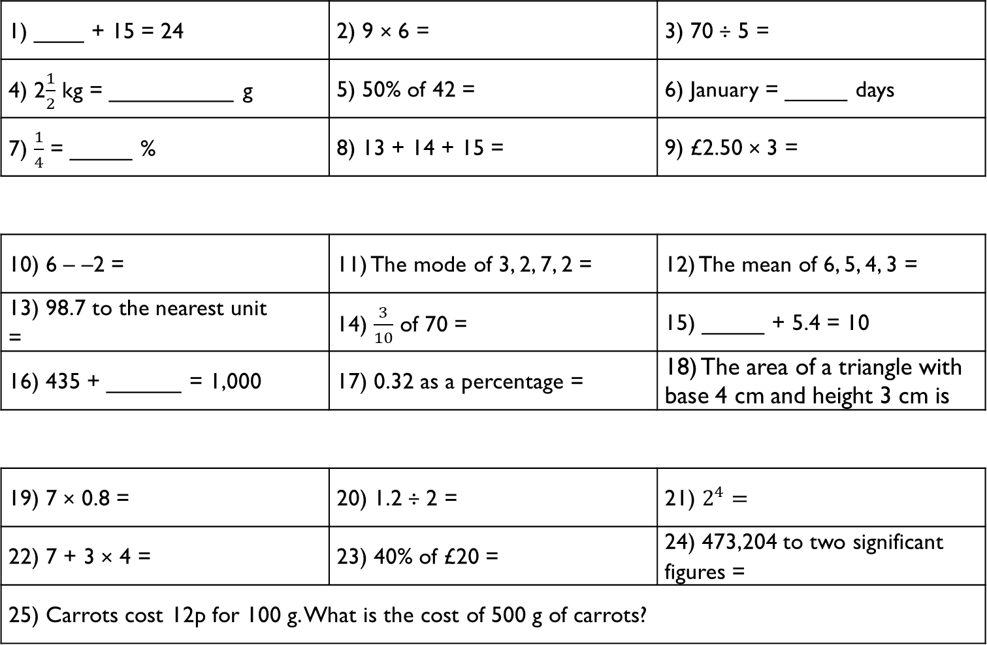
1) ____ + 15 = 24 | 2) 9 × 6 = | 3) 70 ÷ 5 =
4) 2$\frac{1}{2}$ kg = __________ g | 5) 50% of 42 = | 6) January = _____ days
7) $\frac{1}{4}$ = _____ % | 8) 13 + 14 + 15 = | 9) £2.50 × 3 =
10) 6 – –2 = | 11) The mode of 3, 2, 7, 2 = | 12) The mean of 6, 5, 4, 3 =
13) 98.7 to the nearest unit = | 14) $\frac{3}{10}$ of 70 = | 15) _____ + 5.4 = 10
16) 435 + ______ = 1,000 | 17) 0.32 as a percentage = | 18) The area of a triangle with base 4 cm and height 3 cm is
19) 7 × 0.8 = | 20) 1.2 ÷ 2 = | 21) $2^{4}=$
22) 7 + 3 × 4 = | 23) 40% of £20 = | 24) 473,204 to two significant figures =
25) Carrots cost 12p for 100 g. What is the cost of 500 g of carrots?
Gladiator
Numeracy with the Romans
Session 06
Citizen
Emperor

Slide 16
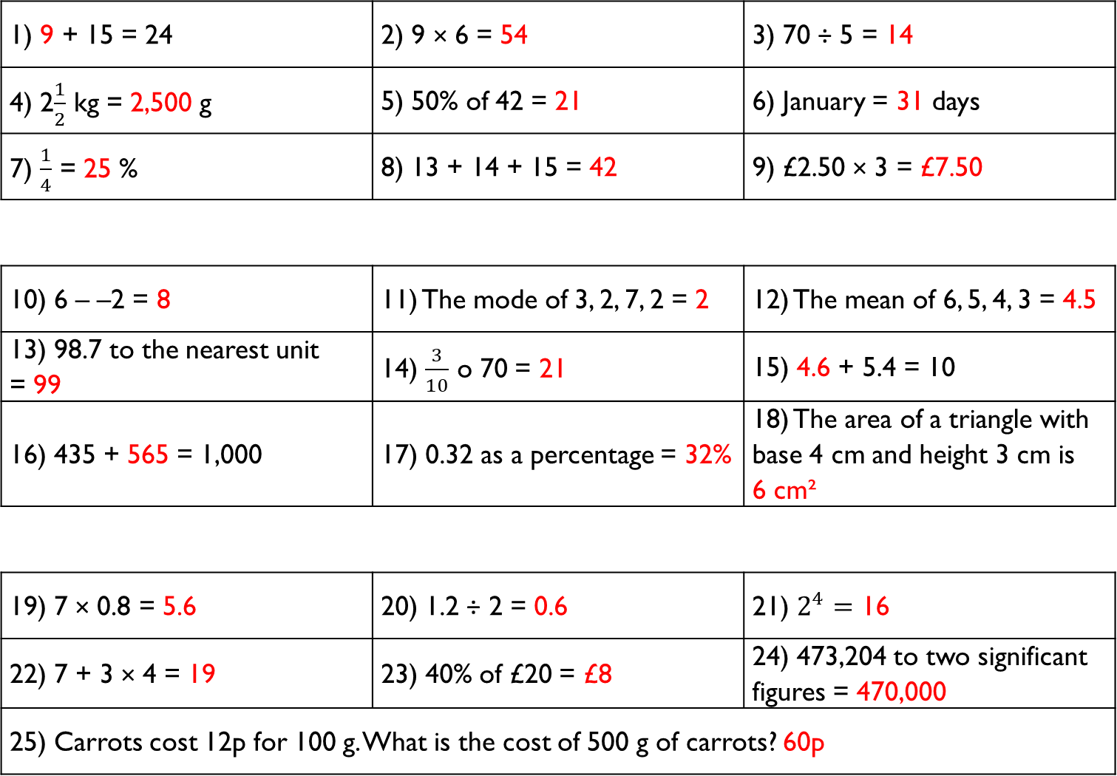
1) 9 + 15 = 24 | 2) 9 × 6 = 54 | 3) 70 ÷ 5 = 14
4) 2$\frac{1}{2}$ kg = 2,500 g | 5) 50% of 42 = 21 | 6) January = 31 days
7) $\frac{1}{4}$ = 25 % | 8) 13 + 14 + 15 = 42 | 9) £2.50 × 3 = £7.50
10) 6 – –2 = 8 | 11) The mode of 3, 2, 7, 2 = 2 | 12) The mean of 6, 5, 4, 3 = 4.5
13) 98.7 to the nearest unit = 99 | 14) $\frac{3}{10}$ o 70 = 21 | 15) 4.6 + 5.4 = 10
16) 435 + 565 = 1,000 | 17) 0.32 as a percentage = 32% | 18) The area of a triangle with base 4 cm and height 3 cm is 6 cm²
19) 7 × 0.8 = 5.6 | 20) 1.2 ÷ 2 = 0.6 | 21) $2^{4}=$ 16
22) 7 + 3 × 4 = 19 | 23) 40% of £20 = £8 | 24) 473,204 to two significant figures = 470,000
25) Carrots cost 12p for 100 g. What is the cost of 500 g of carrots? 60p
Gladiator
Numeracy with the Romans
Answers for Session 06
Citizen
Emperor

Slide 17
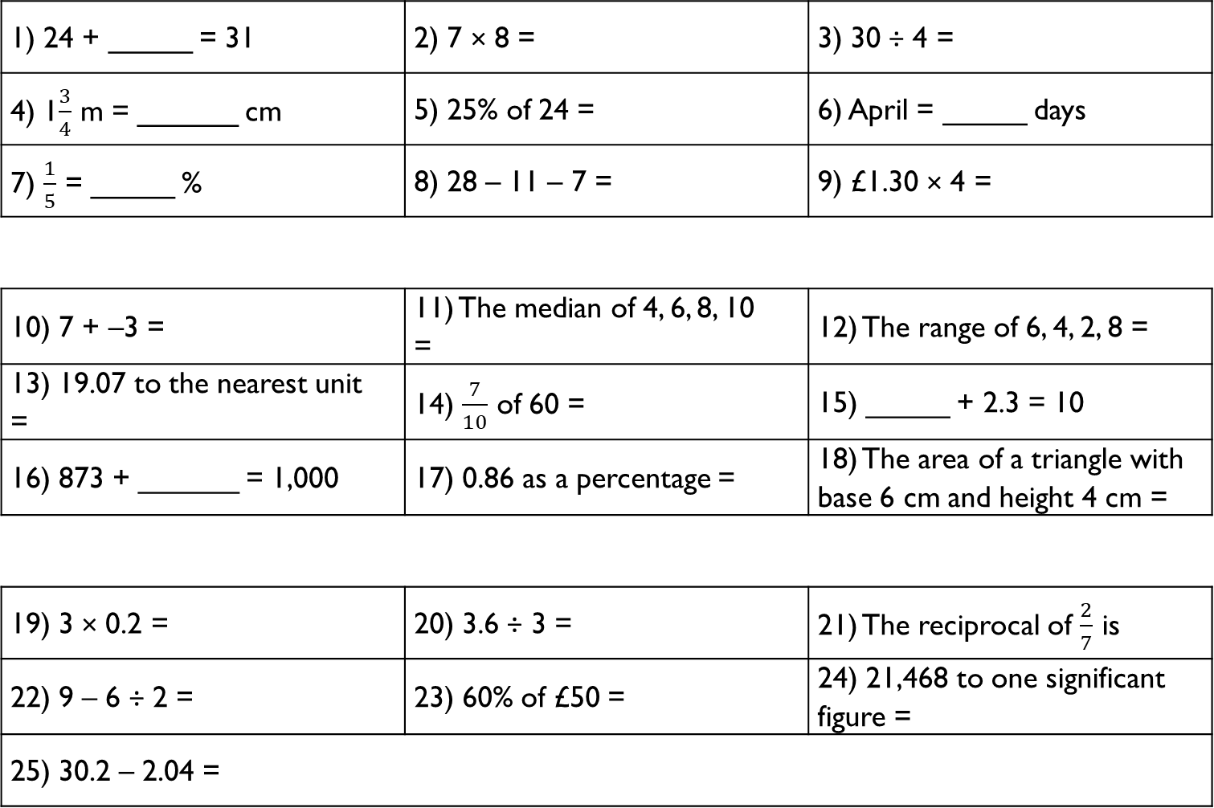
1) 24 + _____ = 31 | 2) 7 × 8 = | 3) 30 ÷ 4 =
4) 1$\frac{3}{4}$ m = ______ cm | 5) 25% of 24 = | 6) April = _____ days
7) $\frac{1}{5}$ = _____ % | 8) 28 – 11 – 7 = | 9) £1.30 × 4 =
10) 7 + –3 = | 11) The median of 4, 6, 8, 10 = | 12) The range of 6, 4, 2, 8 =
13) 19.07 to the nearest unit = | 14) $\frac{7}{10}$ of 60 = | 15) _____ + 2.3 = 10
16) 873 + ______ = 1,000 | 17) 0.86 as a percentage = | 18) The area of a triangle with base 6 cm and height 4 cm =
19) 3 × 0.2 = | 20) 3.6 ÷ 3 = | 21) The reciprocal of $\frac{2}{7}$ is
22) 9 – 6 ÷ 2 = | 23) 60% of £50 = | 24) 21,468 to one significant figure =
25) 30.2 – 2.04 =
Gladiator
Numeracy with the Romans
Session 07
Citizen
Emperor

Slide 18
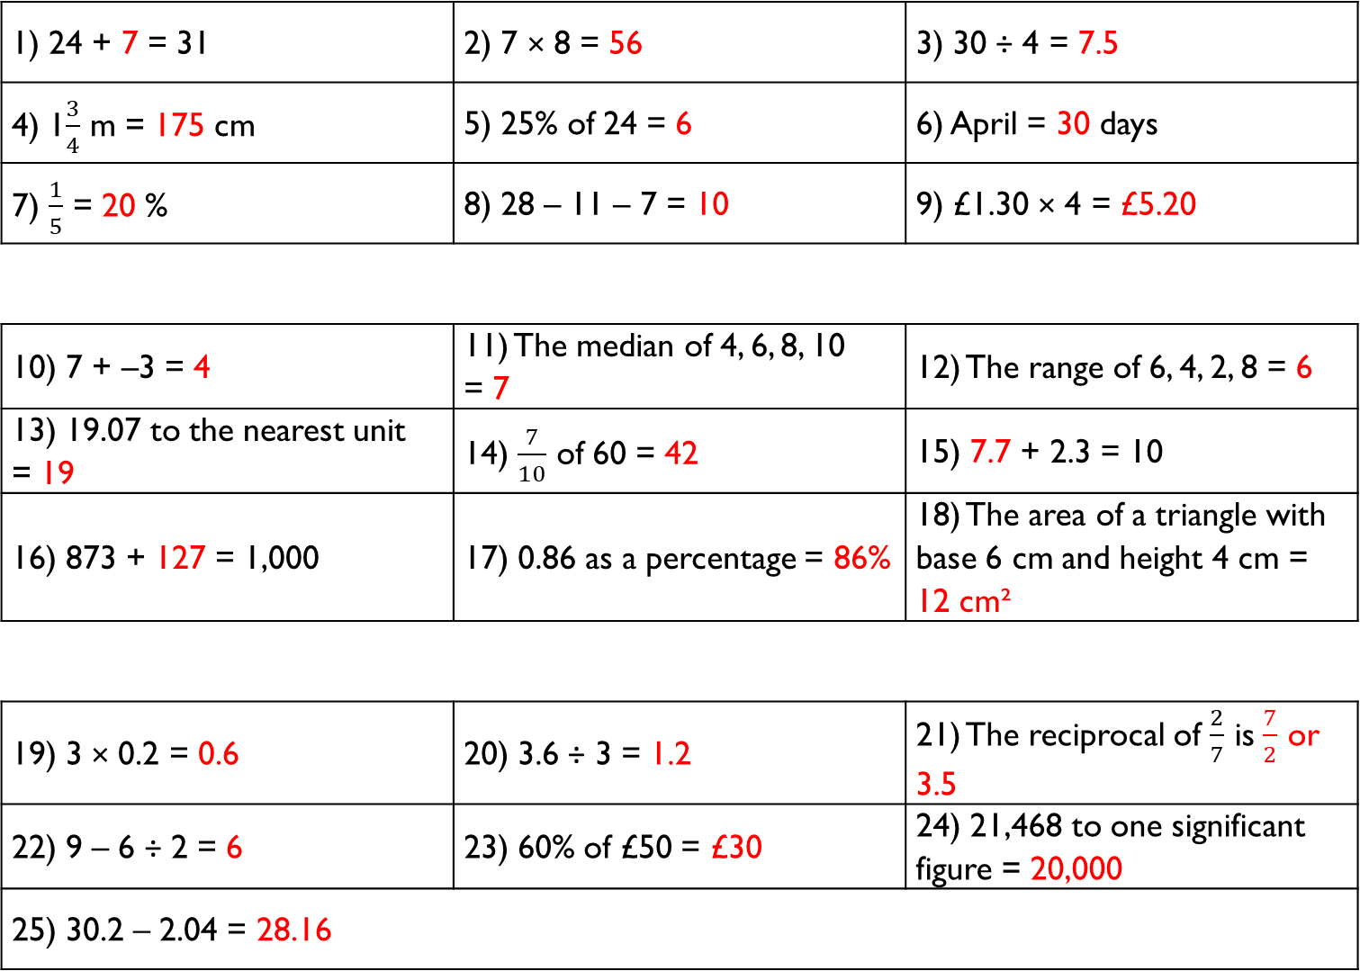
1) 24 + 7 = 31 | 2) 7 × 8 = 56 | 3) 30 ÷ 4 = 7.5
4) 1$\frac{3}{4}$ m = 175 cm | 5) 25% of 24 = 6 | 6) April = 30 days
7) $\frac{1}{5}$ = 20 % | 8) 28 – 11 – 7 = 10 | 9) £1.30 × 4 = £5.20
10) 7 + –3 = 4 | 11) The median of 4, 6, 8, 10 = 7 | 12) The range of 6, 4, 2, 8 = 6
13) 19.07 to the nearest unit = 19 | 14) $\frac{7}{10}$ of 60 = 42 | 15) 7.7 + 2.3 = 10
16) 873 + 127 = 1,000 | 17) 0.86 as a percentage = 86% | 18) The area of a triangle with base 6 cm and height 4 cm = 12 cm²
19) 3 × 0.2 = 0.6 | 20) 3.6 ÷ 3 = 1.2 | 21) The reciprocal of $\frac{2}{7}$ is $\frac{7}{2}$ or 3.5
22) 9 – 6 ÷ 2 = 6 | 23) 60% of £50 = £30 | 24) 21,468 to one significant figure = 20,000
25) 30.2 – 2.04 = 28.16
Gladiator
Numeracy with the Romans
Answers for Session 07
Citizen
Emperor

Slide 19
1) 50% of 30 = | 2) 50% of 140 = | 3) 50% of 19 =
4) 10% of 60 = | 5) 10% of 170 = | 6) 10% of 85 =
7) 25% of £40 = | 8) 25% of £120 = | 9) 25% of £32 =
10) 20% of 40 = | 11) 30% of 80 = | 12) 40% of 40 =
13) 45% as a decimal = | 14) 12% as a decimal = | 15) 4% as a decimal =
16) 99% as a fraction = | 17) 19% as a fraction = | 18) 9% as a fraction =
19) 15% of £50 = | 20) 5% of £20 = | 21) 1% of £87 =
22) 3% of $50 = | 23) 150% of 400 = | 24) 0.1% of 600 =
25) There is a 40% price reduction in a sale. Walking shoes usually cost £35. What will be the price of the walking shoes in the sale?
Gladiator
Numeracy with the Romans
Session 08
Citizen
Emperor

Slide 20
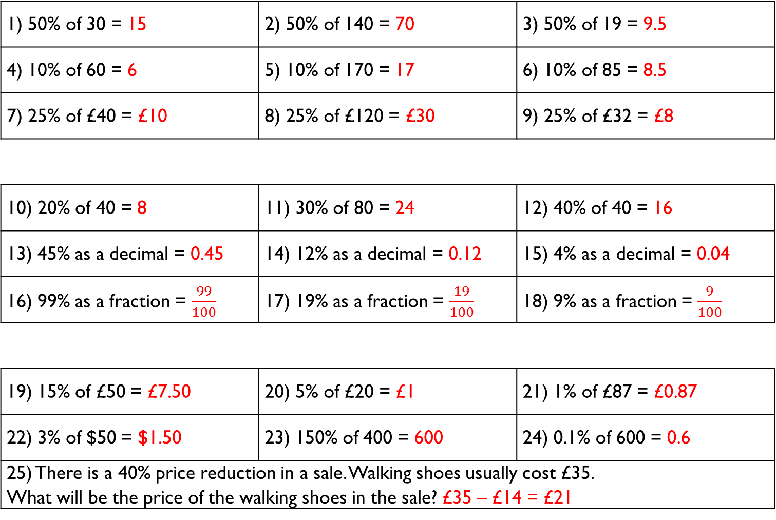
1) 50% of 30 = 15 | 2) 50% of 140 = 70 | 3) 50% of 19 = 9.5
4) 10% of 60 = 6 | 5) 10% of 170 = 17 | 6) 10% of 85 = 8.5
7) 25% of £40 = £10 | 8) 25% of £120 = £30 | 9) 25% of £32 = £8
10) 20% of 40 = 8 | 11) 30% of 80 = 24 | 12) 40% of 40 = 16
13) 45% as a decimal = 0.45 | 14) 12% as a decimal = 0.12 | 15) 4% as a decimal = 0.04
16) 99% as a fraction = $\frac{99}{100}$ | 17) 19% as a fraction = $\frac{19}{100}$ | 18) 9% as a fraction = $\frac{9}{100}$
19) 15% of £50 = £7.50 | 20) 5% of £20 = £1 | 21) 1% of £87 = £0.87
22) 3% of $50 = $1.50 | 23) 150% of 400 = 600 | 24) 0.1% of 600 = 0.6
25) There is a 40% price reduction in a sale. Walking shoes usually cost £35. What will be the price of the walking shoes in the sale? £35 – £14 = £21
Gladiator
Numeracy with the Romans
Answers for Session 08
Citizen
Emperor

Slide 21
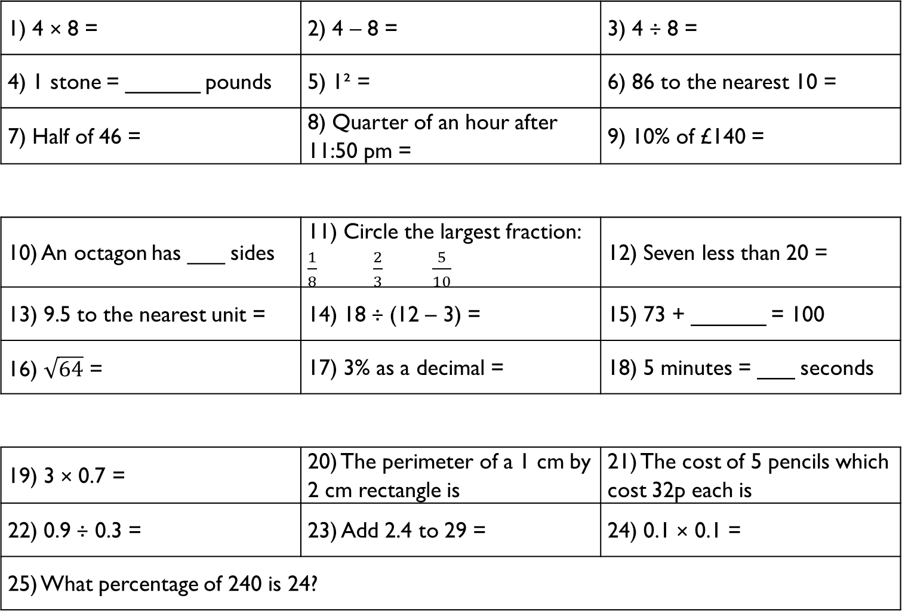
1) 4 × 8 = | 2) 4 – 8 = | 3) 4 ÷ 8 =
4) 1 stone = ______ pounds | 5) 1² = | 6) 86 to the nearest 10 =
7) Half of 46 = | 8) Quarter of an hour after 11:50 pm = | 9) 10% of £140 =
10) An octagon has ___ sides | 11) Circle the largest fraction: $\frac{1}{8}$ $\frac{2}{3}$ $\frac{5}{10}$ | 12) Seven less than 20 =
13) 9.5 to the nearest unit = | 14) 18 ÷ (12 – 3) = | 15) 73 + ______ = 100
16) $\sqrt{64}$ = | 17) 3% as a decimal = | 18) 5 minutes = ___ seconds
19) 3 × 0.7 = | 20) The perimeter of a 1 cm by 2 cm rectangle is | 21) The cost of 5 pencils which cost 32p each is
22) 0.9 ÷ 0.3 = | 23) Add 2.4 to 29 = | 24) 0.1 × 0.1 =
25) What percentage of 240 is 24?
Gladiator
Numeracy with the Romans
Session 09
Citizen
Emperor

Slide 22
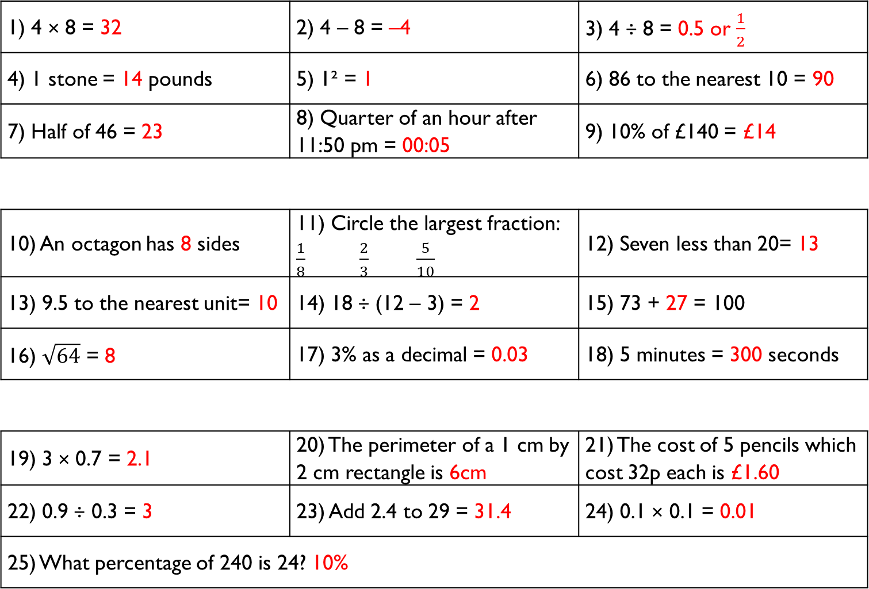
1) 4 × 8 = 32 | 2) 4 – 8 = –4 | 3) 4 ÷ 8 = 0.5 or $\frac{1}{2}$
4) 1 stone = 14 pounds | 5) 1² = 1 | 6) 86 to the nearest 10 = 90
7) Half of 46 = 23 | 8) Quarter of an hour after 11:50 pm = 00:05 | 9) 10% of £140 = £14
10) An octagon has 8 sides | 11) Circle the largest fraction: $\frac{1}{8}$ $\frac{2}{3}$ $\frac{5}{10}$ | 12) Seven less than 20= 13
13) 9.5 to the nearest unit= 10 | 14) 18 ÷ (12 – 3) = 2 | 15) 73 + 27 = 100
16) $\sqrt{64}$ = 8 | 17) 3% as a decimal = 0.03 | 18) 5 minutes = 300 seconds
19) 3 × 0.7 = 2.1 | 20) The perimeter of a 1 cm by 2 cm rectangle is 6cm | 21) The cost of 5 pencils which cost 32p each is £1.60
22) 0.9 ÷ 0.3 = 3 | 23) Add 2.4 to 29 = 31.4 | 24) 0.1 × 0.1 = 0.01
25) What percentage of 240 is 24? 10%
Gladiator
Numeracy with the Romans
Answers for Session 09
Citizen
Emperor

Slide 23
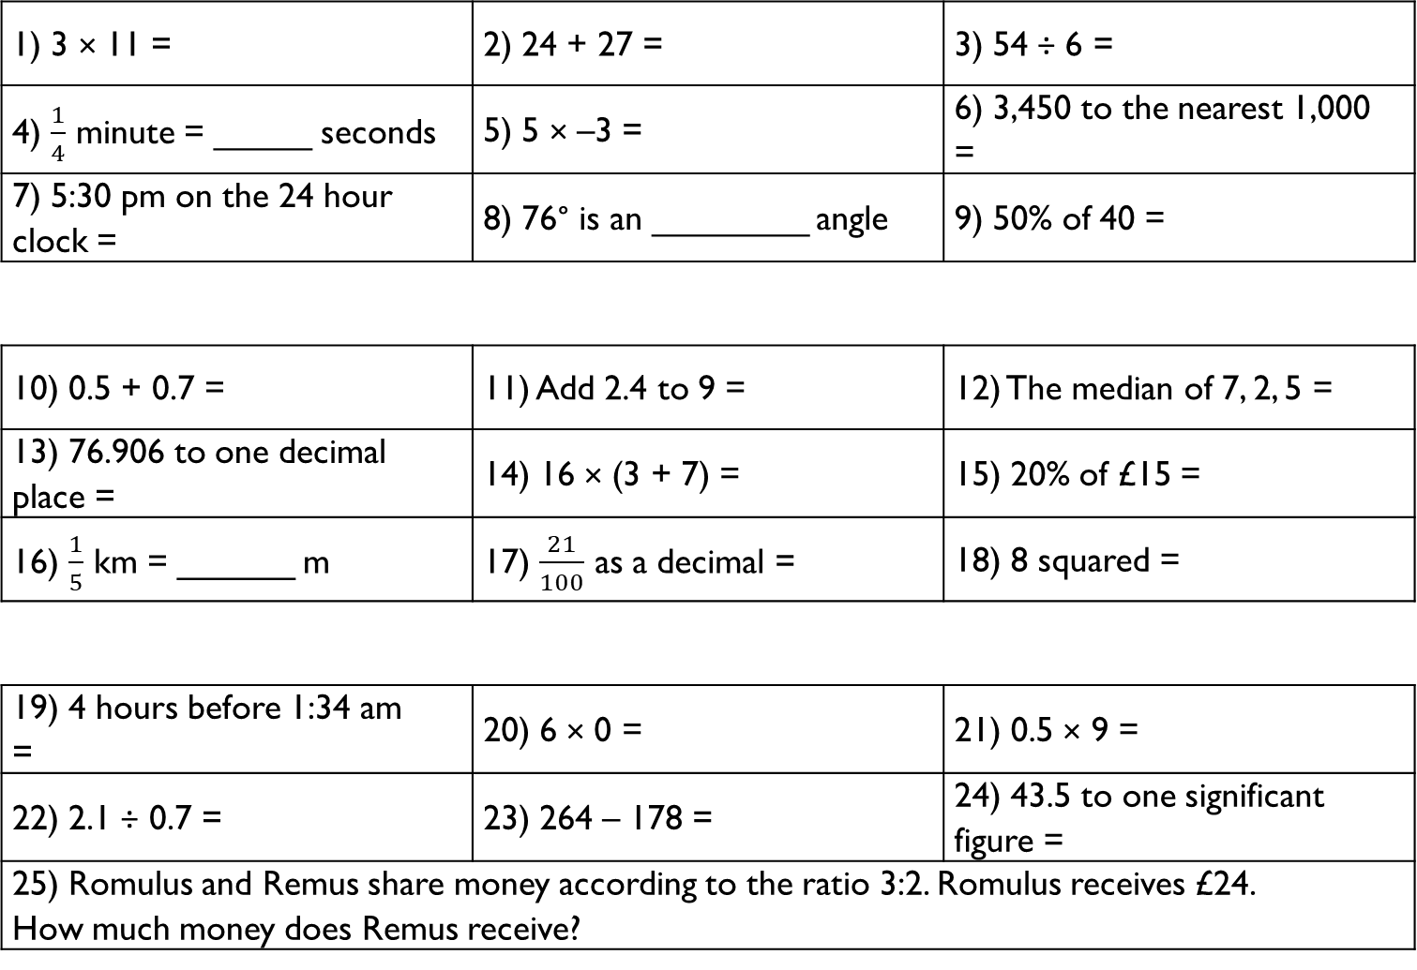
1) 3 × 11 = | 2) 24 + 27 = | 3) 54 ÷ 6 =
4) $\frac{1}{4}$ minute = _____ seconds | 5) 5 × –3 = | 6) 3,450 to the nearest 1,000 =
7) 5:30 pm on the 24 hour clock = | 8) 76° is an ________ angle | 9) 50% of 40 =
10) 0.5 + 0.7 = | 11) Add 2.4 to 9 = | 12) The median of 7, 2, 5 =
13) 76.906 to one decimal place = | 14) 16 × (3 + 7) = | 15) 20% of £15 =
16) $\frac{1}{5}$ km = ______ m | 17) $\frac{21}{100}$ as a decimal = | 18) 8 squared =
19) 4 hours before 1:34 am = | 20) 6 × 0 = | 21) 0.5 × 9 =
22) 2.1 ÷ 0.7 = | 23) 264 – 178 = | 24) 43.5 to one significant figure =
25) Romulus and Remus share money according to the ratio 3:2. Romulus receives £24. How much money does Remus receive?
Gladiator
Numeracy with the Romans
Session 10
Citizen
Emperor

Slide 24
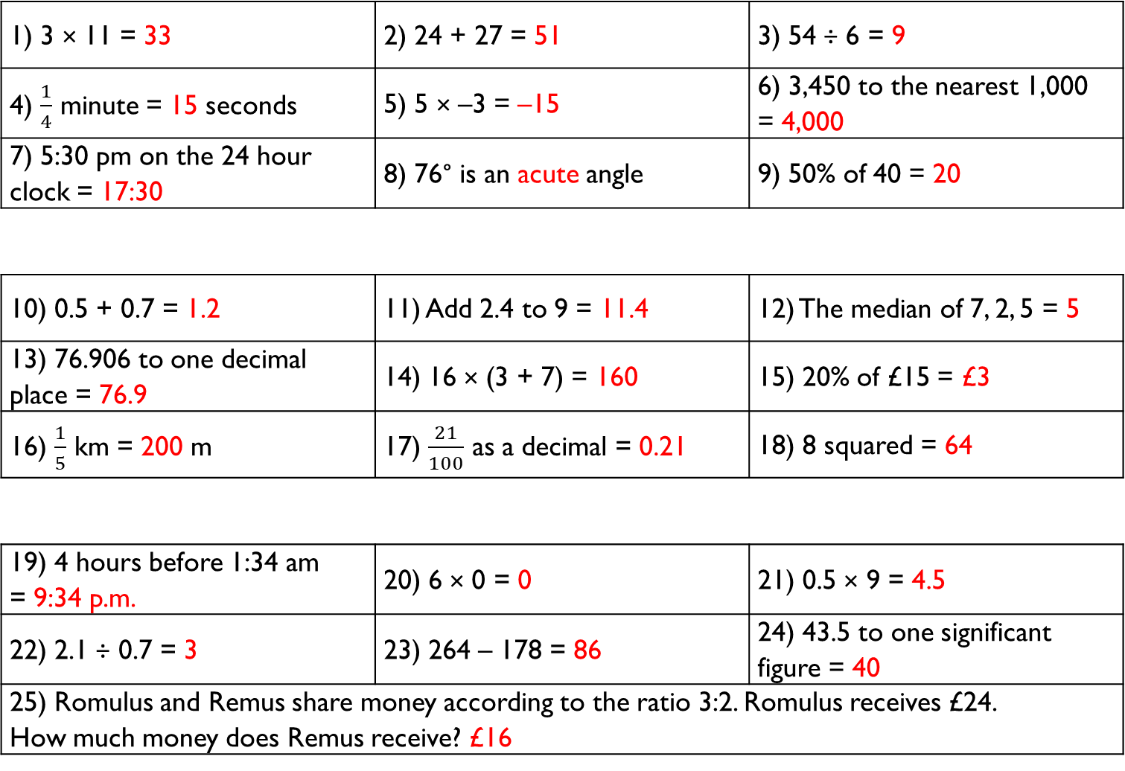
1) 3 × 11 = 33 | 2) 24 + 27 = 51 | 3) 54 ÷ 6 = 9
4) $\frac{1}{4}$ minute = 15 seconds | 5) 5 × –3 = –15 | 6) 3,450 to the nearest 1,000 = 4,000
7) 5:30 pm on the 24 hour clock = 17:30 | 8) 76° is an acute angle | 9) 50% of 40 = 20
10) 0.5 + 0.7 = 1.2 | 11) Add 2.4 to 9 = 11.4 | 12) The median of 7, 2, 5 = 5
13) 76.906 to one decimal place = 76.9 | 14) 16 × (3 + 7) = 160 | 15) 20% of £15 = £3
16) $\frac{1}{5}$ km = 200 m | 17) $\frac{21}{100}$ as a decimal = 0.21 | 18) 8 squared = 64
19) 4 hours before 1:34 am = 9:34 p.m. | 20) 6 × 0 = 0 | 21) 0.5 × 9 = 4.5
22) 2.1 ÷ 0.7 = 3 | 23) 264 – 178 = 86 | 24) 43.5 to one significant figure = 40
25) Romulus and Remus share money according to the ratio 3:2. Romulus receives £24. How much money does Remus receive? £16
Gladiator
Numeracy with the Romans
Answers for Session 10
Citizen
Emperor

Slide 25
1) How many people lived in the Roman Empire when it was at its peak?
__________________________________________________________
2) When was Rome established by the twin Brothers Romulus and Remus?
__________________________________________________________
3) Who was the last king of the empire?
__________________________________________________________
4) Who was Rome’s most powerful general in 49 B.C.?
__________________________________________________________
5) Who was the Empire’s first Emperor?
__________________________________________________________
6) Which animals did Claudius bring to Britain?
__________________________________________________________
7) How many Celtic tribes were living in Wales before the Romans arrived?
__________________________________________________________
8) When was Caratacus defeated in battle?
__________________________________________________________
Numeracy with the Romans
History Revision 01–10

Slide 26
1) How many people lived in the Roman Empire when it was at its peak?
45 million
2) When was Rome established by the twin Brothers Romulus and Remus?
753 B.C.
3) Who was the last king of the empire?
Tarquinius Superbus
4) Who was Rome’s most powerful general in 49 B.C.?
Julius Caesar
5) Who was the Empire’s first Emperor?
Octavianus / Augustus
6) Which animals did Claudius bring to Britain?
War Elephants
7) How many Celtic tribes were living in Wales before the Romans arrived?
5
8) When was Caratacus defeated in battle?
51 A.D.
Numeracy with the Romans
History Revision Answers 01–10

Slide 27
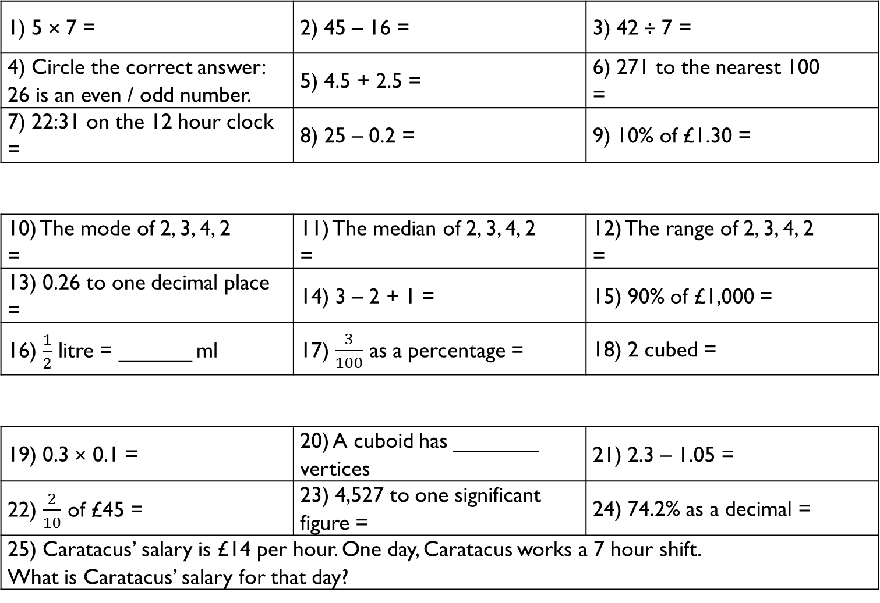
1) 5 × 7 = | 2) 45 – 16 = | 3) 42 ÷ 7 =
4) Circle the correct answer: 26 is an even / odd number. | 5) 4.5 + 2.5 = | 6) 271 to the nearest 100 =
7) 22:31 on the 12 hour clock = | 8) 25 – 0.2 = | 9) 10% of £1.30 =
10) The mode of 2, 3, 4, 2 = | 11) The median of 2, 3, 4, 2 = | 12) The range of 2, 3, 4, 2 =
13) 0.26 to one decimal place = | 14) 3 – 2 + 1 = | 15) 90% of £1,000 =
16) $\frac{1}{2}$ litre = ______ ml | 17) $\frac{3}{100}$ as a percentage = | 18) 2 cubed =
19) 0.3 × 0.1 = | 20) A cuboid has _______ vertices | 21) 2.3 – 1.05 =
22) $\frac{2}{10}$ of £45 = | 23) 4,527 to one significant figure = | 24) 74.2% as a decimal =
25) Caratacus’ salary is £14 per hour. One day, Caratacus works a 7 hour shift. What is Caratacus’ salary for that day?
Gladiator
Numeracy with the Romans
Session 11
Citizen
Emperor

Slide 28
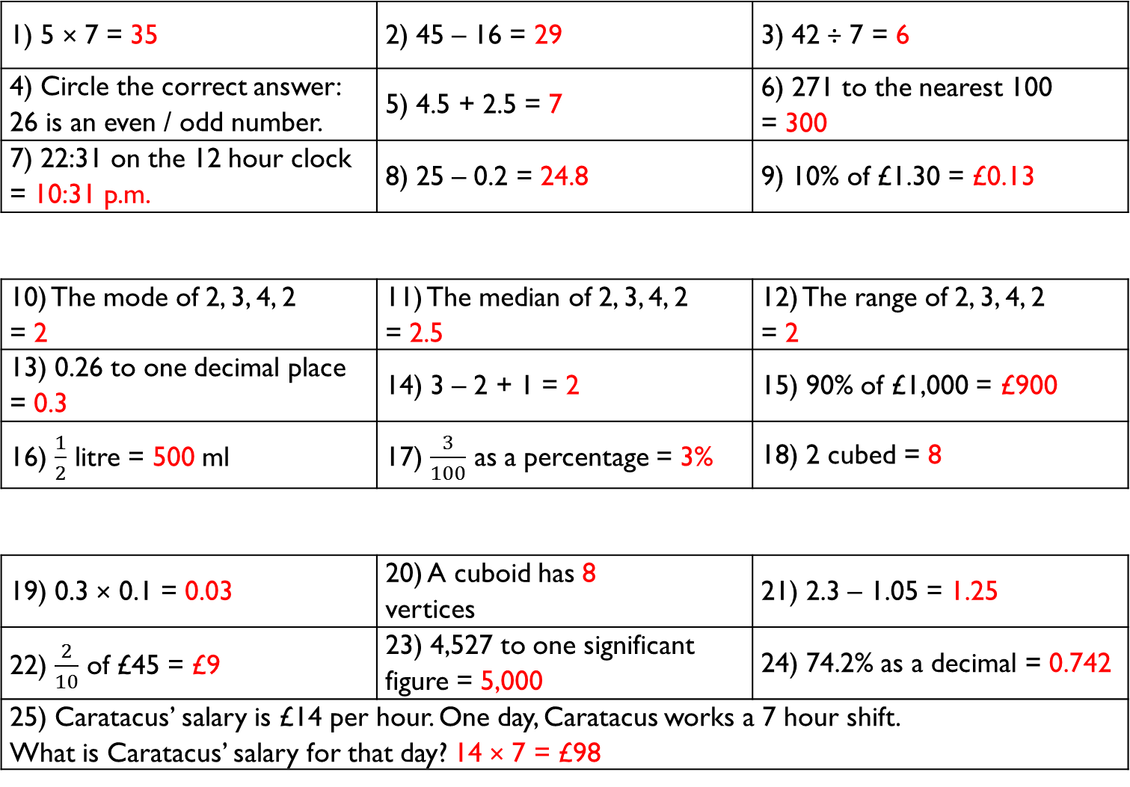
1) 5 × 7 = 35 | 2) 45 – 16 = 29 | 3) 42 ÷ 7 = 6
4) Circle the correct answer: 26 is an even / odd number. | 5) 4.5 + 2.5 = 7 | 6) 271 to the nearest 100 = 300
7) 22:31 on the 12 hour clock = 10:31 p.m. | 8) 25 – 0.2 = 24.8 | 9) 10% of £1.30 = £0.13
10) The mode of 2, 3, 4, 2 = 2 | 11) The median of 2, 3, 4, 2 = 2.5 | 12) The range of 2, 3, 4, 2 = 2
13) 0.26 to one decimal place = 0.3 | 14) 3 – 2 + 1 = 2 | 15) 90% of £1,000 = £900
16) $\frac{1}{2}$ litre = 500 ml | 17) $\frac{3}{100}$ as a percentage = 3% | 18) 2 cubed = 8
19) 0.3 × 0.1 = 0.03 | 20) A cuboid has 8 vertices | 21) 2.3 – 1.05 = 1.25
22) $\frac{2}{10}$ of £45 = £9 | 23) 4,527 to one significant figure = 5,000 | 24) 74.2% as a decimal = 0.742
25) Caratacus’ salary is £14 per hour. One day, Caratacus works a 7 hour shift. What is Caratacus’ salary for that day? 14 × 7 = £98
Gladiator
Numeracy with the Romans
Answers for Session 11
Citizen
Emperor

Slide 29
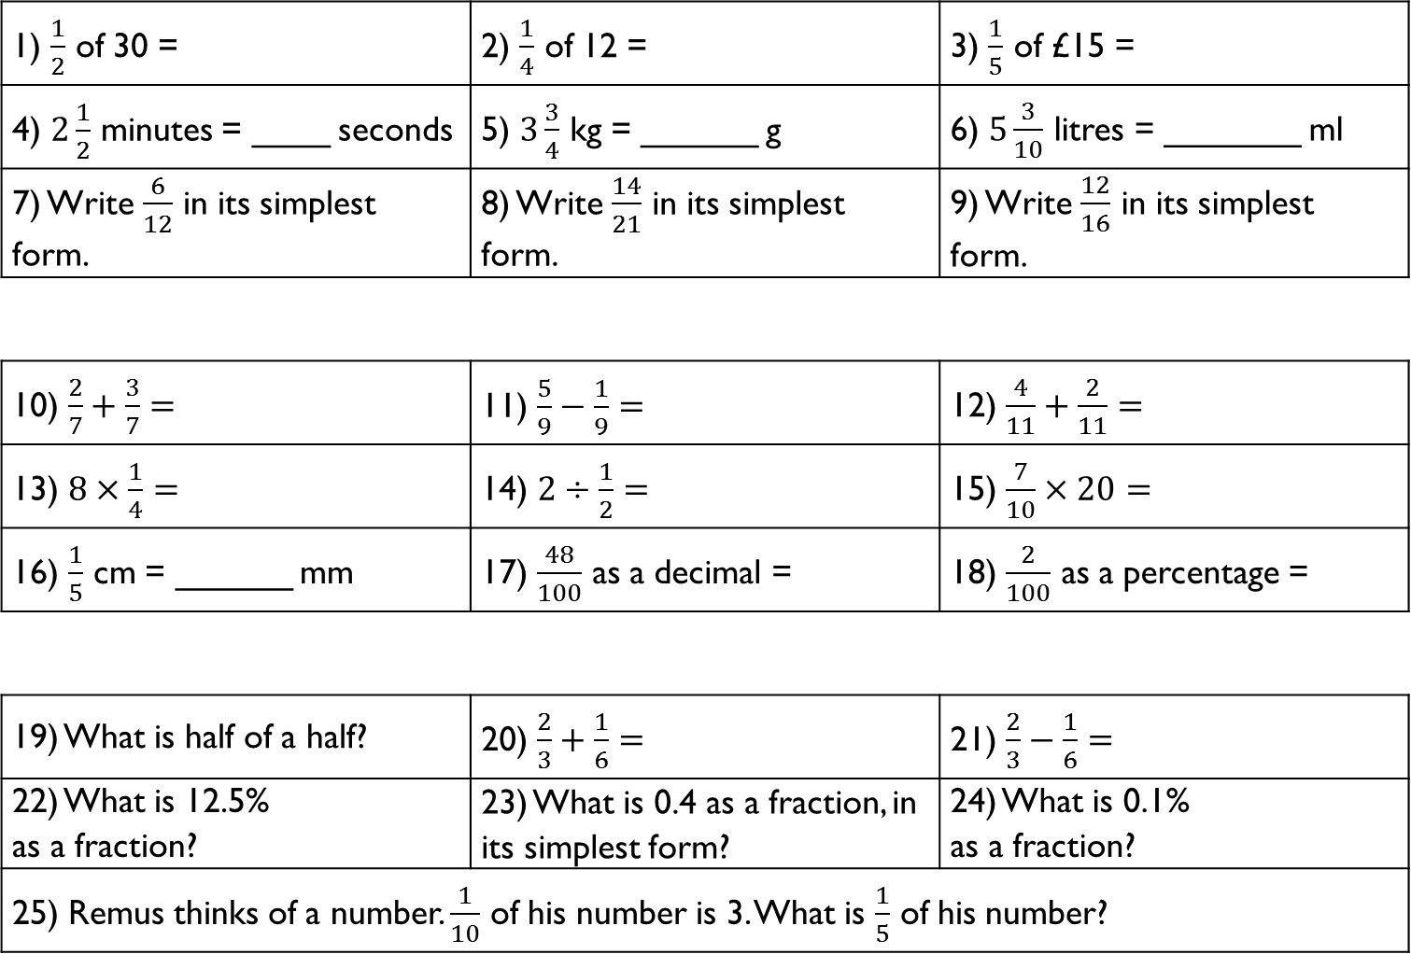
1) $\frac{1}{2}$ of 30 = | 2) $\frac{1}{4}$ of 12 = | 3) $\frac{1}{5}$ of £15 =
4) $2\frac{1}{2}$ minutes = ____ seconds | 5) $3\frac{3}{4}$ kg = ______ g | 6) $5\frac{3}{10}$ litres = _______ ml
7) Write $\frac{6}{12}$ in its simplest form. | 8) Write $\frac{14}{21}$ in its simplest form. | 9) Write $\frac{12}{16}$ in its simplest form.
10) $\frac{2}{7}+\frac{3}{7}=$ | 11) $\frac{5}{9}−\frac{1}{9}=$ | 12) $\frac{4}{11}+\frac{2}{11}=$
13) $8×\frac{1}{4}=$ | 14) $2÷\frac{1}{2}=$ | 15) $\frac{7}{10}×20=$
16) $\frac{1}{5}$ cm = ______ mm | 17) $\frac{48}{100}$ as a decimal = | 18) $\frac{2}{100}$ as a percentage =
19) What is half of a half? | 20) $\frac{2}{3}+\frac{1}{6}=$ | 21) $\frac{2}{3}−\frac{1}{6}=$
22) What is 12.5% as a fraction? | 23) What is 0.4 as a fraction, in its simplest form? | 24) What is 0.1% as a fraction?
25) Remus thinks of a number. $\frac{1}{10}$ of his number is 3. What is $\frac{1}{5}$ of his number?
Gladiator
Numeracy with the Romans
Session 12
Citizen
Emperor

Slide 30
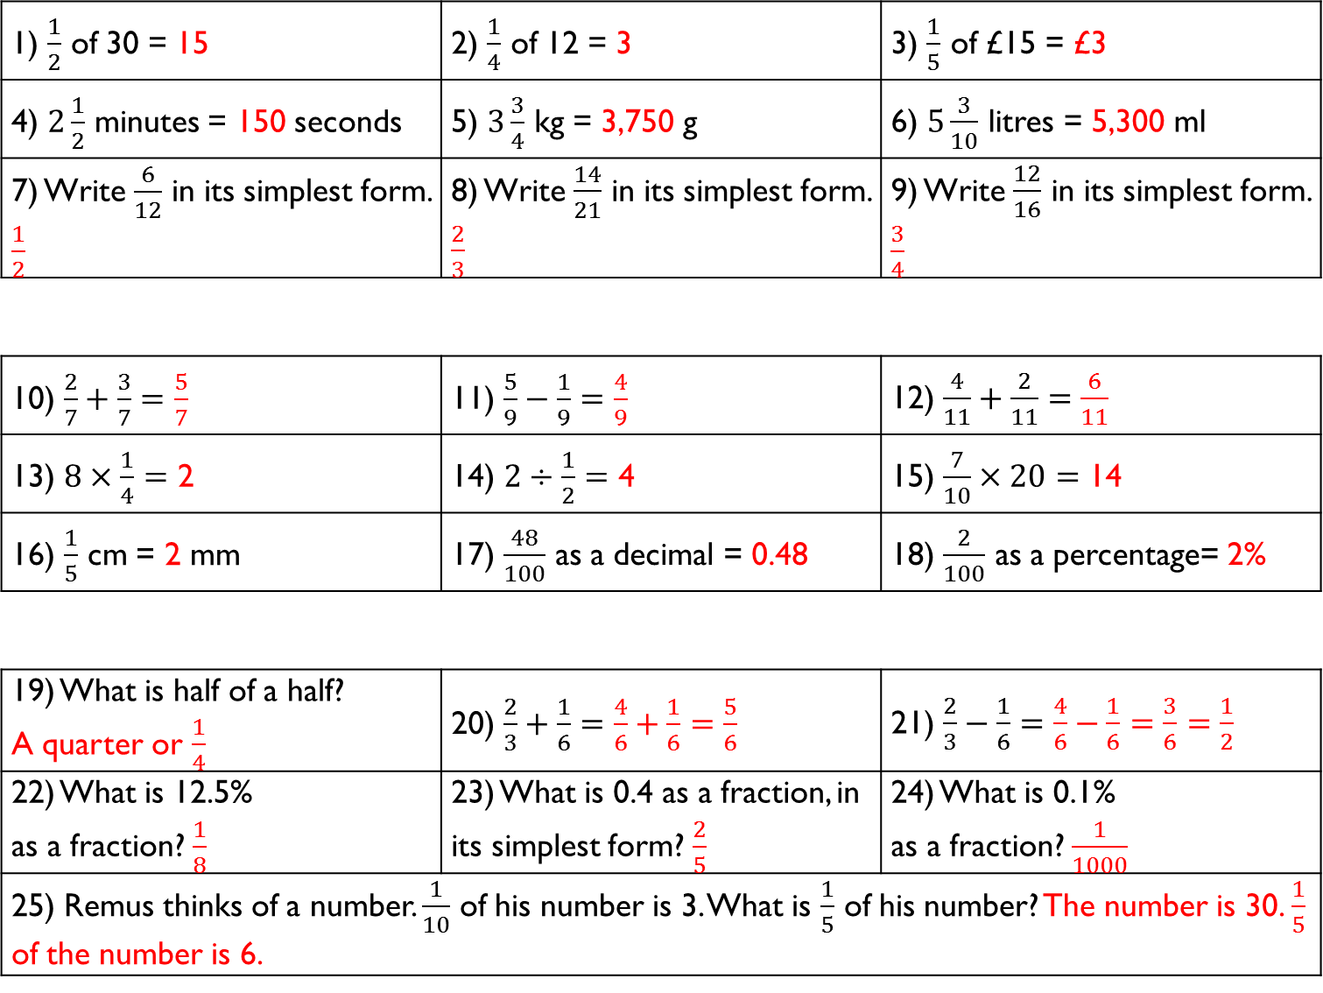
1) $\frac{1}{2}$ of 30 = 15 | 2) $\frac{1}{4}$ of 12 = 3 | 3) $\frac{1}{5}$ of £15 = £3
4) $2\frac{1}{2}$ minutes = 150 seconds | 5) $3\frac{3}{4}$ kg = 3,750 g | 6) $5\frac{3}{10}$ litres = 5,300 ml
7) Write $\frac{6}{12}$ in its simplest form. $\frac{1}{2}$ | 8) Write $\frac{14}{21}$ in its simplest form. $\frac{2}{3}$ | 9) Write $\frac{12}{16}$ in its simplest form. $\frac{3}{4}$
10) $\frac{2}{7}+\frac{3}{7}=\frac{5}{7}$ | 11) $\frac{5}{9}−\frac{1}{9}=\frac{4}{9}$ | 12) $\frac{4}{11}+\frac{2}{11}=\frac{6}{11}$
13) $8×\frac{1}{4}=$ 2 | 14) $2÷\frac{1}{2}=$ 4 | 15) $\frac{7}{10}×20=$ 14
16) $\frac{1}{5}$ cm = 2 mm | 17) $\frac{48}{100}$ as a decimal = 0.48 | 18) $\frac{2}{100}$ as a percentage= 2%
19) What is half of a half? A quarter or $\frac{1}{4}$ | 20) $\frac{2}{3}+\frac{1}{6}=\frac{4}{6}+\frac{1}{6}=\frac{5}{6}$ | 21) $\frac{2}{3}−\frac{1}{6}=\frac{4}{6}−\frac{1}{6}=\frac{3}{6}=\frac{1}{2}$
22) What is 12.5% as a fraction? $\frac{1}{8}$ | 23) What is 0.4 as a fraction, in its simplest form? $\frac{2}{5}$ | 24) What is 0.1% as a fraction? $\frac{1}{1000}$
25) Remus thinks of a number. $\frac{1}{10}$ of his number is 3. What is $\frac{1}{5}$ of his number? The number is 30. $\frac{1}{5}$ of the number is 6.
Gladiator
Numeracy with the Romans
Answers for Session 12
Citizen
Emperor

Slide 31
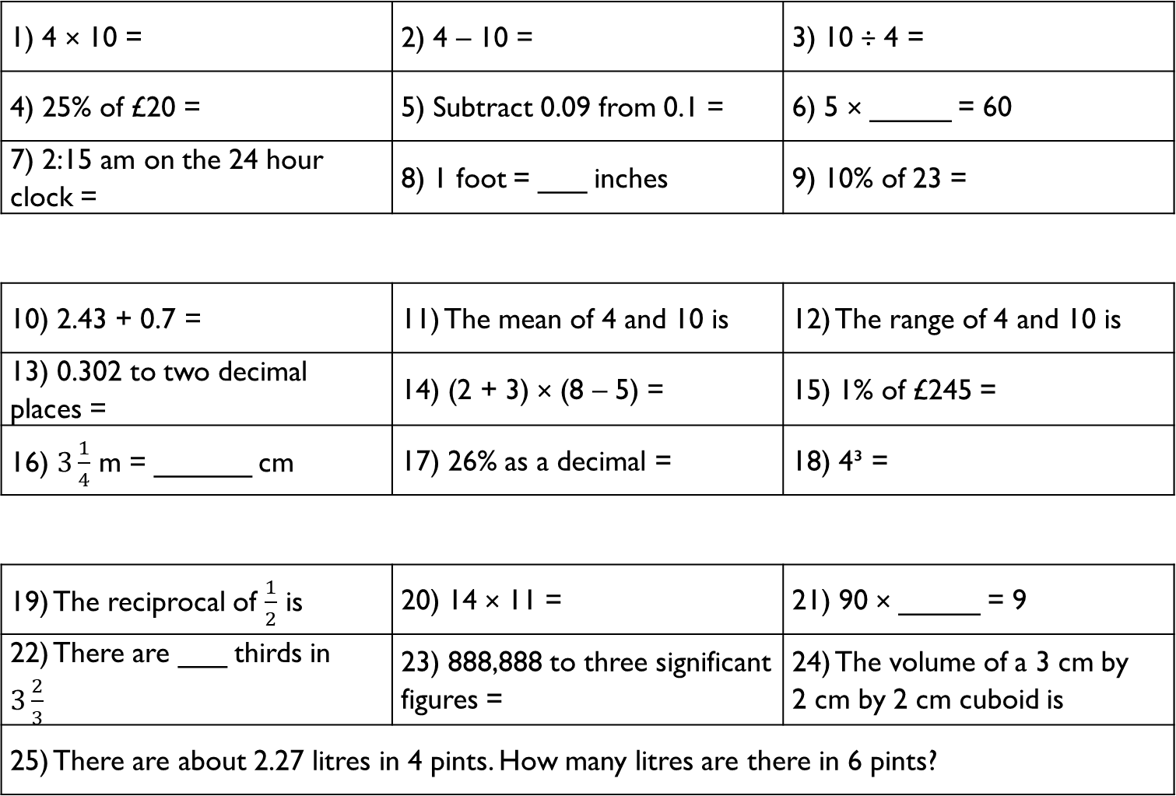
1) 4 × 10 = | 2) 4 – 10 = | 3) 10 ÷ 4 =
4) 25% of £20 = | 5) Subtract 0.09 from 0.1 = | 6) 5 × _____ = 60
7) 2:15 am on the 24 hour clock = | 8) 1 foot = ___ inches | 9) 10% of 23 =
10) 2.43 + 0.7 = | 11) The mean of 4 and 10 is | 12) The range of 4 and 10 is
13) 0.302 to two decimal places = | 14) (2 + 3) × (8 – 5) = | 15) 1% of £245 =
16) $3\frac{1}{4}$ m = ______ cm | 17) 26% as a decimal = | 18) 4³ =
19) The reciprocal of $\frac{1}{2}$ is | 20) 14 × 11 = | 21) 90 × _____ = 9
22) There are ___ thirds in $3\frac{2}{3}$ | 23) 888,888 to three significant figures = | 24) The volume of a 3 cm by 2 cm by 2 cm cuboid is
25) There are about 2.27 litres in 4 pints. How many litres are there in 6 pints?
Gladiator
Numeracy with the Romans
Session 13
Citizen
Emperor

Slide 32
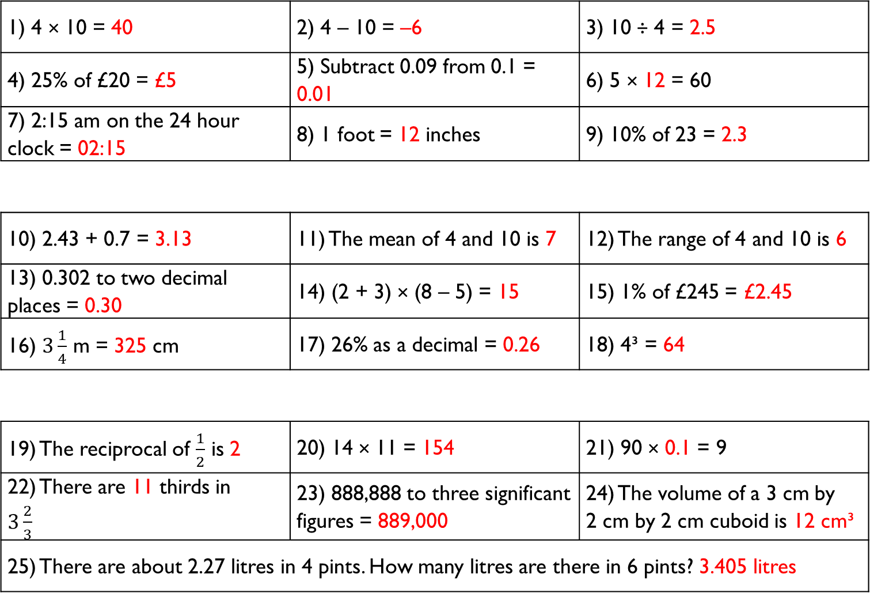
1) 4 × 10 = 40 | 2) 4 – 10 = –6 | 3) 10 ÷ 4 = 2.5
4) 25% of £20 = £5 | 5) Subtract 0.09 from 0.1 = 0.01 | 6) 5 × 12 = 60
7) 2:15 am on the 24 hour clock = 02:15 | 8) 1 foot = 12 inches | 9) 10% of 23 = 2.3
10) 2.43 + 0.7 = 3.13 | 11) The mean of 4 and 10 is 7 | 12) The range of 4 and 10 is 6
13) 0.302 to two decimal places = 0.30 | 14) (2 + 3) × (8 – 5) = 15 | 15) 1% of £245 = £2.45
16) $3\frac{1}{4}$ m = 325 cm | 17) 26% as a decimal = 0.26 | 18) 4³ = 64
19) The reciprocal of $\frac{1}{2}$ is 2 | 20) 14 × 11 = 154 | 21) 90 × 0.1 = 9
22) There are 11 thirds in $3\frac{2}{3}$ | 23) 888,888 to three significant figures = 889,000 | 24) The volume of a 3 cm by 2 cm by 2 cm cuboid is 12 cm³
25) There are about 2.27 litres in 4 pints. How many litres are there in 6 pints? 3.405 litres
Gladiator
Numeracy with the Romans
Answers for Session 13
Citizen
Emperor

Slide 33
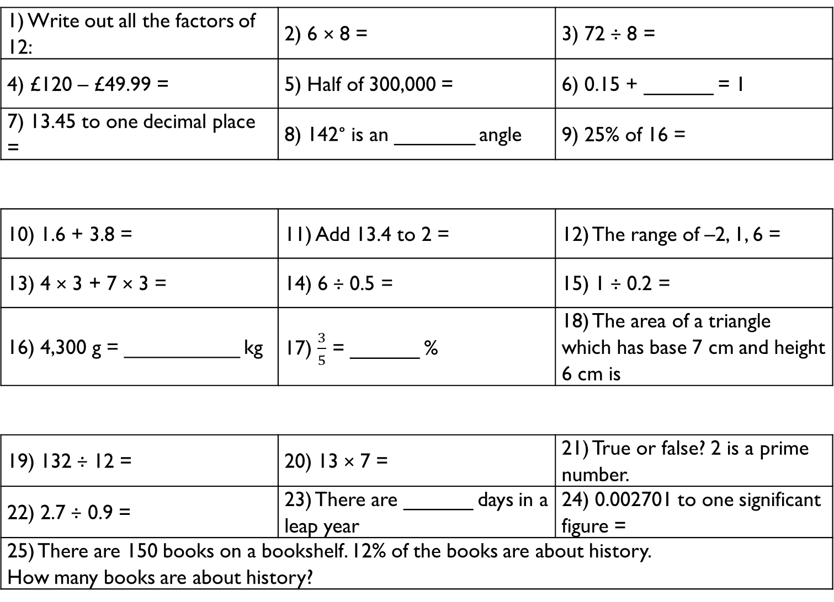
1) Write out all the factors of 12: | 2) 6 × 8 = | 3) 72 ÷ 8 =
4) £120 – £49.99 = | 5) Half of 300,000 = | 6) 0.15 + ______ = 1
7) 13.45 to one decimal place = | 8) 142° is an _______ angle | 9) 25% of 16 =
10) 1.6 + 3.8 = | 11) Add 13.4 to 2 = | 12) The range of –2, 1, 6 =
13) 4 × 3 + 7 × 3 = | 14) 6 ÷ 0.5 = | 15) 1 ÷ 0.2 =
16) 4,300 g = __________ kg | 17) $\frac{3}{5}$ = ______ % | 18) The area of a triangle which has base 7 cm and height 6 cm is
19) 132 ÷ 12 = | 20) 13 × 7 = | 21) True or false? 2 is a prime number.
22) 2.7 ÷ 0.9 = | 23) There are ______ days in a leap year | 24) 0.002701 to one significant figure =
25) There are 150 books on a bookshelf. 12% of the books are about history. How many books are about history?
Gladiator
Numeracy with the Romans
Session 14
Citizen
Emperor

Slide 34
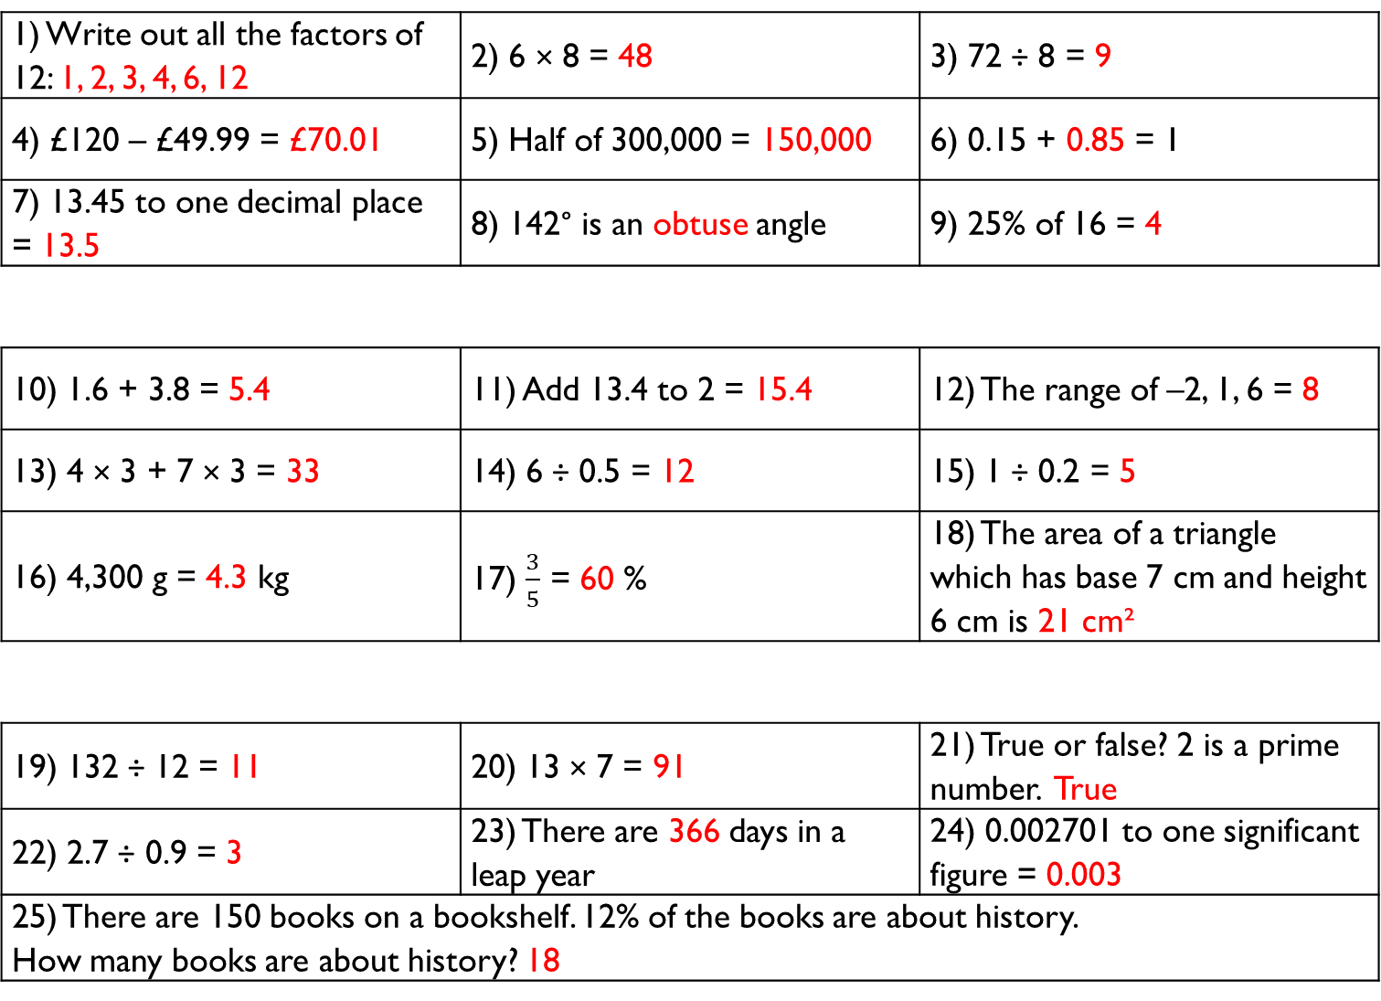
1) Write out all the factors of 12: 1, 2, 3, 4, 6, 12 | 2) 6 × 8 = 48 | 3) 72 ÷ 8 = 9
4) £120 – £49.99 = £70.01 | 5) Half of 300,000 = 150,000 | 6) 0.15 + 0.85 = 1
7) 13.45 to one decimal place = 13.5 | 8) 142° is an obtuse angle | 9) 25% of 16 = 4
10) 1.6 + 3.8 = 5.4 | 11) Add 13.4 to 2 = 15.4 | 12) The range of –2, 1, 6 = 8
13) 4 × 3 + 7 × 3 = 33 | 14) 6 ÷ 0.5 = 12 | 15) 1 ÷ 0.2 = 5
16) 4,300 g = 4.3 kg | 17) $\frac{3}{5}$ = 60 % | 18) The area of a triangle which has base 7 cm and height 6 cm is 21 cm²
19) 132 ÷ 12 = 11 | 20) 13 × 7 = 91 | 21) True or false? 2 is a prime number. True
22) 2.7 ÷ 0.9 = 3 | 23) There are 366 days in a leap year | 24) 0.002701 to one significant figure = 0.003
25) There are 150 books on a bookshelf. 12% of the books are about history. How many books are about history? 18
Gladiator
Numeracy with the Romans
Answers for Session 14
Citizen
Emperor

Slide 35
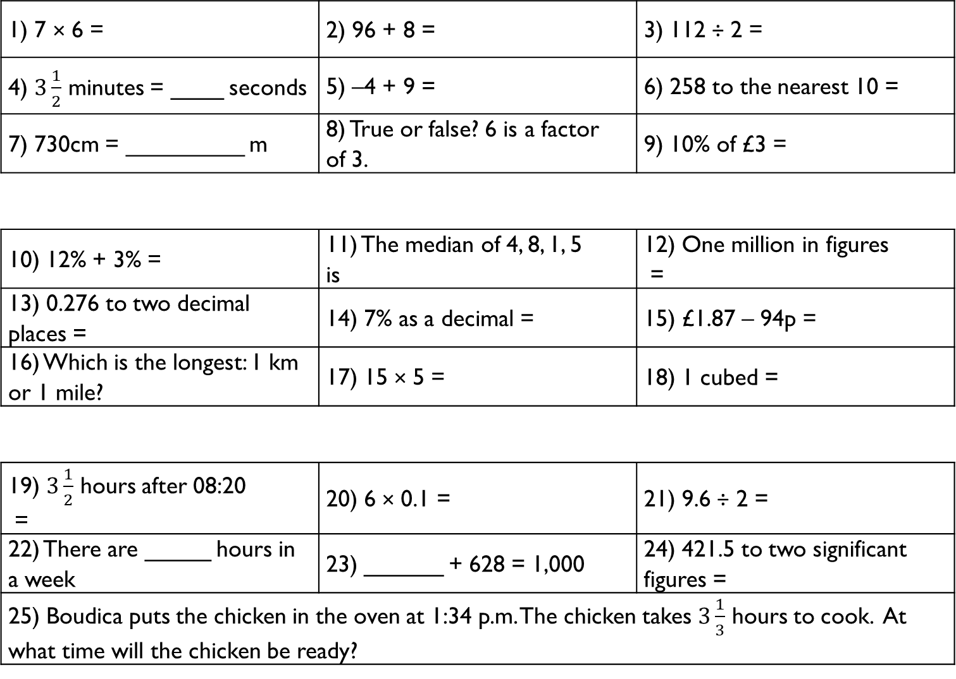
1) 7 × 6 = | 2) 96 + 8 = | 3) 112 ÷ 2 =
4) $3\frac{1}{2}$ minutes = ____ seconds | 5) –4 + 9 = | 6) 258 to the nearest 10 =
7) 730cm = _________ m | 8) True or false? 6 is a factor of 3. | 9) 10% of £3 =
10) 12% + 3% = | 11) The median of 4, 8, 1, 5 is | 12) One million in figures =
13) 0.276 to two decimal places = | 14) 7% as a decimal = | 15) £1.87 – 94p =
16) Which is the longest: 1 km or 1 mile? | 17) 15 × 5 = | 18) 1 cubed =
19) $3\frac{1}{2}$ hours after 08:20 = | 20) 6 × 0.1 = | 21) 9.6 ÷ 2 =
22) There are _____ hours in a week | 23) ______ + 628 = 1,000 | 24) 421.5 to two significant figures =
25) Boudica puts the chicken in the oven at 1:34 p.m. The chicken takes $3\frac{1}{3}$ hours to cook. At what time will the chicken be ready?
Gladiator
Numeracy with the Romans
Session 15
Citizen
Emperor

Slide 36
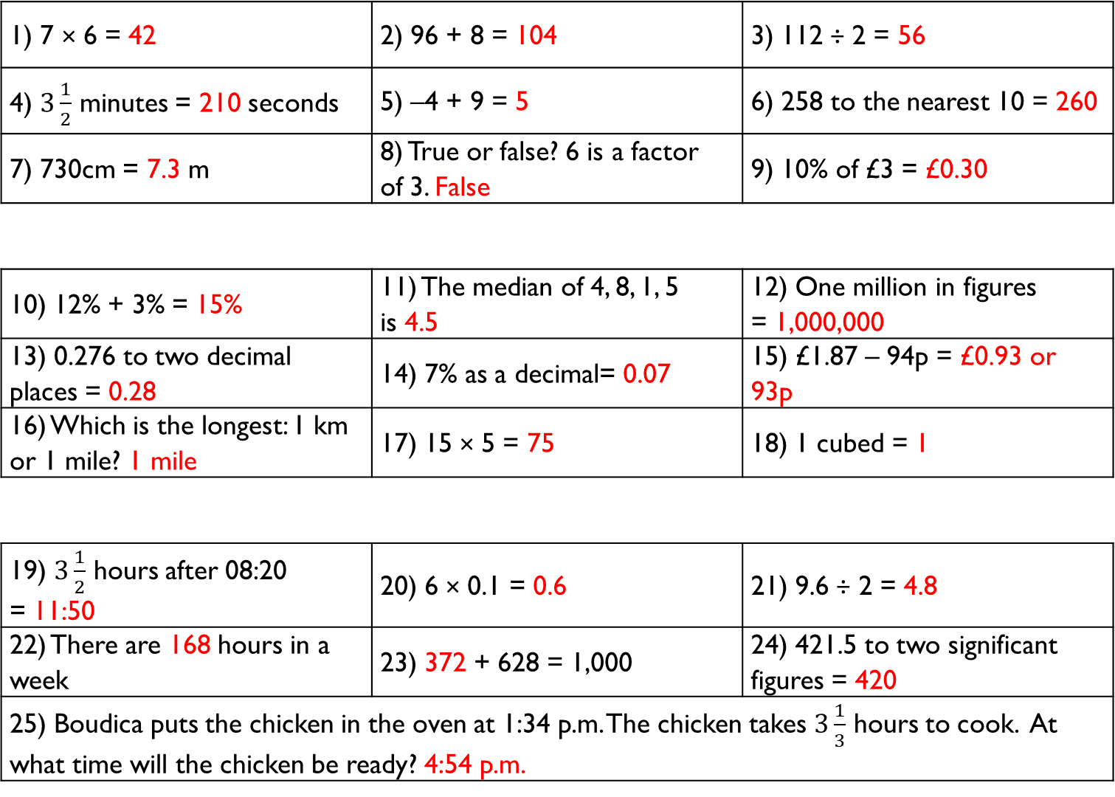
1) 7 × 6 = 42 | 2) 96 + 8 = 104 | 3) 112 ÷ 2 = 56
4) $3\frac{1}{2}$ minutes = 210 seconds | 5) –4 + 9 = 5 | 6) 258 to the nearest 10 = 260
7) 730cm = 7.3 m | 8) True or false? 6 is a factor of 3. False | 9) 10% of £3 = £0.30
10) 12% + 3% = 15% | 11) The median of 4, 8, 1, 5 is 4.5 | 12) One million in figures = 1,000,000
13) 0.276 to two decimal places = 0.28 | 14) 7% as a decimal= 0.07 | 15) £1.87 – 94p = £0.93 or 93p
16) Which is the longest: 1 km or 1 mile? 1 mile | 17) 15 × 5 = 75 | 18) 1 cubed = 1
19) $3\frac{1}{2}$ hours after 08:20 = 11:50 | 20) 6 × 0.1 = 0.6 | 21) 9.6 ÷ 2 = 4.8
22) There are 168 hours in a week | 23) 372 + 628 = 1,000 | 24) 421.5 to two significant figures = 420
25) Boudica puts the chicken in the oven at 1:34 p.m. The chicken takes $3\frac{1}{3}$ hours to cook. At what time will the chicken be ready? 4:54 p.m.
Gladiator
Numeracy with the Romans
Answers for Session 15
Citizen
Emperor

Slide 37
1) 1.2 + 1.5 = | 2) 3 – 0.2 = | 3) £1.48 + £0.50 =
4) 2 × 0.6 = | 5) 2.4 ÷ 2 = | 6) Circle the largest number: 0.208 0.082 0.28
7) 2.5 × 10 = | 8) 164 ÷ 10 = | 9) 5.6 ÷ 100 =
10) 0.26 as a percentage = | 11) 0.8 as a percentage = | 12) 0.02 as a percentage =
13) 0.5 as a fraction = | 14) 0.17 as a fraction = | 15) 0.2 as a fraction =
16) 1.24 + 0.41 = | 17) 2.43 – 1.27 = | 18) 0.7 × 11 =
19) The reciprocal of 0.5 is | 20) The reciprocal of 0.2 is | 21) The reciprocal of 0.1 is
22) Half of 0.45 = | 23) 0.2 + 0.3 × 2 = | 24) 0.4 × 0.1 =
25) Romulus buys 5 loaves of bread, which cost £1.25 each. How much does Romulus pay for all the bread?
Gladiator
Numeracy with the Romans
Session 16
Citizen
Emperor

Slide 38
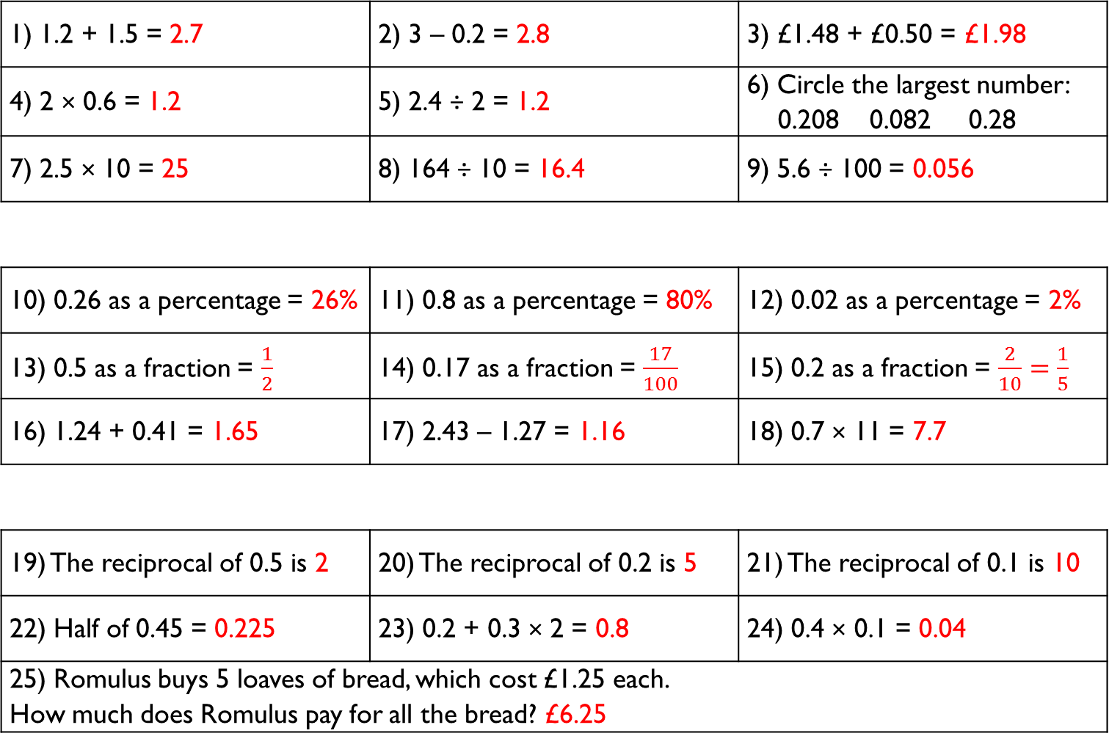
1) 1.2 + 1.5 = 2.7 | 2) 3 – 0.2 = 2.8 | 3) £1.48 + £0.50 = £1.98
4) 2 × 0.6 = 1.2 | 5) 2.4 ÷ 2 = 1.2 | 6) Circle the largest number: 0.208 0.082 0.28
7) 2.5 × 10 = 25 | 8) 164 ÷ 10 = 16.4 | 9) 5.6 ÷ 100 = 0.056
10) 0.26 as a percentage = 26% | 11) 0.8 as a percentage = 80% | 12) 0.02 as a percentage = 2%
13) 0.5 as a fraction = $\frac{1}{2}$ | 14) 0.17 as a fraction = $\frac{17}{100}$ | 15) 0.2 as a fraction = $\frac{2}{10}=\frac{1}{5}$
16) 1.24 + 0.41 = 1.65 | 17) 2.43 – 1.27 = 1.16 | 18) 0.7 × 11 = 7.7
19) The reciprocal of 0.5 is 2 | 20) The reciprocal of 0.2 is 5 | 21) The reciprocal of 0.1 is 10
22) Half of 0.45 = 0.225 | 23) 0.2 + 0.3 × 2 = 0.8 | 24) 0.4 × 0.1 = 0.04
25) Romulus buys 5 loaves of bread, which cost £1.25 each. How much does Romulus pay for all the bread? £6.25
Gladiator
Numeracy with the Romans
Answers for Session 16
Citizen
Emperor

Slide 39
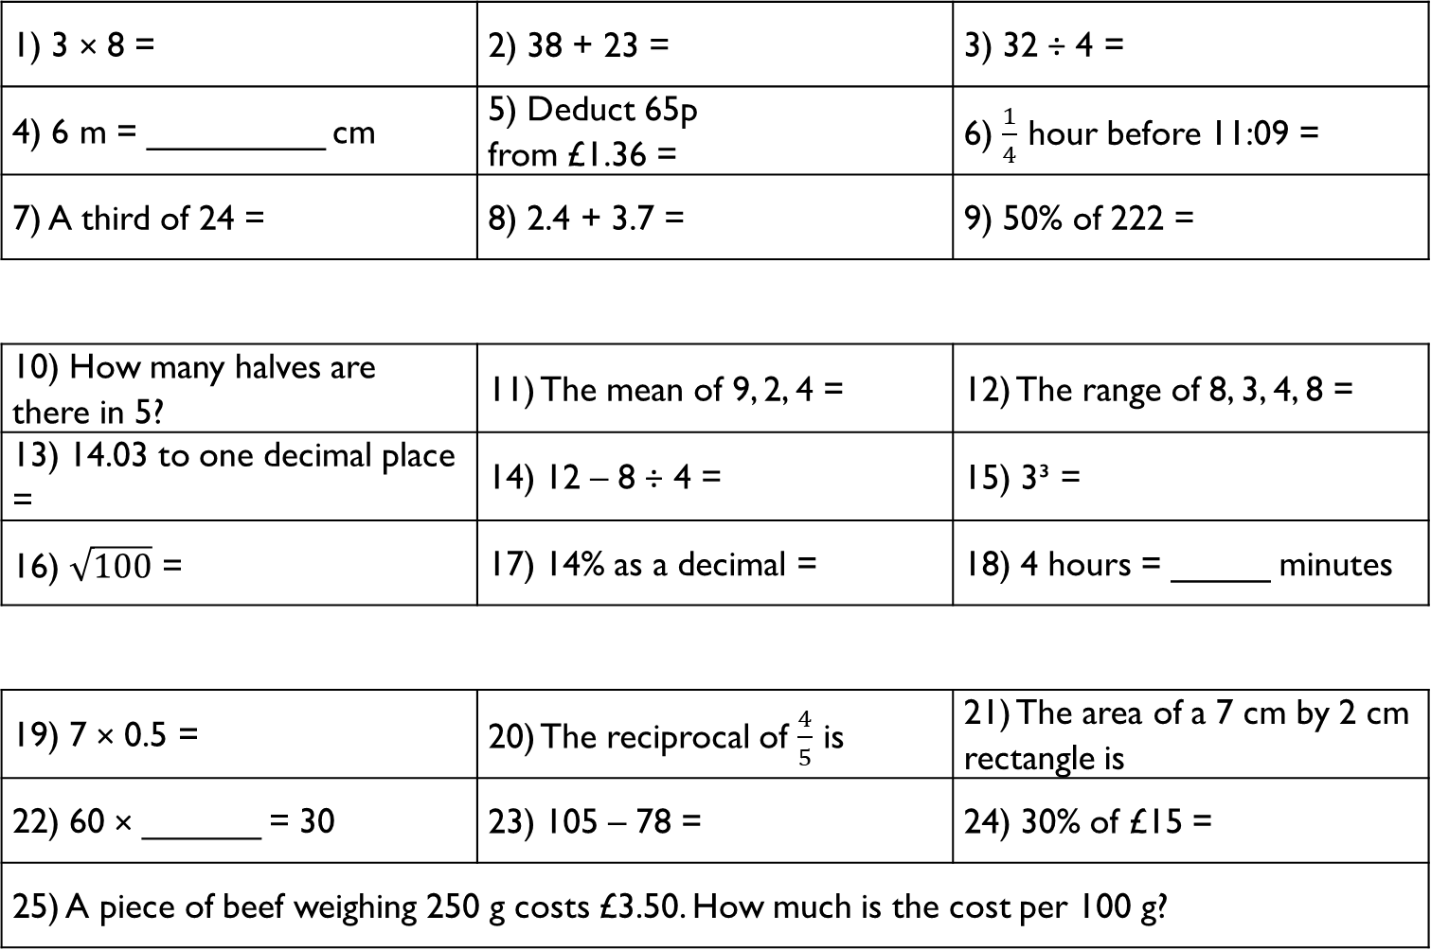
1) 3 × 8 = | 2) 38 + 23 = | 3) 32 ÷ 4 =
4) 6 m = _________ cm | 5) Deduct 65p from £1.36 = | 6) $\frac{1}{4}$ hour before 11:09 =
7) A third of 24 = | 8) 2.4 + 3.7 = | 9) 50% of 222 =
10) How many halves are there in 5? | 11) The mean of 9, 2, 4 = | 12) The range of 8, 3, 4, 8 =
13) 14.03 to one decimal place = | 14) 12 – 8 ÷ 4 = | 15) 3³ =
16) $\sqrt{100}$ = | 17) 14% as a decimal = | 18) 4 hours = _____ minutes
19) 7 × 0.5 = | 20) The reciprocal of $\frac{4}{5}$ is | 21) The area of a 7 cm by 2 cm rectangle is
22) 60 × ______ = 30 | 23) 105 – 78 = | 24) 30% of £15 =
25) A piece of beef weighing 250 g costs £3.50. How much is the cost per 100 g?
Gladiator
Numeracy with the Romans
Session 17
Citizen
Emperor

Slide 40
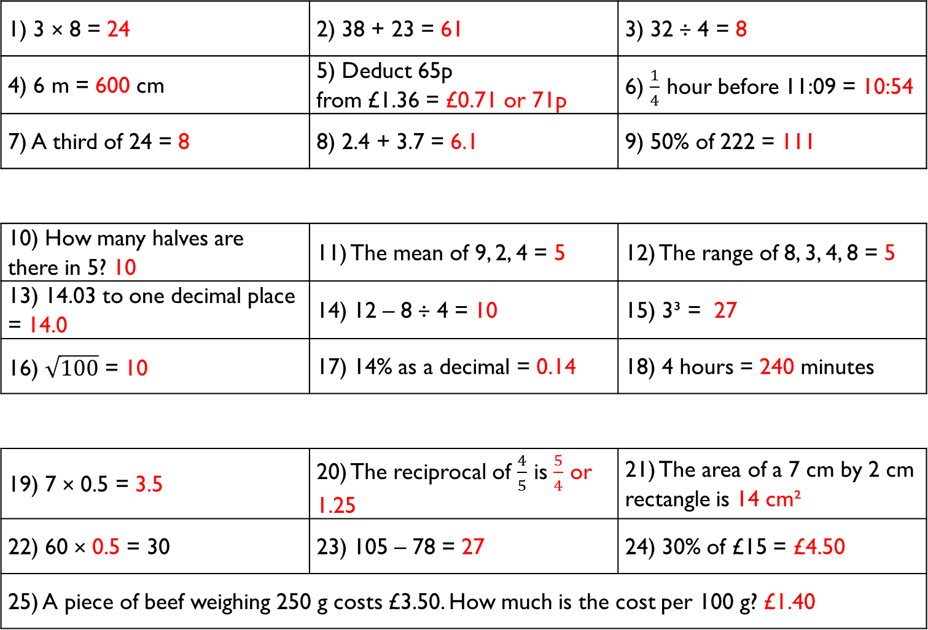
1) 3 × 8 = 24 | 2) 38 + 23 = 61 | 3) 32 ÷ 4 = 8
4) 6 m = 600 cm | 5) Deduct 65p from £1.36 = £0.71 or 71p | 6) $\frac{1}{4}$ hour before 11:09 = 10:54
7) A third of 24 = 8 | 8) 2.4 + 3.7 = 6.1 | 9) 50% of 222 = 111
10) How many halves are there in 5? 10 | 11) The mean of 9, 2, 4 = 5 | 12) The range of 8, 3, 4, 8 = 5
13) 14.03 to one decimal place = 14.0 | 14) 12 – 8 ÷ 4 = 10 | 15) 3³ = 27
16) $\sqrt{100}$ = 10 | 17) 14% as a decimal = 0.14 | 18) 4 hours = 240 minutes
19) 7 × 0.5 = 3.5 | 20) The reciprocal of $\frac{4}{5}$ is $\frac{5}{4}$ or 1.25 | 21) The area of a 7 cm by 2 cm rectangle is 14 cm²
22) 60 × 0.5 = 30 | 23) 105 – 78 = 27 | 24) 30% of £15 = £4.50
25) A piece of beef weighing 250 g costs £3.50. How much is the cost per 100 g? £1.40
Gladiator
Numeracy with the Romans
Answers for Session 17
Citizen
Emperor

Slide 41
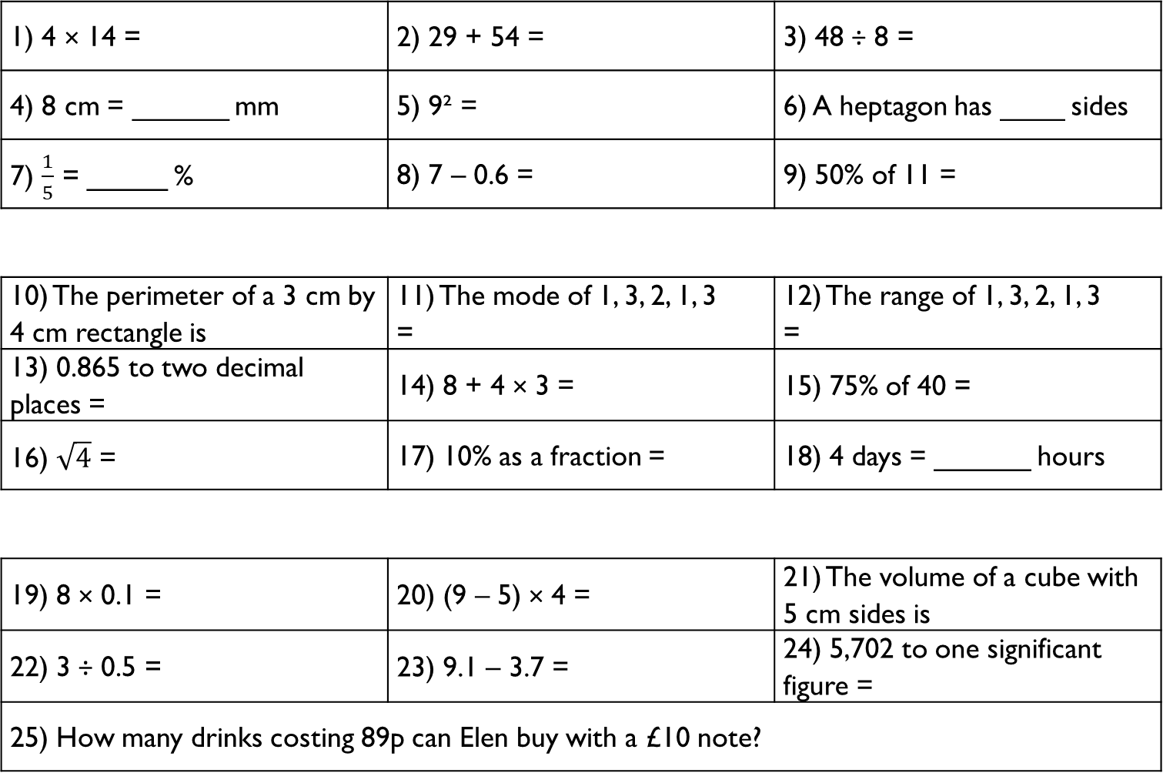
1) 4 × 14 = | 2) 29 + 54 = | 3) 48 ÷ 8 =
4) 8 cm = ______ mm | 5) 9² = | 6) A heptagon has ____ sides
7) $\frac{1}{5}$ = _____ % | 8) 7 – 0.6 = | 9) 50% of 11 =
10) The perimeter of a 3 cm by 4 cm rectangle is | 11) The mode of 1, 3, 2, 1, 3 = | 12) The range of 1, 3, 2, 1, 3 =
13) 0.865 to two decimal places = | 14) 8 + 4 × 3 = | 15) 75% of 40 =
16) $\sqrt{4}$ = | 17) 10% as a fraction = | 18) 4 days = ______ hours
19) 8 × 0.1 = | 20) (9 – 5) × 4 = | 21) The volume of a cube with 5 cm sides is
22) 3 ÷ 0.5 = | 23) 9.1 – 3.7 = | 24) 5,702 to one significant figure =
25) How many drinks costing 89p can Elen buy with a £10 note?
Gladiator
Numeracy with the Romans
Session 18
Citizen
Emperor

Slide 42
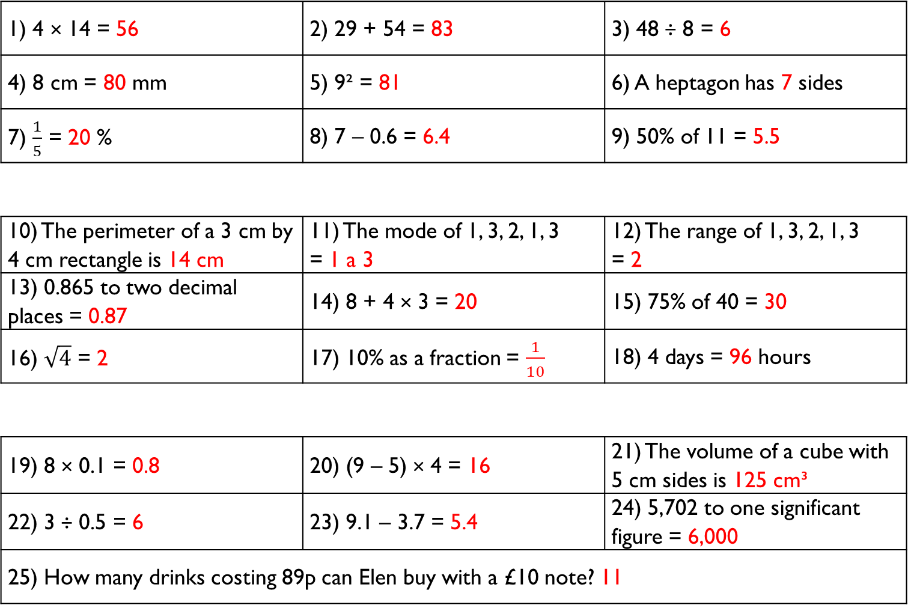
1) 4 × 14 = 56 | 2) 29 + 54 = 83 | 3) 48 ÷ 8 = 6
4) 8 cm = 80 mm | 5) 9² = 81 | 6) A heptagon has 7 sides
7) $\frac{1}{5}$ = 20 % | 8) 7 – 0.6 = 6.4 | 9) 50% of 11 = 5.5
10) The perimeter of a 3 cm by 4 cm rectangle is 14 cm | 11) The mode of 1, 3, 2, 1, 3 = 1 a 3 | 12) The range of 1, 3, 2, 1, 3 = 2
13) 0.865 to two decimal places = 0.87 | 14) 8 + 4 × 3 = 20 | 15) 75% of 40 = 30
16) $\sqrt{4}$ = 2 | 17) 10% as a fraction = $\frac{1}{10}$ | 18) 4 days = 96 hours
19) 8 × 0.1 = 0.8 | 20) (9 – 5) × 4 = 16 | 21) The volume of a cube with 5 cm sides is 125 cm³
22) 3 ÷ 0.5 = 6 | 23) 9.1 – 3.7 = 5.4 | 24) 5,702 to one significant figure = 6,000
25) How many drinks costing 89p can Elen buy with a £10 note? 11
Gladiator
Numeracy with the Romans
Answers for Session 18
Citizen
Emperor

Slide 43
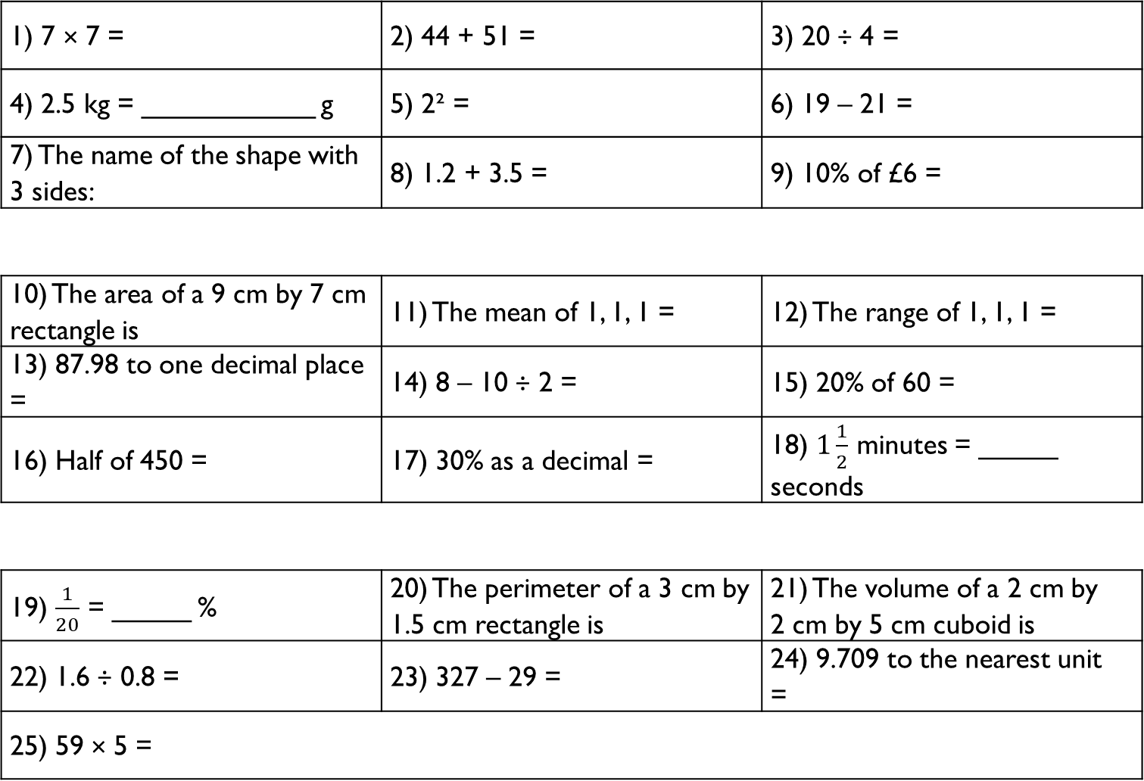
1) 7 × 7 = | 2) 44 + 51 = | 3) 20 ÷ 4 =
4) 2.5 kg = ___________ g | 5) 2² = | 6) 19 – 21 =
7) The name of the shape with 3 sides: | 8) 1.2 + 3.5 = | 9) 10% of £6 =
10) The area of a 9 cm by 7 cm rectangle is | 11) The mean of 1, 1, 1 = | 12) The range of 1, 1, 1 =
13) 87.98 to one decimal place = | 14) 8 – 10 ÷ 2 = | 15) 20% of 60 =
16) Half of 450 = | 17) 30% as a decimal = | 18) $1\frac{1}{2}$ minutes = _____ seconds
19) $\frac{1}{20}$ = _____ % | 20) The perimeter of a 3 cm by 1.5 cm rectangle is | 21) The volume of a 2 cm by 2 cm by 5 cm cuboid is
22) 1.6 ÷ 0.8 = | 23) 327 – 29 = | 24) 9.709 to the nearest unit =
25) 59 × 5 =
Gladiator
Numeracy with the Romans
Session 19
Citizen
Emperor

Slide 44
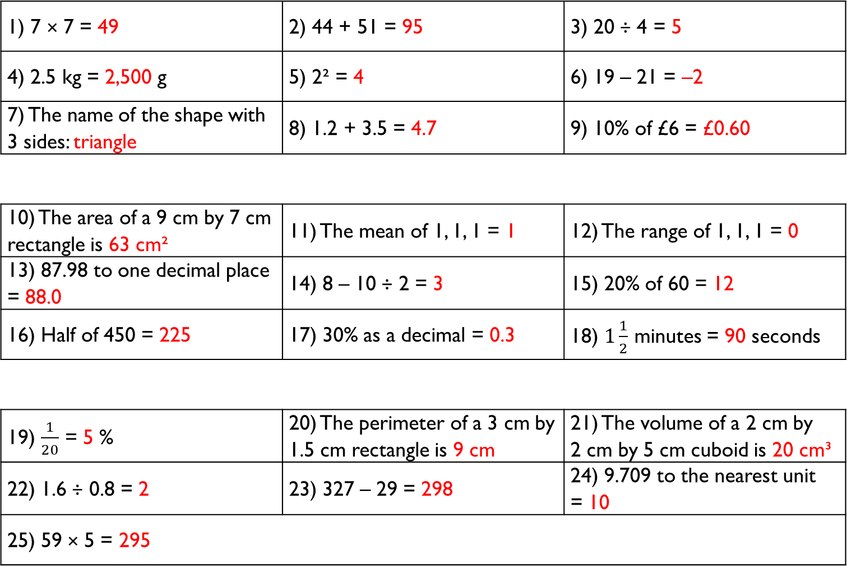
1) 7 × 7 = 49 | 2) 44 + 51 = 95 | 3) 20 ÷ 4 = 5
4) 2.5 kg = 2,500 g | 5) 2² = 4 | 6) 19 – 21 = –2
7) The name of the shape with 3 sides: triangle | 8) 1.2 + 3.5 = 4.7 | 9) 10% of £6 = £0.60
10) The area of a 9 cm by 7 cm rectangle is 63 cm² | 11) The mean of 1, 1, 1 = 1 | 12) The range of 1, 1, 1 = 0
13) 87.98 to one decimal place = 88.0 | 14) 8 – 10 ÷ 2 = 3 | 15) 20% of 60 = 12
16) Half of 450 = 225 | 17) 30% as a decimal = 0.3 | 18) $1\frac{1}{2}$ minutes = 90 seconds
19) $\frac{1}{20}$ = 5 % | 20) The perimeter of a 3 cm by 1.5 cm rectangle is 9 cm | 21) The volume of a 2 cm by 2 cm by 5 cm cuboid is 20 cm³
22) 1.6 ÷ 0.8 = 2 | 23) 327 – 29 = 298 | 24) 9.709 to the nearest unit = 10
25) 59 × 5 = 295
Gladiator
Numeracy with the Romans
Answers for Session 19
Citizen
Emperor

Slide 45
1) 6 × 2 = | 2) 6 × 6 = | 3) 6 × 9 =
4) 32 ÷ 4 = | 5) 49 ÷ 7 = | 6) 34 ÷ 2 =
7) 17 + 18 = | 8) 98 + 64 = | 9) 238 + 104 =
10) 2 + 3 × 5 = | 11) 8 + 12 ÷ 2 = | 12) 4 × 6 ÷ 2 =
13) 12 – 3 + 4 = | 14) 4 + (2 × 7) = | 15) 10 × 2 + 3 =
16) 1 × 2 + 3 × 4 = | 17) 16 ÷ 2 – 6 ÷ 2 = | 18) 3 + 4 × 5 – 2 =
19) 6 + 0.5 = | 20) 6 × 0.5 = | 21) 6 ÷ 0.5 =
22) £4.57 – £1.60 = | 23) £3.35 × 3 = | 24) £1.80 × 10 =
25) What is the difference between five dozens and three eighteens?
Gladiator
Numeracy with the Romans
Session 20
Citizen
Emperor

Slide 46
1) 6 × 2 = 12 | 2) 6 × 6 = 36 | 3) 6 × 9 = 54
4) 32 ÷ 4 = 8 | 5) 49 ÷ 7 = 7 | 6) 34 ÷ 2 = 17
7) 17 + 18 = 35 | 8) 98 + 64 = 162 | 9) 238 + 104 = 342
10) 2 + 3 × 5 = 17 | 11) 8 + 12 ÷ 2 = 14 | 12) 4 × 6 ÷ 2 = 12
13) 12 – 3 + 4 = 13 | 14) 4 + (2 × 7) = 18 | 15) 10 × 2 + 3 = 23
16) 1 × 2 + 3 × 4 = 14 | 17) 16 ÷ 2 – 6 ÷ 2 = 5 | 18) 3 + 4 × 5 – 2 = 21
19) 6 + 0.5 = 6.5 | 20) 6 × 0.5 = 3 | 21) 6 ÷ 0.5 = 12
22) £4.57 – £1.60 = £2.97 | 23) £3.35 × 3 = £10.05 | 24) £1.80 × 10 = £18
25) What is the difference between five dozens and three eighteens? 5 × 12 – 3 × 18 = 60 – 54 = 6
Gladiator
Numeracy with the Romans
Answers for Session 20
Citizen
Emperor

Slide 47
1) When did Boudica’s husband die?
__________________________________________________________
2) Why did the Romans travel to Anglesey?
__________________________________________________________
3) How many soldiers were there in Boudica’s army?
__________________________________________________________
4) What mineral was excavated at The Great Orme?
__________________________________________________________
5) What was the name of the road that connected North and South Wales?
__________________________________________________________
6) What was the name of the Romans’ fort in Caernarfon?
__________________________________________________________
7) In what year did the Empire reach its peak?
__________________________________________________________
8) Give examples of Welsh words deriving from Latin.
__________________________________________________________
Numeracy with the Romans
History Revision 11–20

Slide 48
1) When did Boudica’s husband die?
59 or 60 A.D.
2) Why did the Romans travel to Anglesey?
To destroy the Druids’ base.
3) How many soldiers were there in Boudica’s army?
Around 200,000
4) What mineral was excavated at The Great Orme?
Copper
5) What was the name of the road that connected North and South Wales?
Sarn Helen
6) What was the name of the Romans’ fort in Caernarfon?
Segontium
7) In what year did the Empire reach its peak?
117 A.D.
8) Give examples of Welsh words deriving from Latin.
Pont; Bresych; Eglwys.
Numeracy with the Romans
History Revision Answers 11–20

Slide 49
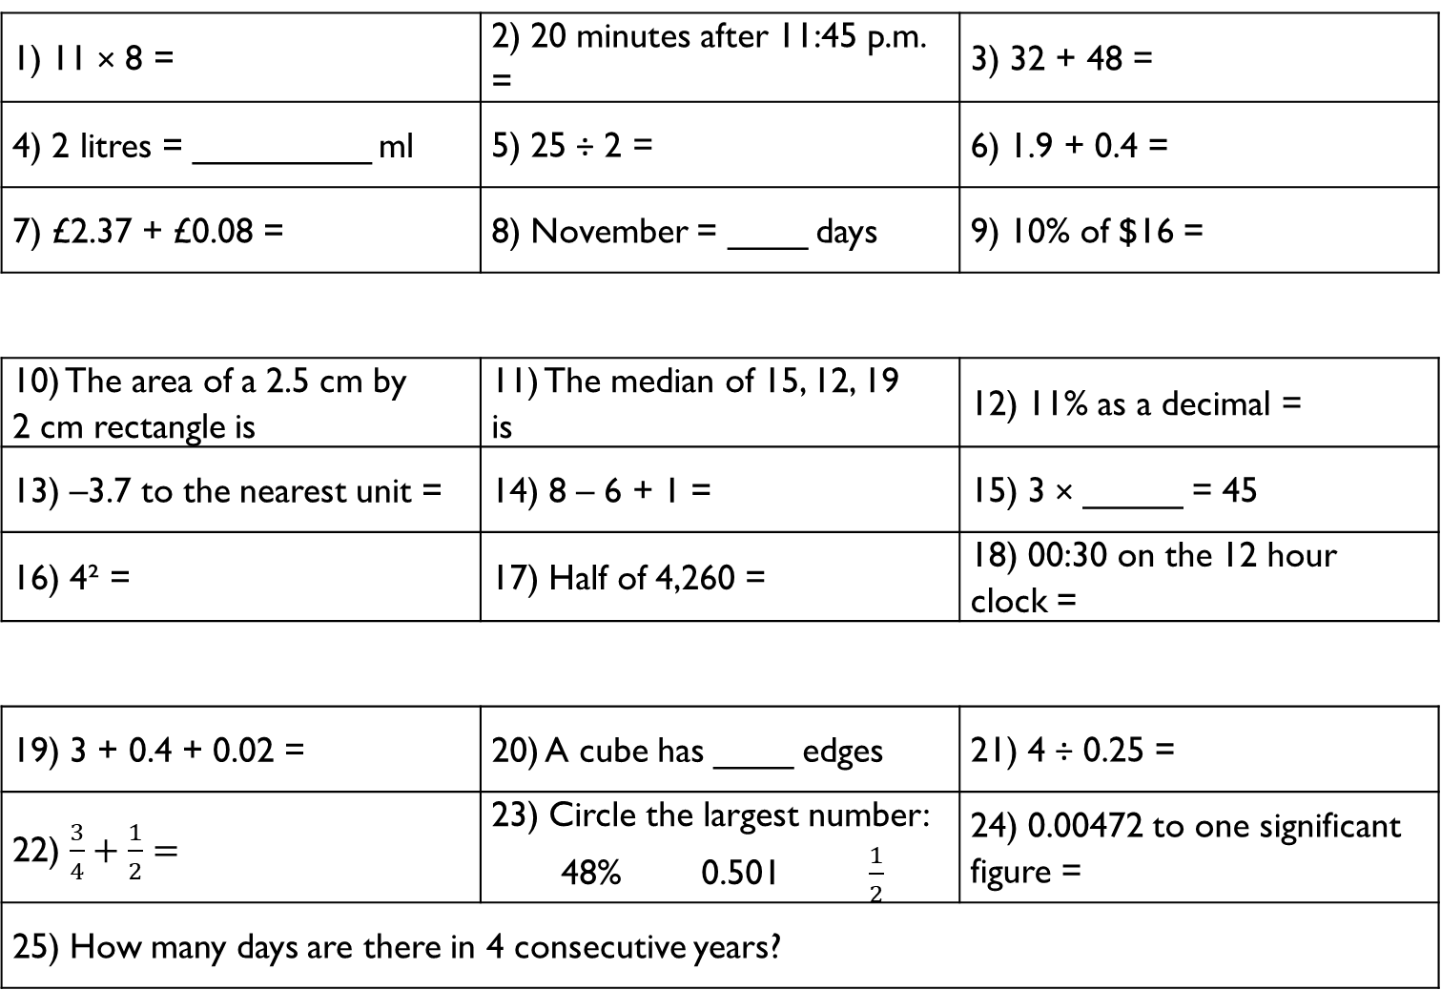
1) 11 × 8 = | 2) 20 minutes after 11:45 p.m. = | 3) 32 + 48 =
4) 2 litres = _________ ml | 5) 25 ÷ 2 = | 6) 1.9 + 0.4 =
7) £2.37 + £0.08 = | 8) November = ____ days | 9) 10% of $16 =
10) The area of a 2.5 cm by 2 cm rectangle is | 11) The median of 15, 12, 19 is | 12) 11% as a decimal =
13) –3.7 to the nearest unit = | 14) 8 – 6 + 1 = | 15) 3 × _____ = 45
16) 4² = | 17) Half of 4,260 = | 18) 00:30 on the 12 hour clock =
19) 3 + 0.4 + 0.02 = | 20) A cube has ____ edges | 21) 4 ÷ 0.25 =
22) $\frac{3}{4}+\frac{1}{2}=$ | 23) Circle the largest number: 48% 0.501 $\frac{1}{2}$ | 24) 0.00472 to one significant figure =
25) How many days are there in 4 consecutive years?
Gladiator
Numeracy with the Romans
Session 21
Citizen
Emperor

Slide 50
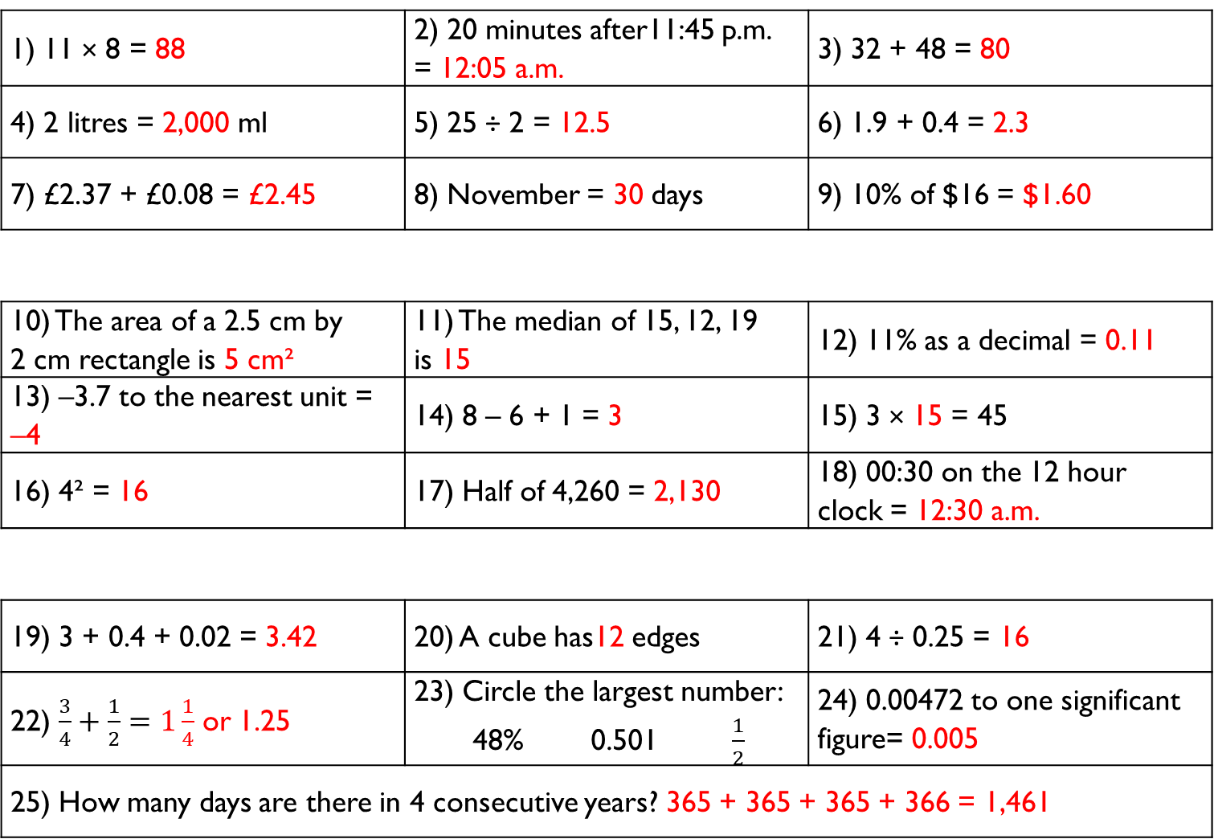
1) 11 × 8 = 88 | 2) 20 minutes after11:45 p.m. = 12:05 a.m. | 3) 32 + 48 = 80
4) 2 litres = 2,000 ml | 5) 25 ÷ 2 = 12.5 | 6) 1.9 + 0.4 = 2.3
7) £2.37 + £0.08 = £2.45 | 8) November = 30 days | 9) 10% of $16 = $1.60
10) The area of a 2.5 cm by 2 cm rectangle is 5 cm² | 11) The median of 15, 12, 19 is 15 | 12) 11% as a decimal = 0.11
13) –3.7 to the nearest unit = –4 | 14) 8 – 6 + 1 = 3 | 15) 3 × 15 = 45
16) 4² = 16 | 17) Half of 4,260 = 2,130 | 18) 00:30 on the 12 hour clock = 12:30 a.m.
19) 3 + 0.4 + 0.02 = 3.42 | 20) A cube has12 edges | 21) 4 ÷ 0.25 = 16
22) $\frac{3}{4}+\frac{1}{2}=1\frac{1}{4}$ or 1.25 | 23) Circle the largest number: 48% 0.501 $\frac{1}{2}$ | 24) 0.00472 to one significant figure= 0.005
25) How many days are there in 4 consecutive years? 365 + 365 + 365 + 366 = 1,461
Gladiator
Numeracy with the Romans
Answers for Session 21
Citizen
Emperor

Slide 51
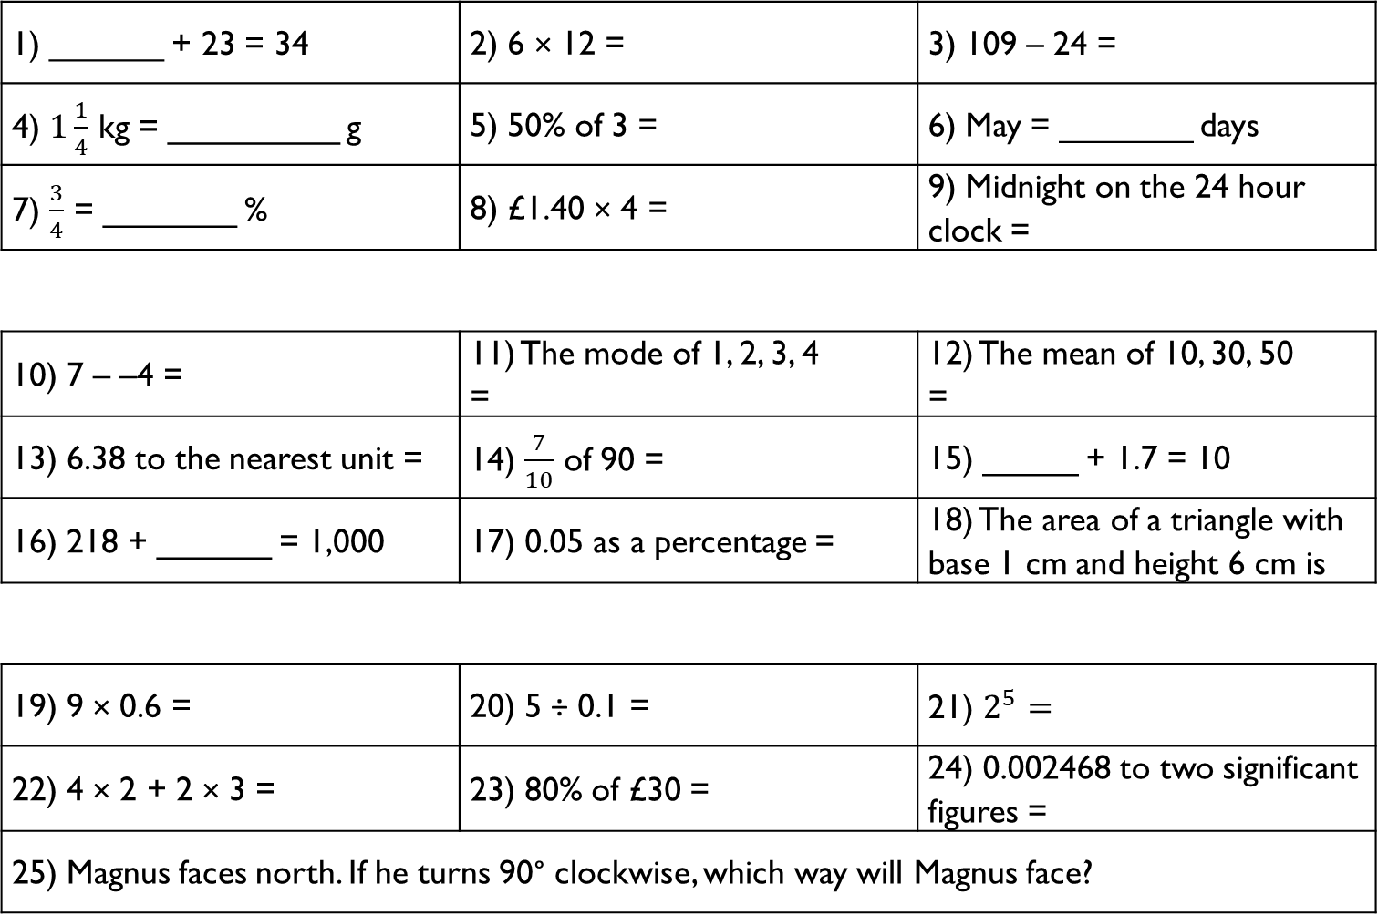
1) ______ + 23 = 34 | 2) 6 × 12 = | 3) 109 – 24 =
4) $1\frac{1}{4}$ kg = _________ g | 5) 50% of 3 = | 6) May = _______ days
7) $\frac{3}{4}$ = _______ % | 8) £1.40 × 4 = | 9) Midnight on the 24 hour clock =
10) 7 – –4 = | 11) The mode of 1, 2, 3, 4 = | 12) The mean of 10, 30, 50 =
13) 6.38 to the nearest unit = | 14) $\frac{7}{10}$ of 90 = | 15) _____ + 1.7 = 10
16) 218 + ______ = 1,000 | 17) 0.05 as a percentage = | 18) The area of a triangle with base 1 cm and height 6 cm is
19) 9 × 0.6 = | 20) 5 ÷ 0.1 = | 21) $2^{5}=$
22) 4 × 2 + 2 × 3 = | 23) 80% of £30 = | 24) 0.002468 to two significant figures =
25) Magnus faces north. If he turns 90° clockwise, which way will Magnus face?
Gladiator
Numeracy with the Romans
Session 22
Citizen
Emperor

Slide 52
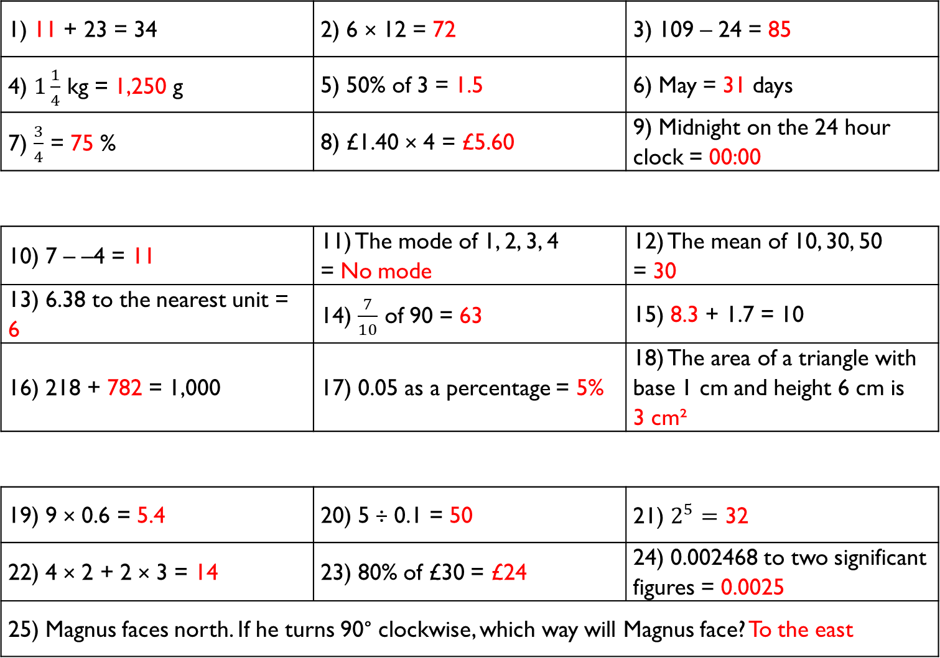
1) 11 + 23 = 34 | 2) 6 × 12 = 72 | 3) 109 – 24 = 85
4) $1\frac{1}{4}$ kg = 1,250 g | 5) 50% of 3 = 1.5 | 6) May = 31 days
7) $\frac{3}{4}$ = 75 % | 8) £1.40 × 4 = £5.60 | 9) Midnight on the 24 hour clock = 00:00
10) 7 – –4 = 11 | 11) The mode of 1, 2, 3, 4 = No mode | 12) The mean of 10, 30, 50 = 30
13) 6.38 to the nearest unit = 6 | 14) $\frac{7}{10}$ of 90 = 63 | 15) 8.3 + 1.7 = 10
16) 218 + 782 = 1,000 | 17) 0.05 as a percentage = 5% | 18) The area of a triangle with base 1 cm and height 6 cm is 3 cm²
19) 9 × 0.6 = 5.4 | 20) 5 ÷ 0.1 = 50 | 21) $2^{5}=$ 32
22) 4 × 2 + 2 × 3 = 14 | 23) 80% of £30 = £24 | 24) 0.002468 to two significant figures = 0.0025
25) Magnus faces north. If he turns 90° clockwise, which way will Magnus face? To the east
Gladiator
Numeracy with the Romans
Answers for Session 22
Citizen
Emperor

Slide 53
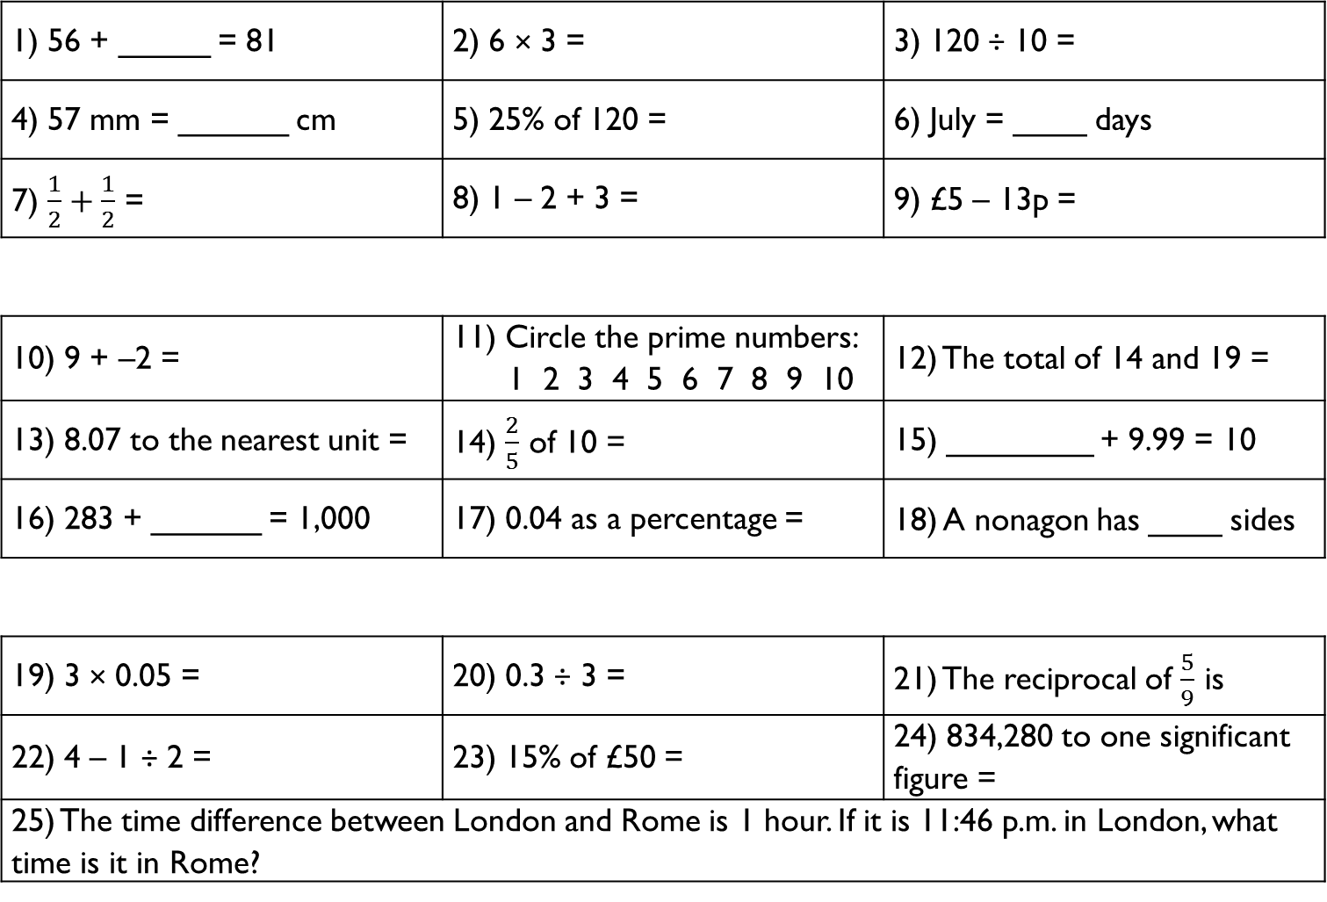
1) 56 + _____ = 81 | 2) 6 × 3 = | 3) 120 ÷ 10 =
4) 57 mm = ______ cm | 5) 25% of 120 = | 6) July = ____ days
7) $\frac{1}{2}+\frac{1}{2}$ = | 8) 1 – 2 + 3 = | 9) £5 – 13p =
10) 9 + –2 = | 11) Circle the prime numbers: 1 2 3 4 5 6 7 8 9 10 | 12) The total of 14 and 19 =
13) 8.07 to the nearest unit = | 14) $\frac{2}{5}$ of 10 = | 15) ________ + 9.99 = 10
16) 283 + ______ = 1,000 | 17) 0.04 as a percentage = | 18) A nonagon has ____ sides
19) 3 × 0.05 = | 20) 0.3 ÷ 3 = | 21) The reciprocal of $\frac{5}{9}$ is
22) 4 – 1 ÷ 2 = | 23) 15% of £50 = | 24) 834,280 to one significant figure =
25) The time difference between London and Rome is 1 hour. If it is 11:46 p.m. in London, what time is it in Rome?
Gladiator
Numeracy with the Romans
Session 23
Citizen
Emperor

Slide 54
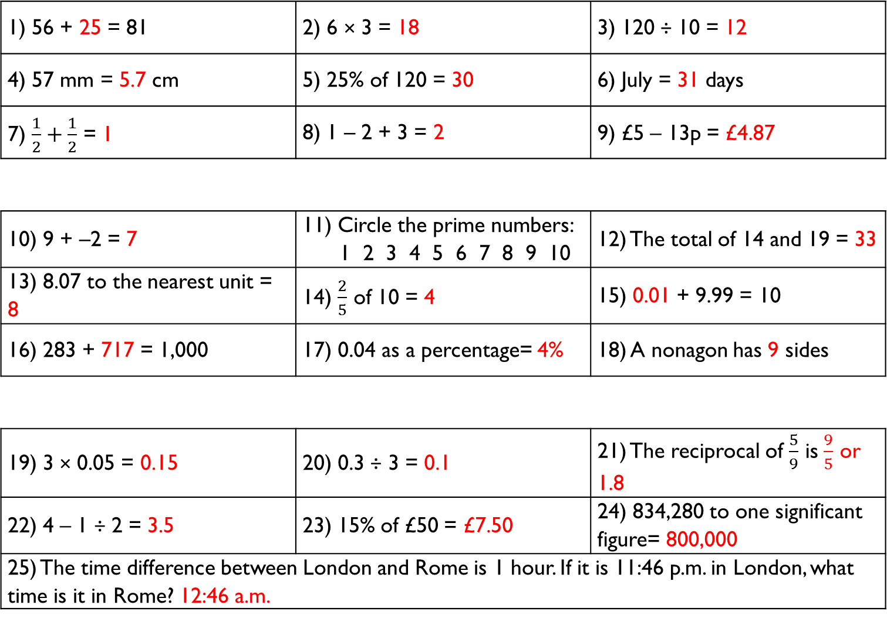
1) 56 + 25 = 81 | 2) 6 × 3 = 18 | 3) 120 ÷ 10 = 12
4) 57 mm = 5.7 cm | 5) 25% of 120 = 30 | 6) July = 31 days
7) $\frac{1}{2}+\frac{1}{2}$ = 1 | 8) 1 – 2 + 3 = 2 | 9) £5 – 13p = £4.87
10) 9 + –2 = 7 | 11) Circle the prime numbers: 1 2 3 4 5 6 7 8 9 10 | 12) The total of 14 and 19 = 33
13) 8.07 to the nearest unit = 8 | 14) $\frac{2}{5}$ of 10 = 4 | 15) 0.01 + 9.99 = 10
16) 283 + 717 = 1,000 | 17) 0.04 as a percentage= 4% | 18) A nonagon has 9 sides
19) 3 × 0.05 = 0.15 | 20) 0.3 ÷ 3 = 0.1 | 21) The reciprocal of $\frac{5}{9}$ is $\frac{9}{5}$ or 1.8
22) 4 – 1 ÷ 2 = 3.5 | 23) 15% of £50 = £7.50 | 24) 834,280 to one significant figure= 800,000
25) The time difference between London and Rome is 1 hour. If it is 11:46 p.m. in London, what time is it in Rome? 12:46 a.m.
Gladiator
Numeracy with the Romans
Answers for Session 23
Citizen
Emperor

Slide 55
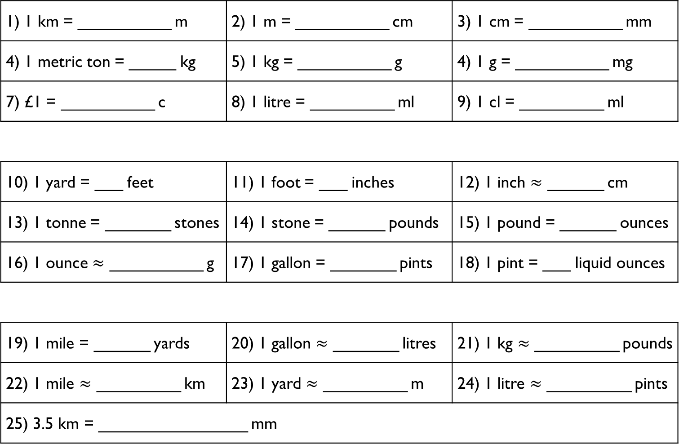
1) 1 km = __________ m | 2) 1 m = __________ cm | 3) 1 cm = __________ mm
4) 1 metric ton = _____ kg | 5) 1 kg = __________ g | 4) 1 g = __________ mg
7) £1 = __________ c | 8) 1 litre = _________ ml | 9) 1 cl = _________ ml
10) 1 yard = ___ feet | 11) 1 foot = ___ inches | 12) 1 inch $≈$ ______ cm
13) 1 tonne = _______ stones | 14) 1 stone = ______ pounds | 15) 1 pound = ______ ounces
16) 1 ounce $≈$ __________ g | 17) 1 gallon = _______ pints | 18) 1 pint = ___ liquid ounces
19) 1 mile = ______ yards | 20) 1 gallon $≈$ _______ litres | 21) 1 kg $≈$ _________ pounds
22) 1 mile $≈$ _________ km | 23) 1 yard $≈$ _________ m | 24) 1 litre $≈$ _________ pints
25) 3.5 km = ________________ mm
Gladiator
Numeracy with the Romans
Session 24
Citizen
Emperor

Slide 56
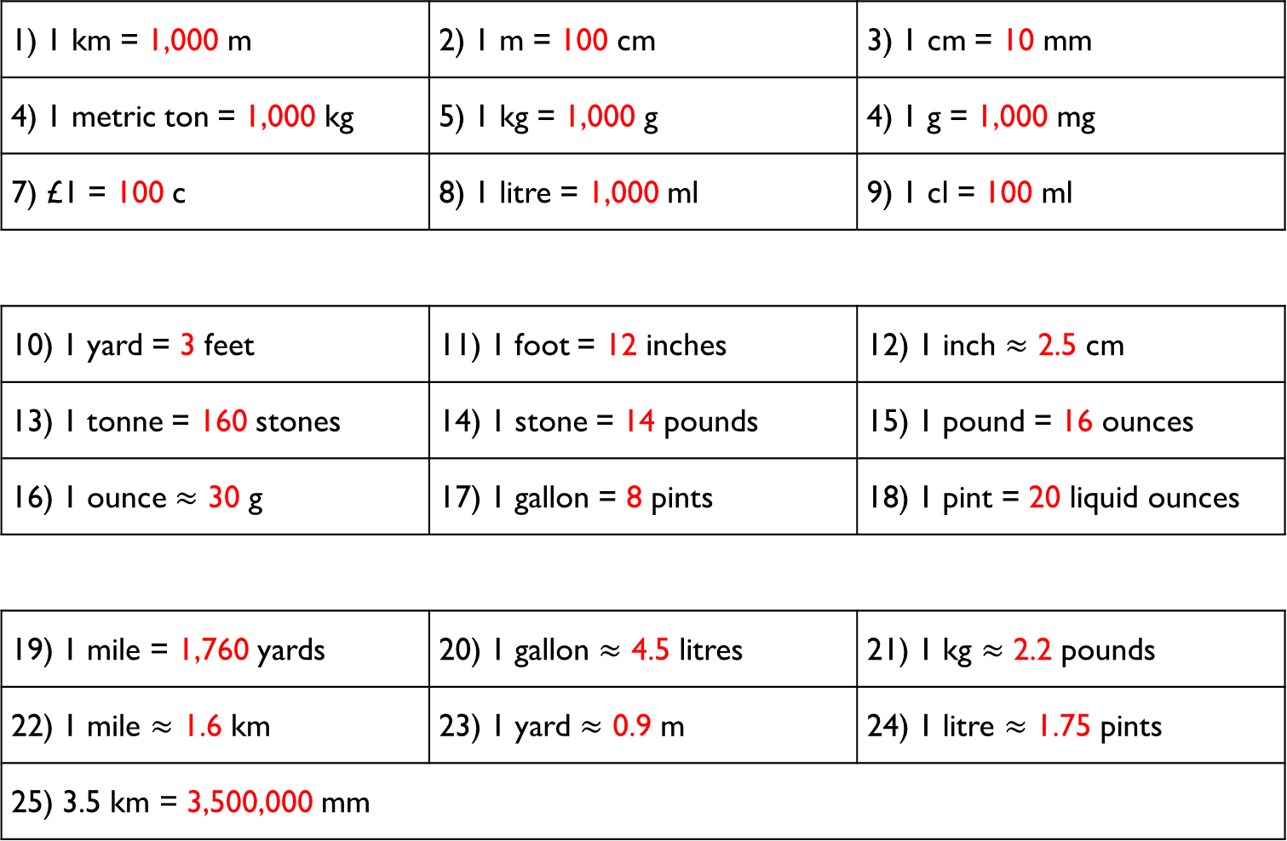
1) 1 km = 1,000 m | 2) 1 m = 100 cm | 3) 1 cm = 10 mm
4) 1 metric ton = 1,000 kg | 5) 1 kg = 1,000 g | 4) 1 g = 1,000 mg
7) £1 = 100 c | 8) 1 litre = 1,000 ml | 9) 1 cl = 100 ml
10) 1 yard = 3 feet | 11) 1 foot = 12 inches | 12) 1 inch $≈$ 2.5 cm
13) 1 tonne = 160 stones | 14) 1 stone = 14 pounds | 15) 1 pound = 16 ounces
16) 1 ounce $≈$ 30 g | 17) 1 gallon = 8 pints | 18) 1 pint = 20 liquid ounces
19) 1 mile = 1,760 yards | 20) 1 gallon $≈$ 4.5 litres | 21) 1 kg $≈$ 2.2 pounds
22) 1 mile $≈$ 1.6 km | 23) 1 yard $≈$ 0.9 m | 24) 1 litre $≈$ 1.75 pints
25) 3.5 km = 3,500,000 mm
Gladiator
Numeracy with the Romans
Answers for Session 24
Citizen
Emperor

Slide 57
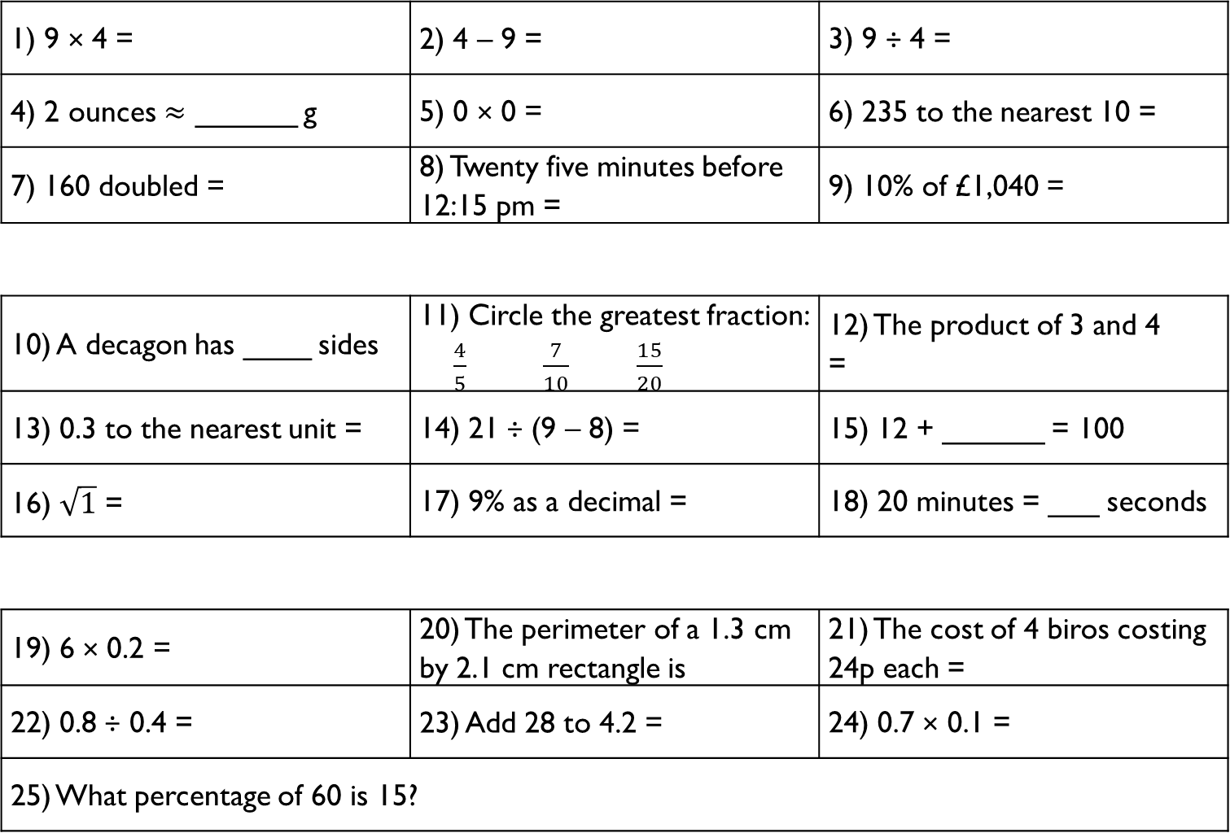
1) 9 × 4 = | 2) 4 – 9 = | 3) 9 ÷ 4 =
4) 2 ounces $≈$ ______ g | 5) 0 × 0 = | 6) 235 to the nearest 10 =
7) 160 doubled = | 8) Twenty five minutes before 12:15 pm = | 9) 10% of £1,040 =
10) A decagon has ____ sides | 11) Circle the greatest fraction: $\frac{4}{5}$ $\frac{7}{10}$ $\frac{15}{20}$ | 12) The product of 3 and 4 =
13) 0.3 to the nearest unit = | 14) 21 ÷ (9 – 8) = | 15) 12 + ______ = 100
16) $\sqrt{1}$ = | 17) 9% as a decimal = | 18) 20 minutes = ___ seconds
19) 6 × 0.2 = | 20) The perimeter of a 1.3 cm by 2.1 cm rectangle is | 21) The cost of 4 biros costing 24p each =
22) 0.8 ÷ 0.4 = | 23) Add 28 to 4.2 = | 24) 0.7 × 0.1 =
25) What percentage of 60 is 15?
Gladiator
Numeracy with the Romans
Session 25
Citizen
Emperor

Slide 58
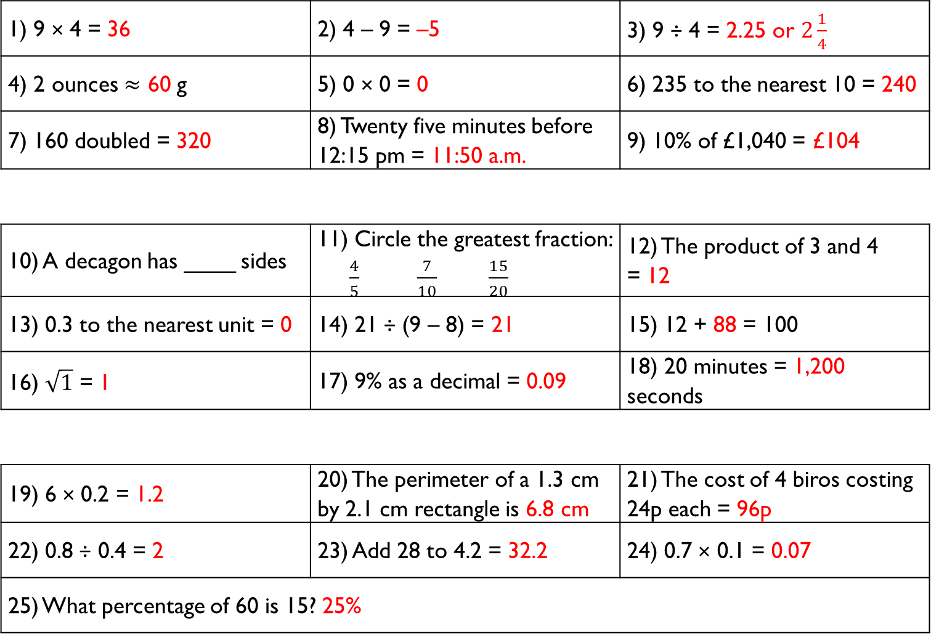
1) 9 × 4 = 36 | 2) 4 – 9 = –5 | 3) 9 ÷ 4 = 2.25 or $2\frac{1}{4}$
4) 2 ounces $≈$ 60 g | 5) 0 × 0 = 0 | 6) 235 to the nearest 10 = 240
7) 160 doubled = 320 | 8) Twenty five minutes before 12:15 pm = 11:50 a.m. | 9) 10% of £1,040 = £104
10) A decagon has ____ sides | 11) Circle the greatest fraction: $\frac{4}{5}$ $\frac{7}{10}$ $\frac{15}{20}$ | 12) The product of 3 and 4 = 12
13) 0.3 to the nearest unit = 0 | 14) 21 ÷ (9 – 8) = 21 | 15) 12 + 88 = 100
16) $\sqrt{1}$ = 1 | 17) 9% as a decimal = 0.09 | 18) 20 minutes = 1,200 seconds
19) 6 × 0.2 = 1.2 | 20) The perimeter of a 1.3 cm by 2.1 cm rectangle is 6.8 cm | 21) The cost of 4 biros costing 24p each = 96p
22) 0.8 ÷ 0.4 = 2 | 23) Add 28 to 4.2 = 32.2 | 24) 0.7 × 0.1 = 0.07
25) What percentage of 60 is 15? 25%
Gladiator
Numeracy with the Romans
Answers for Session 25
Citizen
Emperor

Slide 59
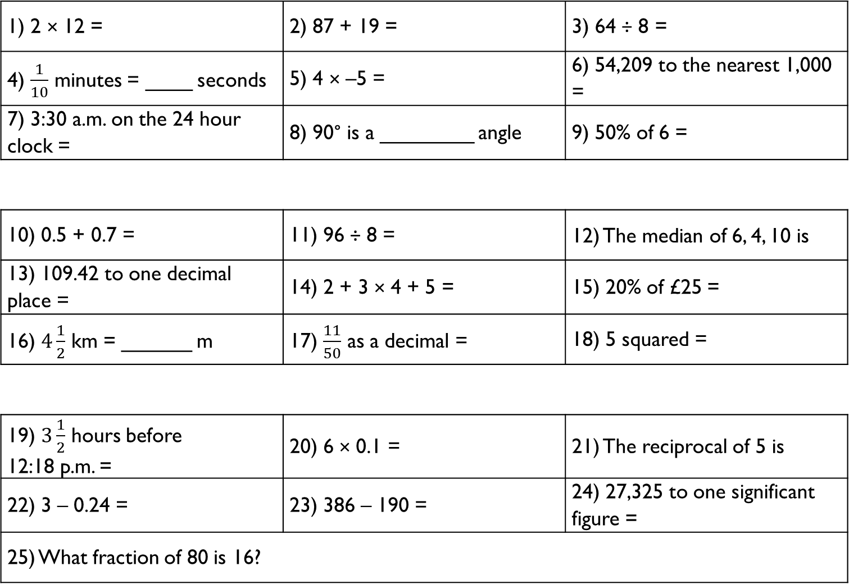
1) 2 × 12 = | 2) 87 + 19 = | 3) 64 ÷ 8 =
4) $\frac{1}{10}$ minutes = ____ seconds | 5) 4 × –5 = | 6) 54,209 to the nearest 1,000 =
7) 3:30 a.m. on the 24 hour clock = | 8) 90° is a ________ angle | 9) 50% of 6 =
10) 0.5 + 0.7 = | 11) 96 ÷ 8 = | 12) The median of 6, 4, 10 is
13) 109.42 to one decimal place = | 14) 2 + 3 × 4 + 5 = | 15) 20% of £25 =
16) $4\frac{1}{2}$ km = ______ m | 17) $\frac{11}{50}$ as a decimal = | 18) 5 squared =
19) $3\frac{1}{2}$ hours before 12:18 p.m. = | 20) 6 × 0.1 = | 21) The reciprocal of 5 is
22) 3 – 0.24 = | 23) 386 – 190 = | 24) 27,325 to one significant figure =
25) What fraction of 80 is 16?
Gladiator
Numeracy with the Romans
Session 26
Citizen
Emperor

Slide 60
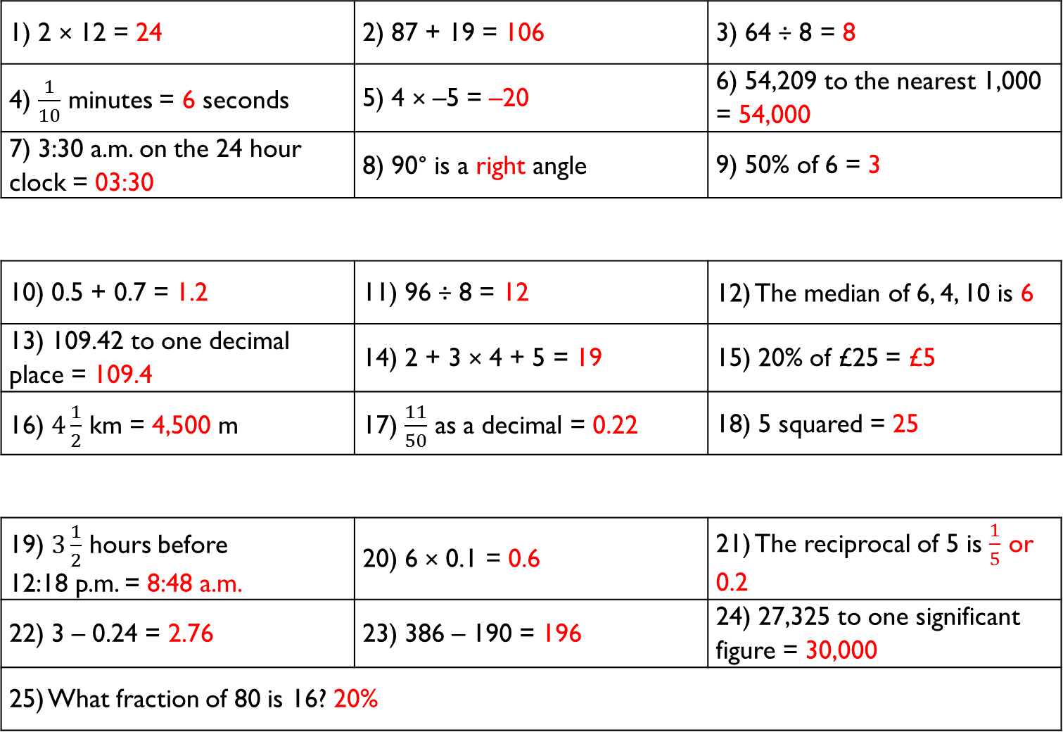
1) 2 × 12 = 24 | 2) 87 + 19 = 106 | 3) 64 ÷ 8 = 8
4) $\frac{1}{10}$ minutes = 6 seconds | 5) 4 × –5 = –20 | 6) 54,209 to the nearest 1,000 = 54,000
7) 3:30 a.m. on the 24 hour clock = 03:30 | 8) 90° is a right angle | 9) 50% of 6 = 3
10) 0.5 + 0.7 = 1.2 | 11) 96 ÷ 8 = 12 | 12) The median of 6, 4, 10 is 6
13) 109.42 to one decimal place = 109.4 | 14) 2 + 3 × 4 + 5 = 19 | 15) 20% of £25 = £5
16) $4\frac{1}{2}$ km = 4,500 m | 17) $\frac{11}{50}$ as a decimal = 0.22 | 18) 5 squared = 25
19) $3\frac{1}{2}$ hours before 12:18 p.m. = 8:48 a.m. | 20) 6 × 0.1 = 0.6 | 21) The reciprocal of 5 is $\frac{1}{5}$ or 0.2
22) 3 – 0.24 = 2.76 | 23) 386 – 190 = 196 | 24) 27,325 to one significant figure = 30,000
25) What fraction of 80 is 16? 20%
Gladiator
Numeracy with the Romans
Answers for Session 26
Citizen
Emperor

Slide 61
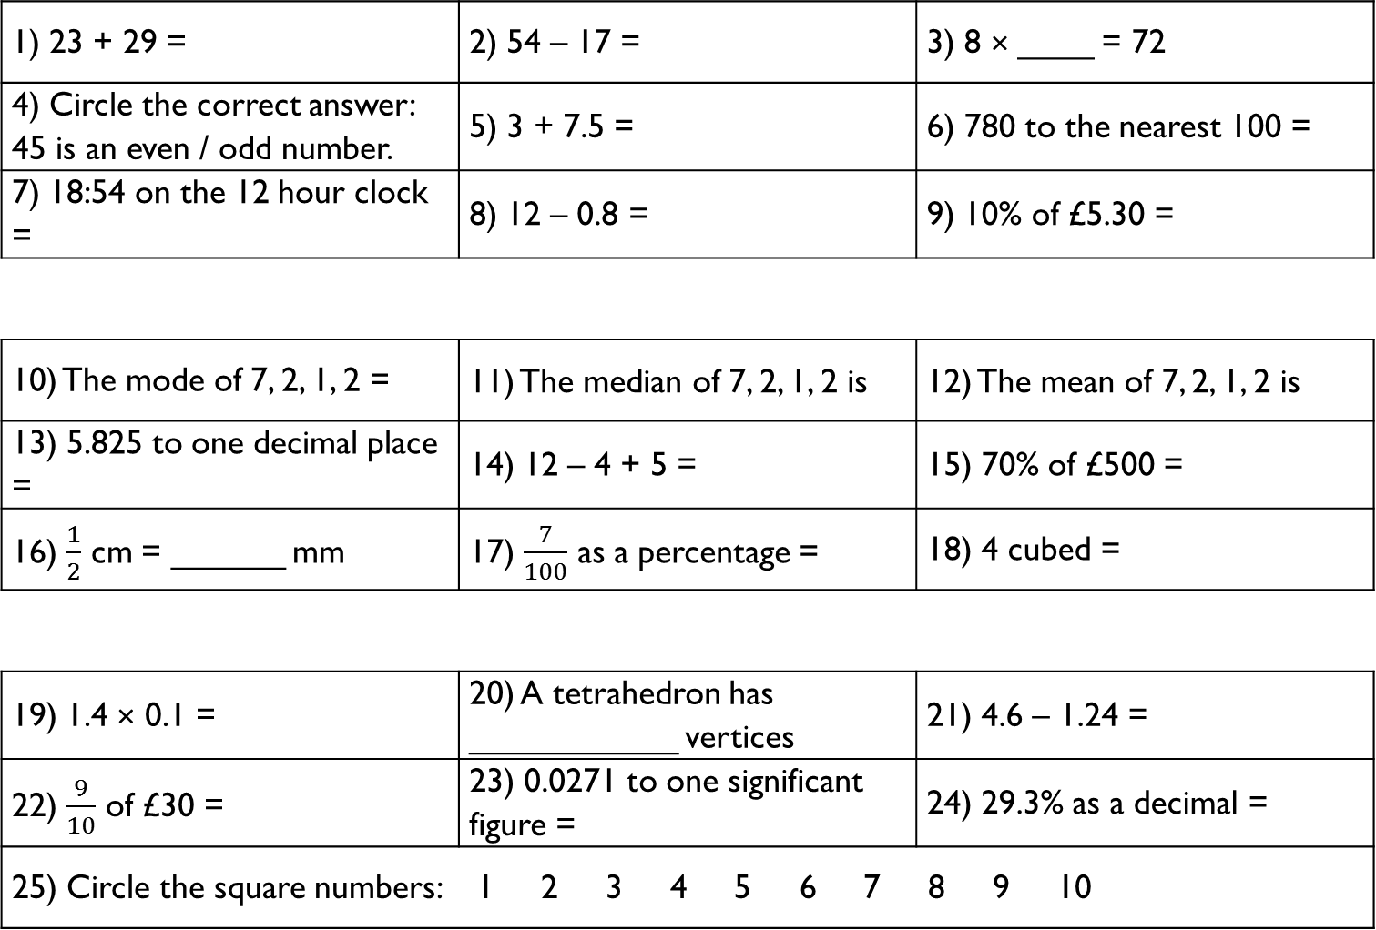
1) 23 + 29 = | 2) 54 – 17 = | 3) 8 × ____ = 72
4) Circle the correct answer: 45 is an even / odd number. | 5) 3 + 7.5 = | 6) 780 to the nearest 100 =
7) 18:54 on the 12 hour clock = | 8) 12 – 0.8 = | 9) 10% of £5.30 =
10) The mode of 7, 2, 1, 2 = | 11) The median of 7, 2, 1, 2 is | 12) The mean of 7, 2, 1, 2 is
13) 5.825 to one decimal place = | 14) 12 – 4 + 5 = | 15) 70% of £500 =
16) $\frac{1}{2}$ cm = ______ mm | 17) $\frac{7}{100}$ as a percentage = | 18) 4 cubed =
19) 1.4 × 0.1 = | 20) A tetrahedron has ___________ vertices | 21) 4.6 – 1.24 =
22) $\frac{9}{10}$ of £30 = | 23) 0.0271 to one significant figure = | 24) 29.3% as a decimal =
25) Circle the square numbers: 1 2 3 4 5 6 7 8 9 10
Gladiator
Numeracy with the Romans
Session 27
Citizen
Emperor

Slide 62
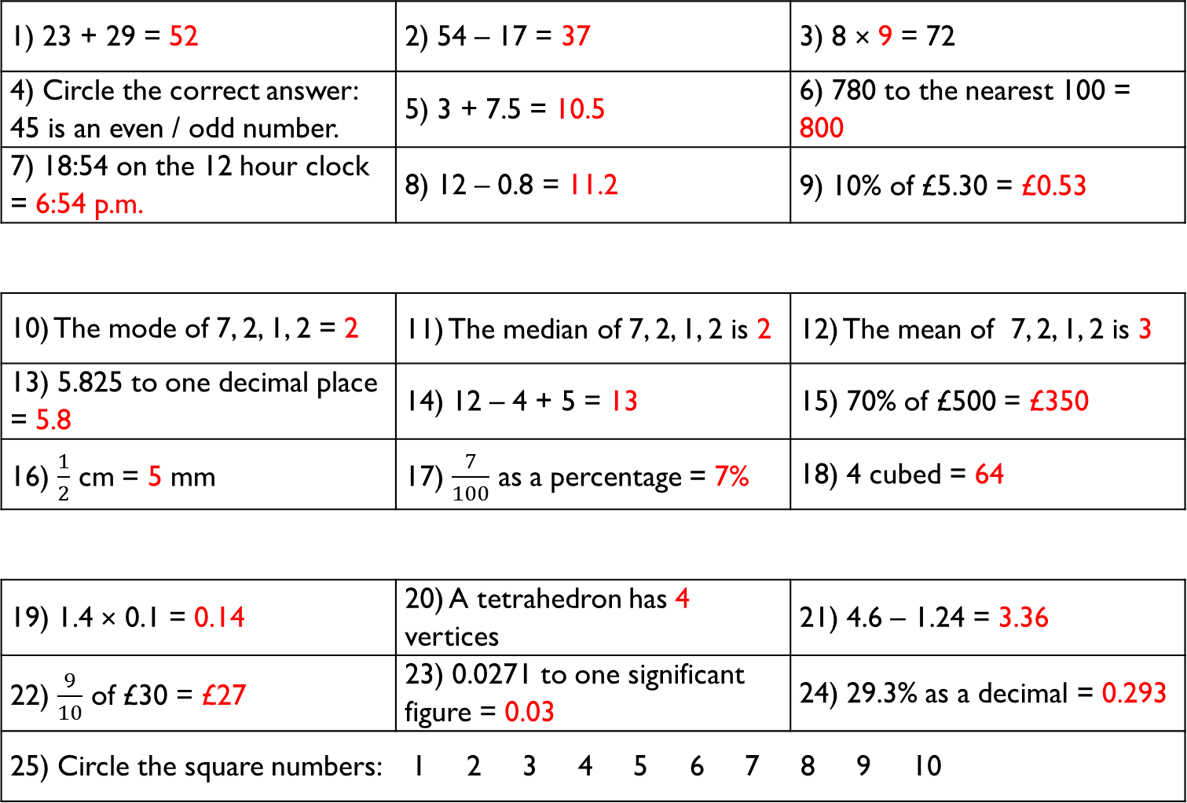
1) 23 + 29 = 52 | 2) 54 – 17 = 37 | 3) 8 × 9 = 72
4) Circle the correct answer: 45 is an even / odd number. | 5) 3 + 7.5 = 10.5 | 6) 780 to the nearest 100 = 800
7) 18:54 on the 12 hour clock = 6:54 p.m. | 8) 12 – 0.8 = 11.2 | 9) 10% of £5.30 = £0.53
10) The mode of 7, 2, 1, 2 = 2 | 11) The median of 7, 2, 1, 2 is 2 | 12) The mean of 7, 2, 1, 2 is 3
13) 5.825 to one decimal place = 5.8 | 14) 12 – 4 + 5 = 13 | 15) 70% of £500 = £350
16) $\frac{1}{2}$ cm = 5 mm | 17) $\frac{7}{100}$ as a percentage = 7% | 18) 4 cubed = 64
19) 1.4 × 0.1 = 0.14 | 20) A tetrahedron has 4 vertices | 21) 4.6 – 1.24 = 3.36
22) $\frac{9}{10}$ of £30 = £27 | 23) 0.0271 to one significant figure = 0.03 | 24) 29.3% as a decimal = 0.293
25) Circle the square numbers: 1 2 3 4 5 6 7 8 9 10
Gladiator
Numeracy with the Romans
Answers for Session 27
Citizen
Emperor

Slide 63
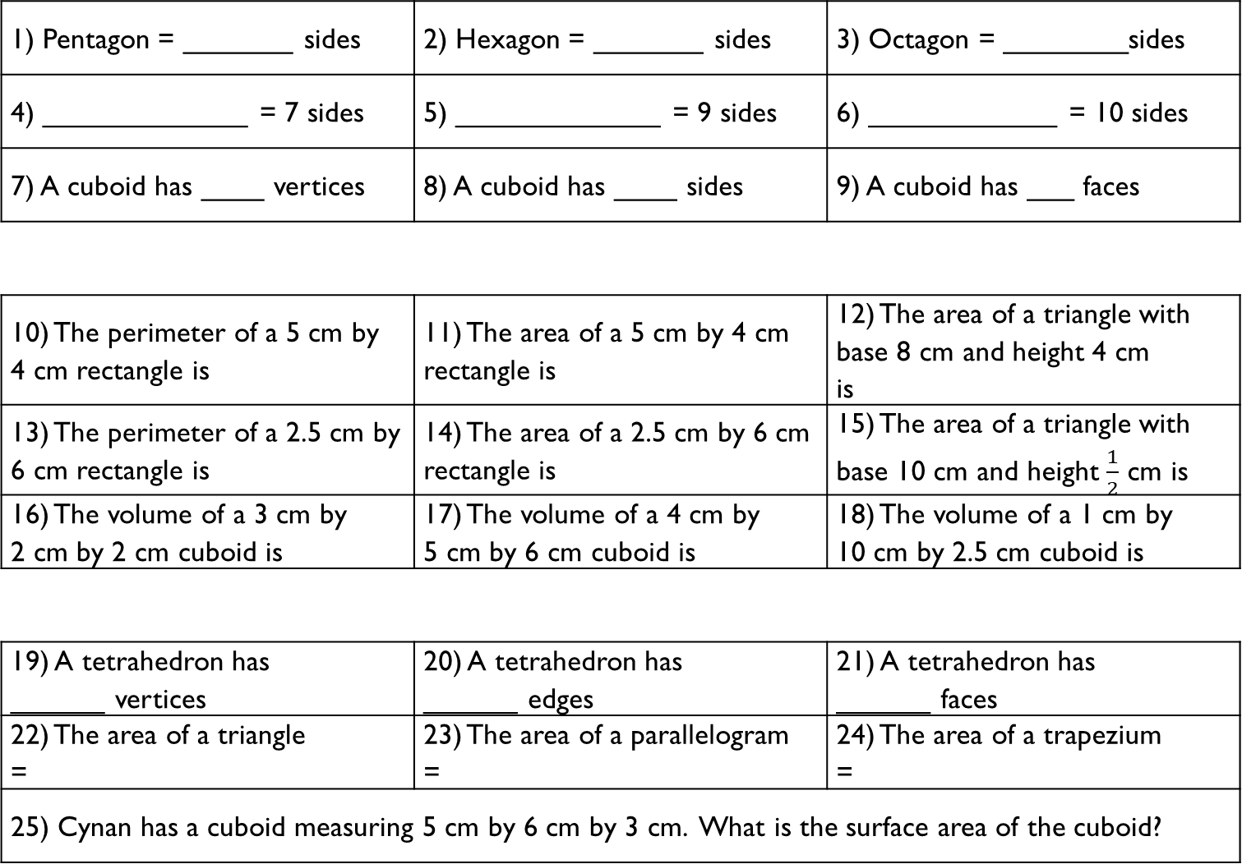
1) Pentagon = _______ sides | 2) Hexagon = _______ sides | 3) Octagon = ________sides
4) _____________ = 7 sides | 5) _____________ = 9 sides | 6) ____________ = 10 sides
7) A cuboid has ____ vertices | 8) A cuboid has ____ sides | 9) A cuboid has ___ faces
10) The perimeter of a 5 cm by 4 cm rectangle is | 11) The area of a 5 cm by 4 cm rectangle is | 12) The area of a triangle with base 8 cm and height 4 cm is
13) The perimeter of a 2.5 cm by 6 cm rectangle is | 14) The area of a 2.5 cm by 6 cm rectangle is | 15) The area of a triangle with base 10 cm and height $\frac{1}{2}$ cm is
16) The volume of a 3 cm by 2 cm by 2 cm cuboid is | 17) The volume of a 4 cm by 5 cm by 6 cm cuboid is | 18) The volume of a 1 cm by 10 cm by 2.5 cm cuboid is
19) A tetrahedron has ______ vertices | 20) A tetrahedron has ______ edges | 21) A tetrahedron has ______ faces
22) The area of a triangle = | 23) The area of a parallelogram = | 24) The area of a trapezium =
25) Cynan has a cuboid measuring 5 cm by 6 cm by 3 cm. What is the surface area of the cuboid?
Gladiator
Numeracy with the Romans
Session 28
Citizen
Emperor

Slide 64
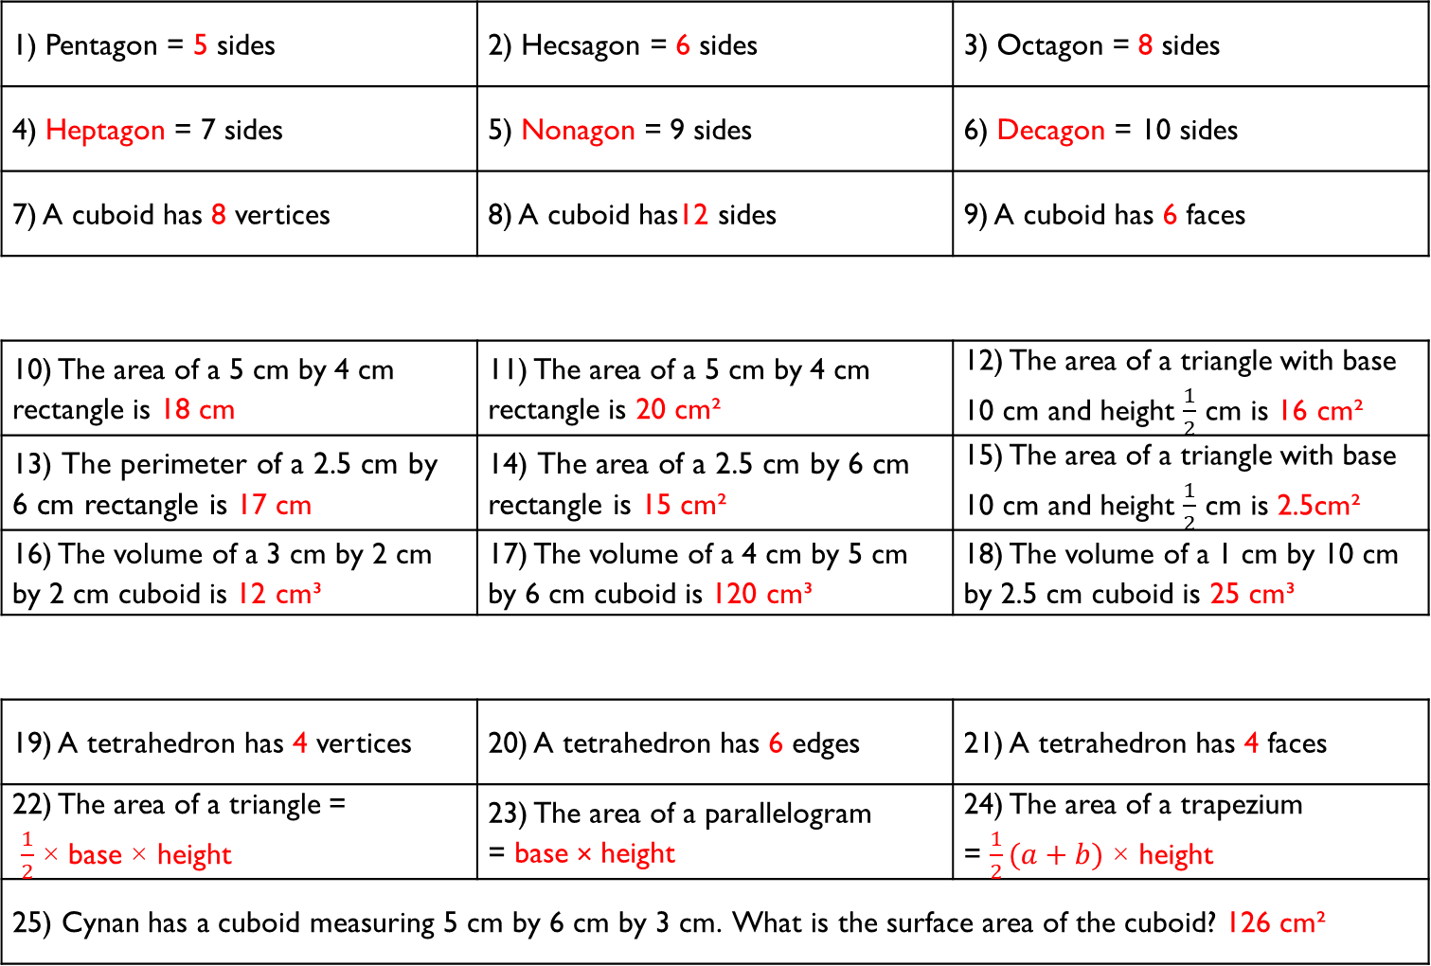
1) Pentagon = 5 sides | 2) Hecsagon = 6 sides | 3) Octagon = 8 sides
4) Heptagon = 7 sides | 5) Nonagon = 9 sides | 6) Decagon = 10 sides
7) A cuboid has 8 vertices | 8) A cuboid has12 sides | 9) A cuboid has 6 faces
10) The area of a 5 cm by 4 cm rectangle is 18 cm | 11) The area of a 5 cm by 4 cm rectangle is 20 cm² | 12) The area of a triangle with base 10 cm and height $\frac{1}{2}$ cm is 16 cm²
13) The perimeter of a 2.5 cm by 6 cm rectangle is 17 cm | 14) The area of a 2.5 cm by 6 cm rectangle is 15 cm² | 15) The area of a triangle with base 10 cm and height $\frac{1}{2}$ cm is 2.5cm²
16) The volume of a 3 cm by 2 cm by 2 cm cuboid is 12 cm³ | 17) The volume of a 4 cm by 5 cm by 6 cm cuboid is 120 cm³ | 18) The volume of a 1 cm by 10 cm by 2.5 cm cuboid is 25 cm³
19) A tetrahedron has 4 vertices | 20) A tetrahedron has 6 edges | 21) A tetrahedron has 4 faces
22) The area of a triangle = $\frac{1}{2}$ × base × height | 23) The area of a parallelogram = base × height | 24) The area of a trapezium = $\frac{1}{2}(a+b)$ × height
25) Cynan has a cuboid measuring 5 cm by 6 cm by 3 cm. What is the surface area of the cuboid? 126 cm²
Gladiator
Numeracy with the Romans
Answers for Session 28
Citizen
Emperor

Slide 65

1) 9 × 6 = | 2) 15 – 19 = | 3) 77 ÷ 11 =
4) 25% of $100 = | 5) Subtract 1.4 from 5 = | 6) 4 × _____ = 100
7) 7:30 a.m. on the 24 hour clock = | 8) 1 pound = _____ ounces | 9) 10% of 350 =
10) 6.32 + 7.4 = | 11) The mean of 2, 4, 15 is | 12) The range of 2, 4, 15 is
13) 5.218 to two decimal places = | 14) 4 + 5 × 2 – 1 = | 15) 1% of £30 =
16) $7\frac{3}{4}$ m = _________ cm | 17) 92% as a decimal = | 18) 6³ =
19) The reciprocal of 8 is | 20) 18 × 11 = | 21) 120 × ________ = 1.2
22) There are ___ thirds in $4\frac{1}{3}$ | 23) 123,456 to three significant figures = | 24) $1^{4}$ =
25) 2 inches is about 5 cm. Approximately how many cm are there in 5 inches?
Gladiator
Numeracy with the Romans
Session 29
Citizen
Emperor

Slide 66

1) 9 × 6 = 54 | 2) 15 – 19 = –4 | 3) 77 ÷ 11 = 7
4) 25% of $100 = $25 | 5) Subtract 1.4 from 5 = 3.6 | 6) 4 × 25 = 100
7) 7:30 a.m. on the 24 hour clock= 07:30 | 8) 1 pound = 16 ounces | 9) 10% of 350 = 35
10) 6.32 + 7.4 = 13.72 | 11) The mean of 2, 4, 15 is 7 | 12) The range of 2, 4, 15 is 13
13) 5.218 to two decimal places = 5.22 | 14) 4 + 5 × 2 – 1 = 13 | 15) 1% of £30 = £0.30
16) $7\frac{3}{4}$ m = 7,750 cm | 17) 92% as a decimal = 0.92 | 18) 6³ = 216
19) The reciprocal of 8 is $\frac{1}{8}$ or 0.125 | 20) 18 × 11 = 198 | 21) 120 × 0.01 = 1.2
22) There are 13 thirds in $4\frac{1}{3}$ | 23) 123,456 to three significant figures = 123,000 | 24) $1^{4}$ = 1
25) 2 inches is about 5 cm. Approximately how many cm are there in 5 inches? 12.5 cm
Gladiator
Numeracy with the Romans
Answers for Session 29
Citizen
Emperor

Slide 67

1) Write down all the factors of 20: | 2) 12 × 11 = | 3) 17 ÷ 2 =
4) £80 – £29.99 = | 5) 240,000 doubled = | 6) 0.2 + ______ = 1
7) 29.87 to one decimal place = | 8) 275° is a _______ angle | 9) 25% of 44 =
10) 7.5 + 2.7 = | 11) Add 28.4 to 4 = | 12) The range of –5, 0, 5 =
13) 3 – 2 × 0 + 4 = | 14) 12 ÷ 0.5 = | 15) 2 ÷ 0.2 =
16) 6,400 g = __________ kg | 17) $\frac{4}{5}$ = ______ % | 18) August = _______ days
19) 120 ÷ 12 = | 20) 13 × 9 = | 21) True or false? 1 is a prime number?
22) 4 ÷ 0.8 = | 23) The reciprocal of 15 is | 24) 0.000709 to one significant figure =
25) What is a quarter of half a kilogram in grams?
Gladiator
Numeracy with the Romans
Session 30
Citizen
Emperor

Slide 68

1) Write down all the factors of 20: 1, 2, 4, 5, 10, 20 | 2) 12 × 11 = 132 | 3) 17 ÷ 2 = 8.5
4) £80 – £29.99 = £50.01 | 5) 240,000 doubled = 480,000 | 6) 0.2 + 0.8 = 1
7) 29.87 to one decimal place= 29.9 | 8) 275° is a reflex angle | 9) 25% of 44 = 11
10) 7.5 + 2.7 = 10.2 | 11) Add 28.4 to 4 = 32.4 | 12) The range of –5, 0, 5 = 10
13) 3 – 2 × 0 + 4 = 7 | 14) 12 ÷ 0.5 = 24 | 15) 2 ÷ 0.2 = 10
16) 6,400 g = 6.4 kg | 17) $\frac{4}{5}$ = 80 % | 18) August = 31 days
19) 120 ÷ 12 = 10 | 20) 13 × 9 = 117 | 21) True or false? 1 is a prime number? False
22) 4 ÷ 0.8 = 5 | 23) The reciprocal of 15 is $\frac{1}{15}$ | 24) 0.000709 to one significant figure = 0.0007
25) What is a quarter of half a kilogram in grams? 125 g
Gladiator
Numeracy with the Romans
Answers for Session 30
Citizen
Emperor

Slide 69
1) In what year was Magnus Maximus born?
__________________________________________________________
2) In Magnus’ dream, what was the spectacular fort made of?
__________________________________________________________
3) What were the slaves doing in the dream?
__________________________________________________________
4) How many messengers did Magnus send to search for Elen?
__________________________________________________________
5) What were the names of Elen’s brothers?
__________________________________________________________
6) When did Magnus leave Great Britain?
__________________________________________________________
7) What is the name of the song which recalls Magnus Maximus?
__________________________________________________________
8) When was the eastern part of the Roman Empire lost?
__________________________________________________________
Numeracy with the Romans
History Revision 21–30

Slide 70
1) In what year was Magnus Maximus born?
325 A.D.
2) In Magnus’ dream, what was the spectacular fort made of?
Gold and shining precious gems
3) What were the slaves doing in the dream?
Playing chess
4) How many messengers did Magnus send to search for Elen?
13
5) What were the names of Elen’s brothers?
Cynan and Adeon
6) When did Magnus leave Great Britain?
383 O.C.
7) What is the name of the song which recalls Magnus Maximus?
Yma o Hyd
8) When was the eastern part of the Roman Empire lost?
1453 O.C.
Numeracy with the Romans
History Revision Answers 21–30

